Slide 1
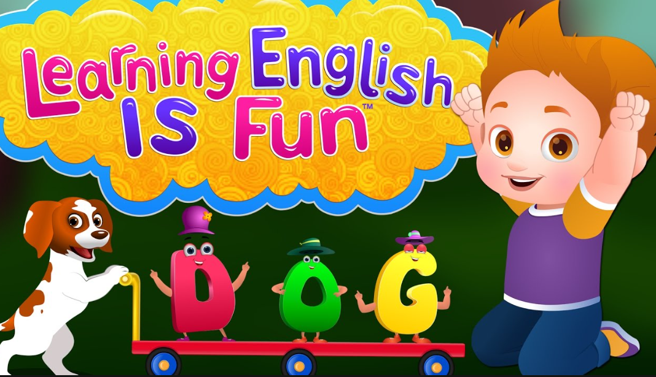
REVISION FOR THE 1ST MID-TERM TEST
COMPARATIVE FORM OF ADJECTIVES & ADVERBS

Slide 2
COMPARATIVE FORM OF ADJECTIVES
1. That building is higher than this building.
2. Minh’s house is bigger than Nga’s house.
3. A lion is more dangerous than a horse.
is less dangerous than a lion.
→ A horse ……………………………………………
A horse is less dangerous.
4. Hung Vuong Street is narrower than Le Loi Street.
narrow → narrower
simple → simpler
clever → cleverer
5. happy →
heavy →
busy →
happier
heavier
busier

Slide 3
COMPARATIVE FORM OF ADVERBS
Adj + ly ➔ Adv
beautiful →
beautifully
dangerous →
dangerously
Nga sings more beautifully than Tam.
sings less beautifully than Nga.
→ Tam ………………………………………………
* Adverbs of manner with the same form as adjectives
Adj = Adv | Comparative form
fast
hard
early
late
faster
harder
earlier
later

Slide 4
** Irregular form of adv & adj
Adj | Adv | Irregular forms
good
bad
well
better
badly
worse
good /bad
Example:
1. She is a ____________ singer.
2. She sings ___________.
well / badly

Slide 5
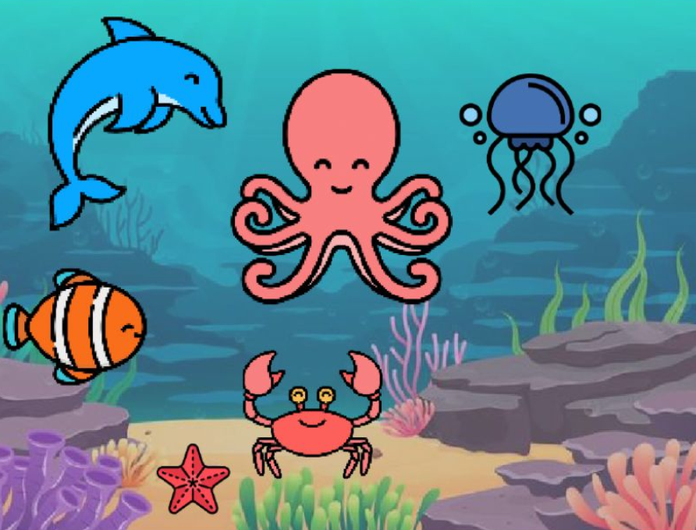
dolphin
octopus
jellyfish
nemo
starfish
crab
big - small long - short fast - slow
beautiful - ugly dangerous - friendly

Slide 6
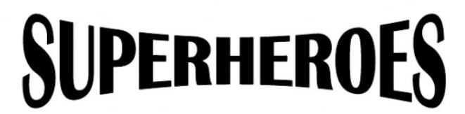
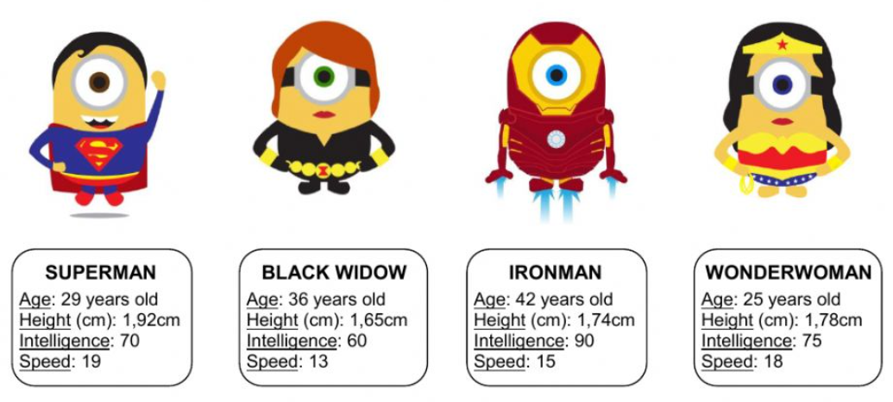
Nouns | Adjectives
age
height
intelligence
speed
old
high
intelligent
(fast)

