Slide 1
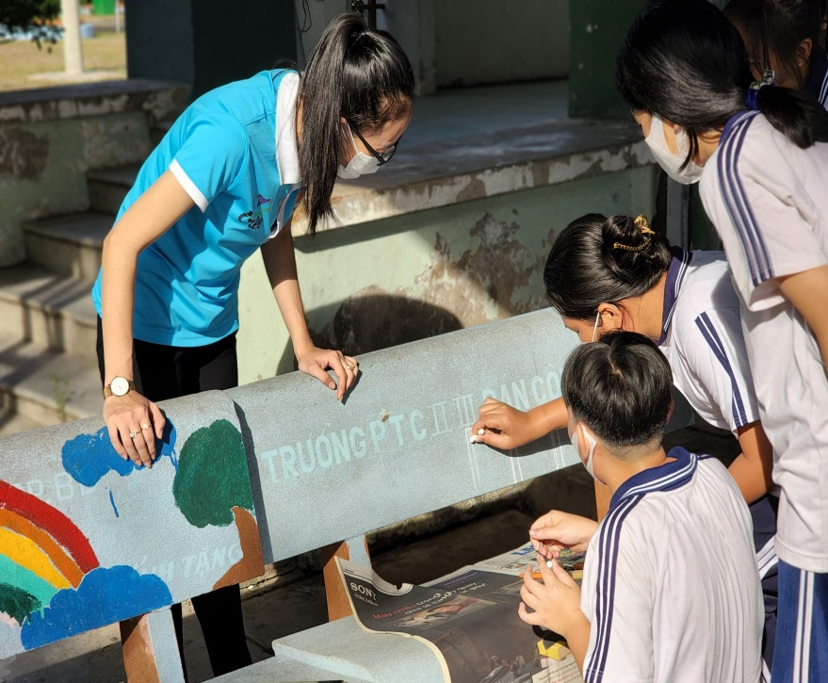
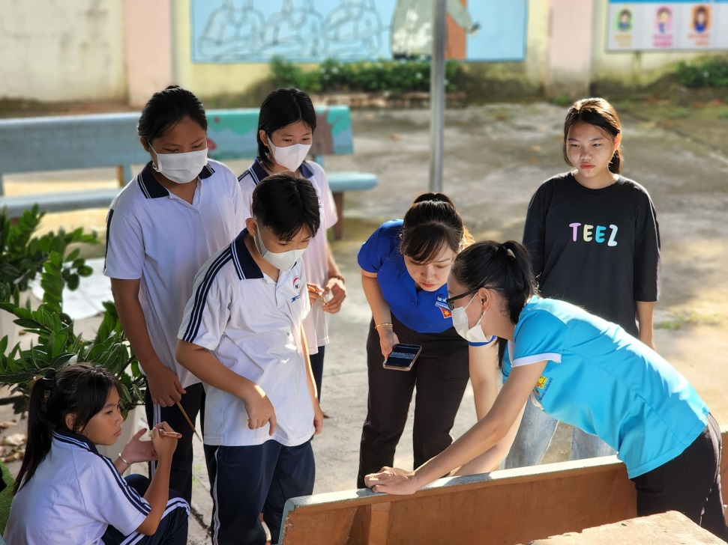
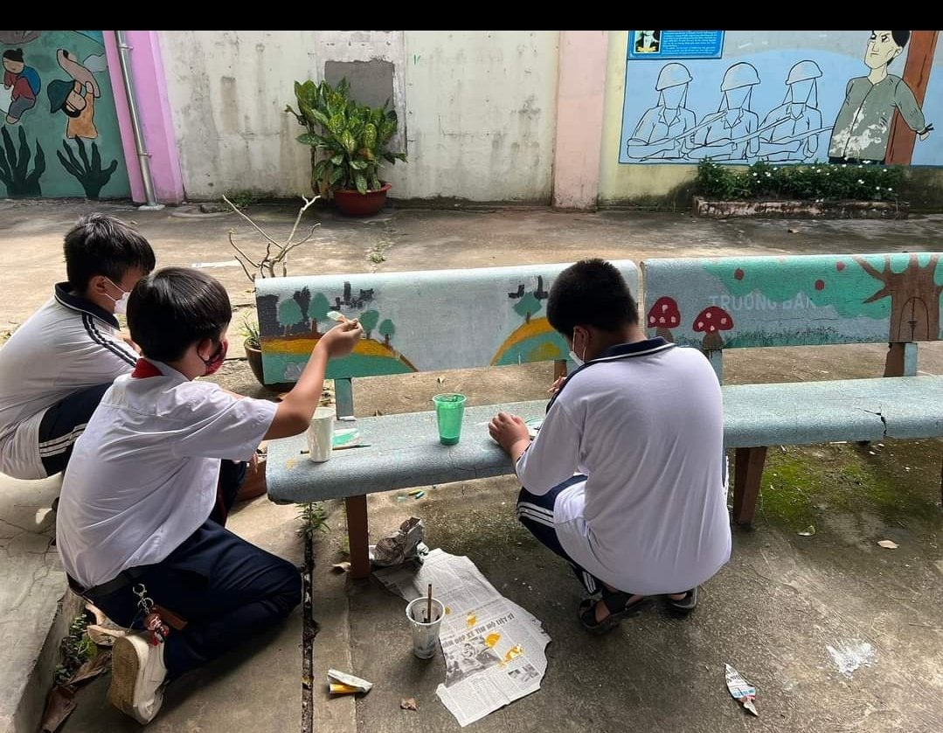

a bench
benches

Slide 2
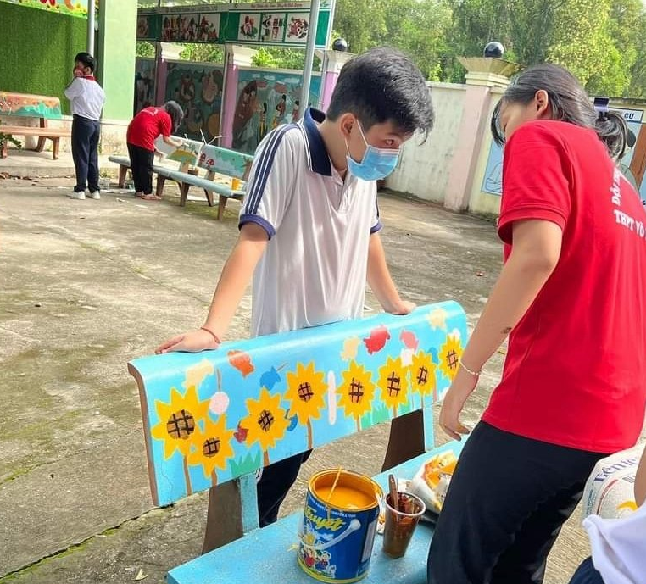

Slide 3
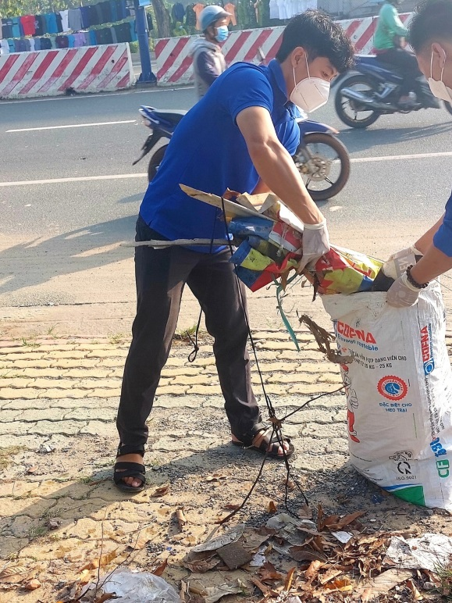
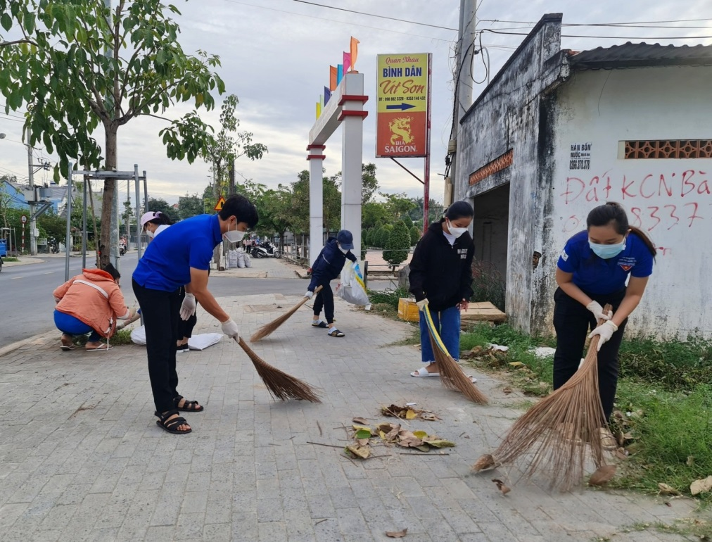
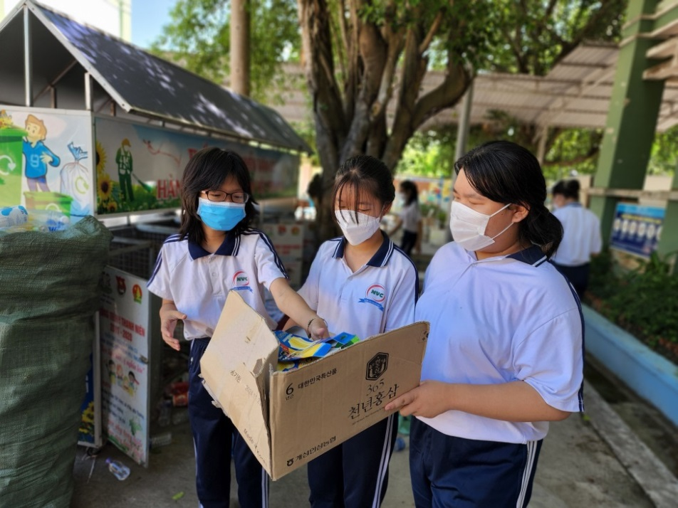

Slide 4
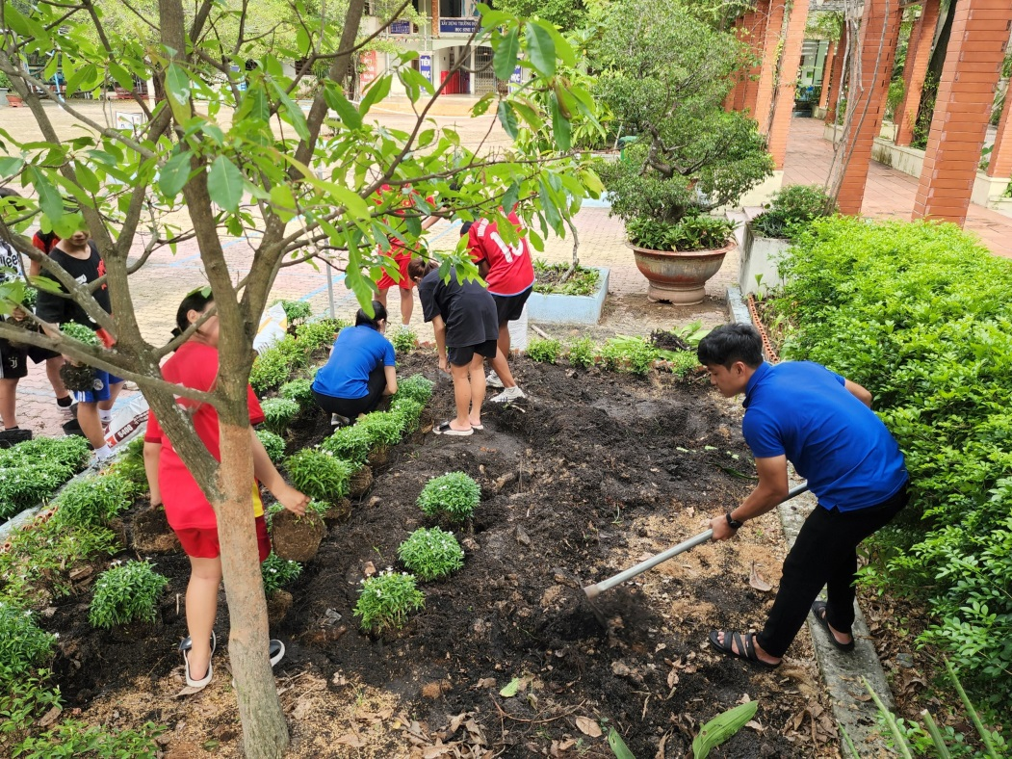
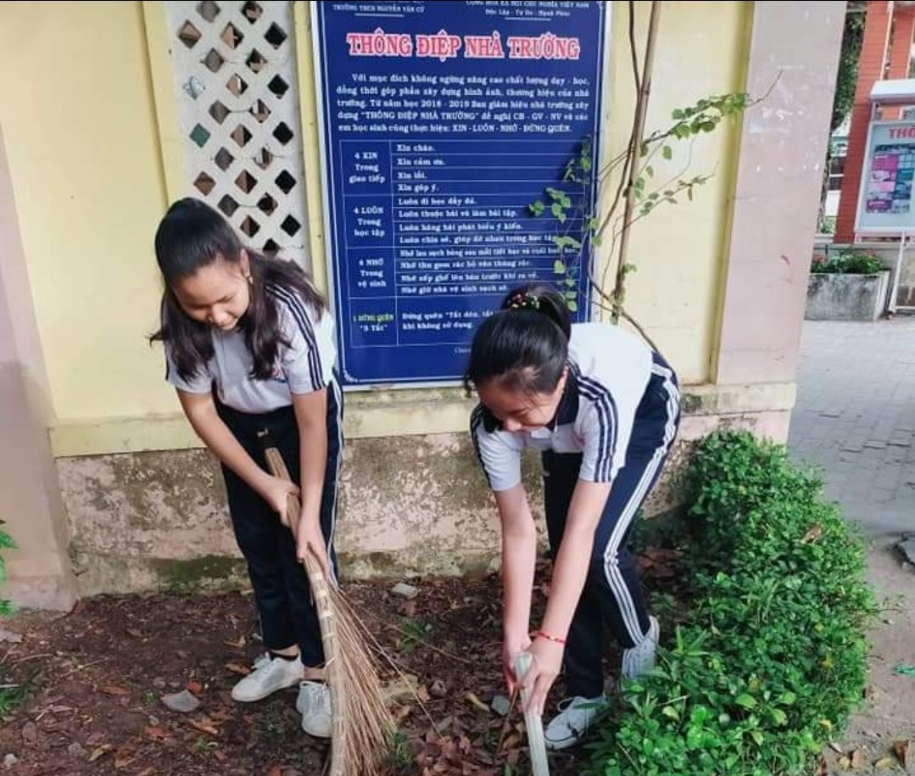

Slide 5
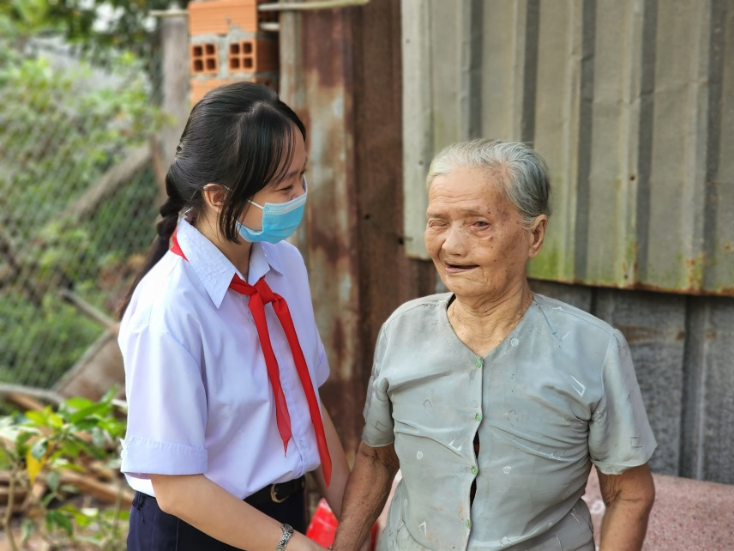
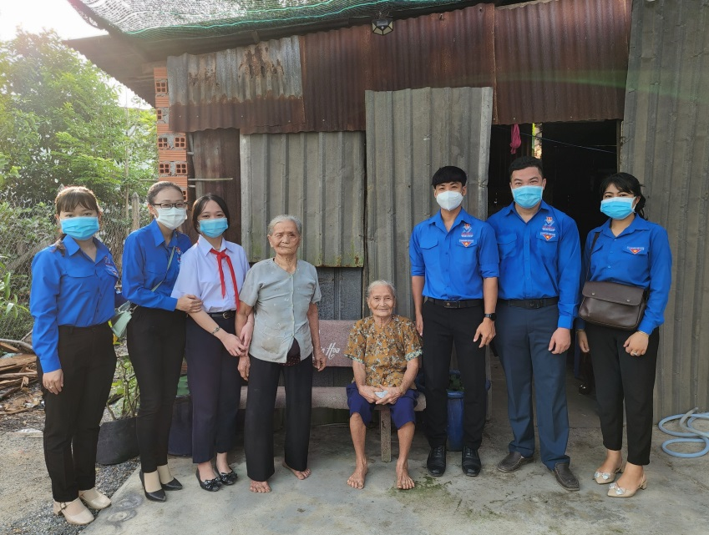
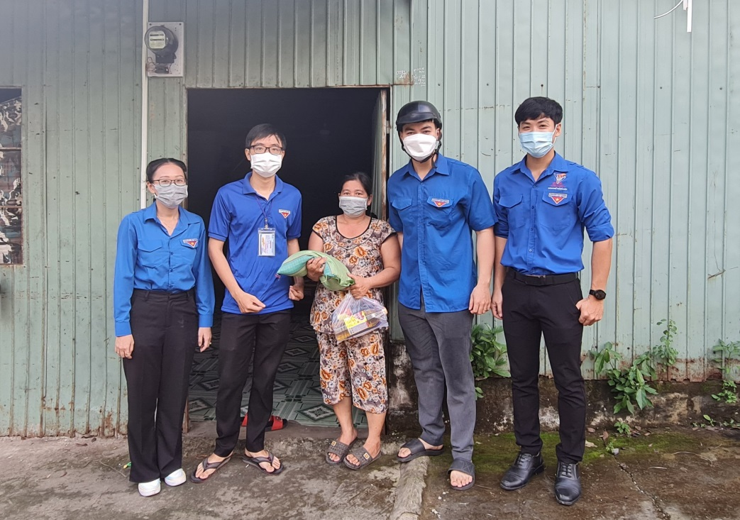

Slide 6



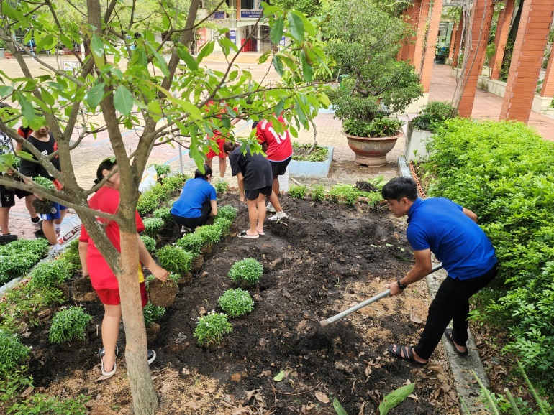

painting benches
picking up litter
planting trees
helping the old people

Slide 7



Unit
3
LESSON 1: GETTING STARTED
LESSON 1: GETTING STARTED
Sounds like great work!

Slide 8
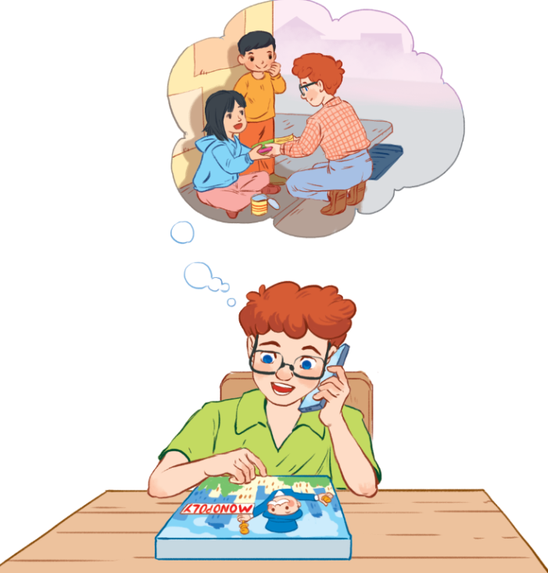
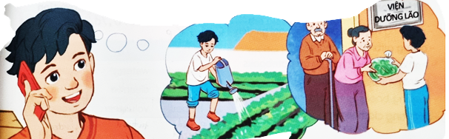


Slide 9

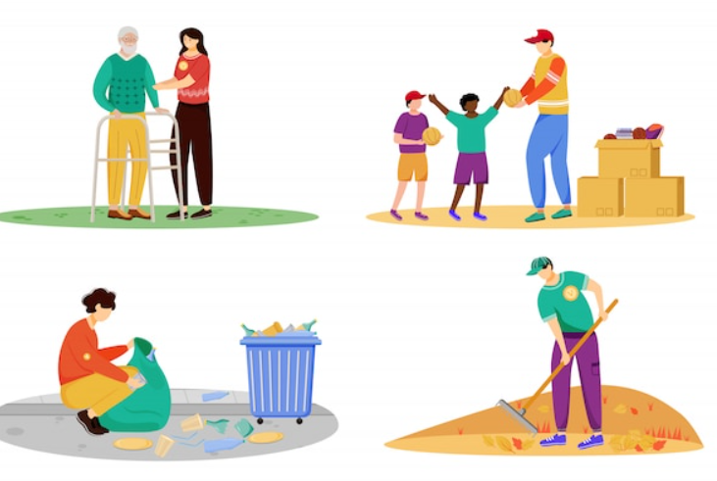
Vocabulary
community service (n.phr.)
/kəˈmjuːnɪti ˈsɜː.vɪs /
dịch vụ cộng đồng

Slide 10
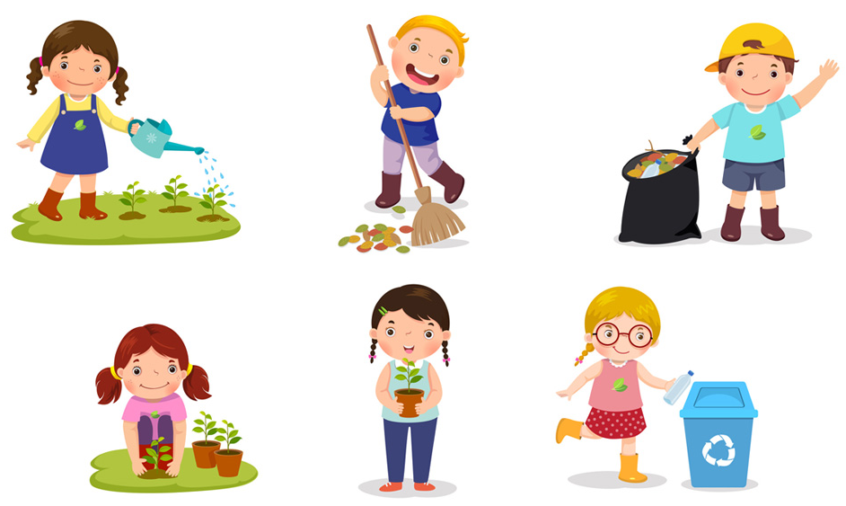
Vocabulary
community activity (n.phr.)
/kəˈmjuːnɪti ækˈtɪvɪti /
hoạt động cộng đồng

Slide 11
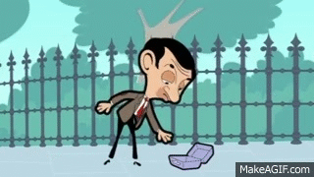
Vocabulary
pick (v) – pick up – pick up litter
/pik /
/pik ʌp /
/pik ʌp ˈlɪt.ə/

Slide 12
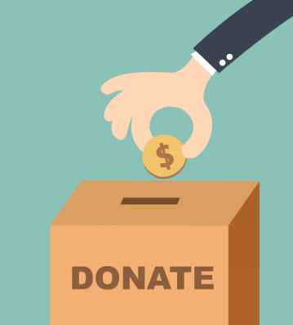


Vocabulary
donate (v)
donation (v)
/dəʊˈneɪt/
/dəʊˈneɪ.ʃən/
quyên góp, ủng hộ

Slide 13
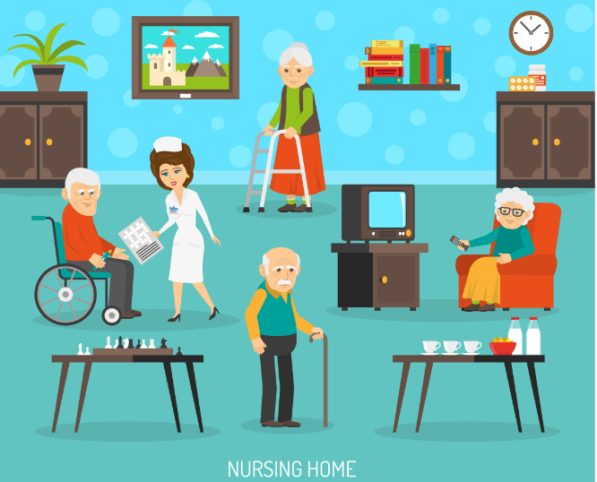
Vocabulary
nursing home (n.phr.)
/ˈnɜː.sɪŋ ˌhəʊm/
viện dưỡng lão

Slide 14
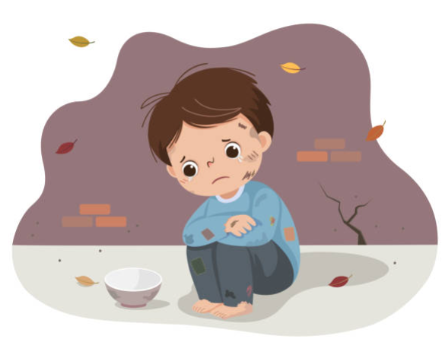
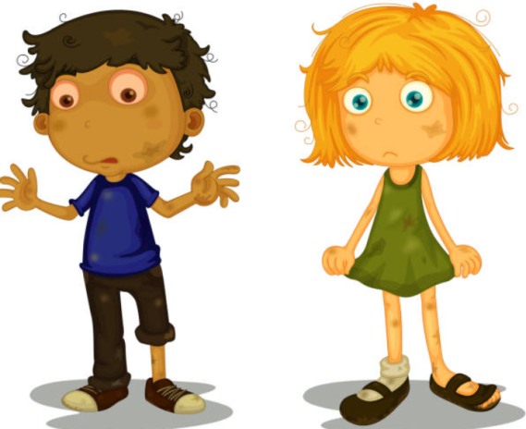
Vocabulary
homeless (adj)
- homeless children
/ˈhəʊm.ləs/
/ˈhəʊm.ləs ˈtʃɪl.drən /
vô gia cư

Slide 15
Vocabulary
New words | Pronunciation | Meaning
community activity | /kəˈmjuːnɪti ækˈtɪvɪti/ | hoạt động cộng đồng
donate | /dəʊˈneɪt/ | quyên góp, ủng hộ
nursing home | /ˈnɜːsɪŋ həʊm/ | viện dưỡng lão
homeless | /ˈhəʊmləs/ | vô gia cư

Slide 16

Minh: Hi, Tom. Are you back in Ha Noi?
Tom: Yes. I came back yesterday. Can we meet up this Sunday morning? I bought you a board game.
Minh: Sure, I can’t wait! But our Green School Club will have some (1) _________ activities on that morning.
Tom: What activities does your club do?
Minh: Well, we (2) ______ ______litter around our school and plant vegetables in our school garden.
Tom: School gardening? That’s fantastic!
Minh: Yes. We (3) _________ the vegetables to a (4) _________ home. Does your school have any activities like these?
Tom: Yes. We donate books to (5) ___________ children. We also have English classes. Last summer, we taught English to 30 kids in the area.
Minh: Sounds like great work!
Tom: Thanks.
Minh: ... So, let’s meet in the afternoon then.
community
pick
up
donate
nursing
homeless

Slide 17
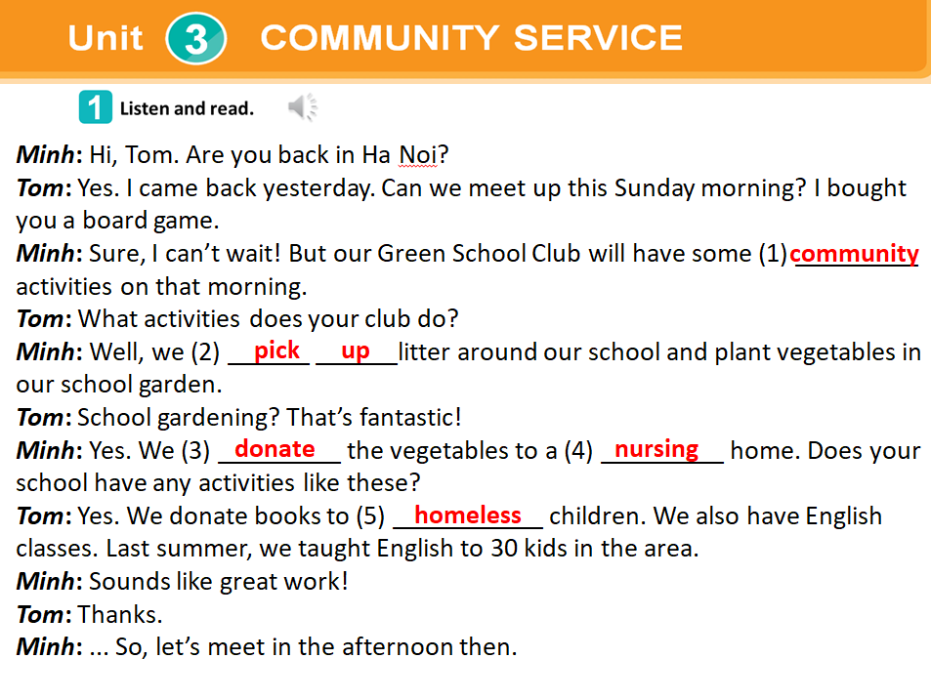

Slide 18

Community activity | Minh’s club | Tom’s club
1. picking up litter
2. planting vegetables
3. donating books
4. donating vegetables
5. teaching English

Slide 19
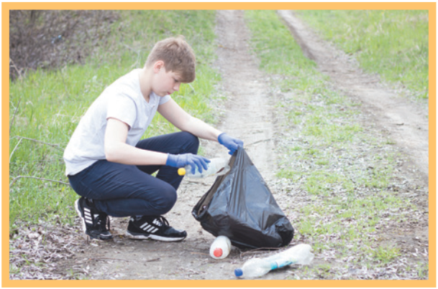
pick up clean donate recycle help
1. ________ litter
pick up

Slide 20
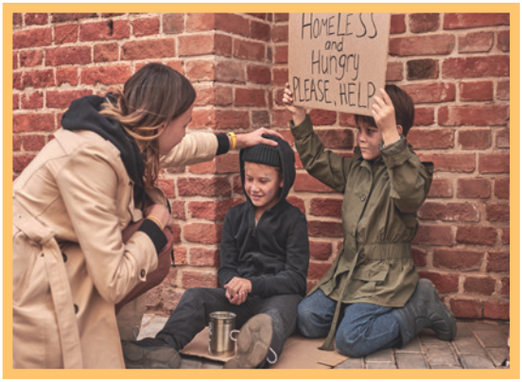
pick up clean donate recycle help
2. ______ homeless children
help

Slide 21
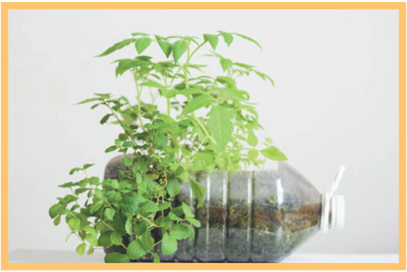
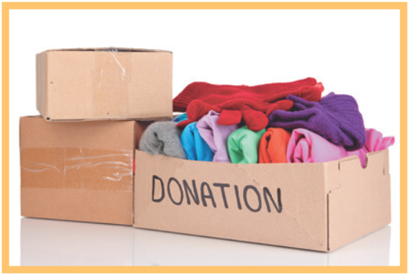
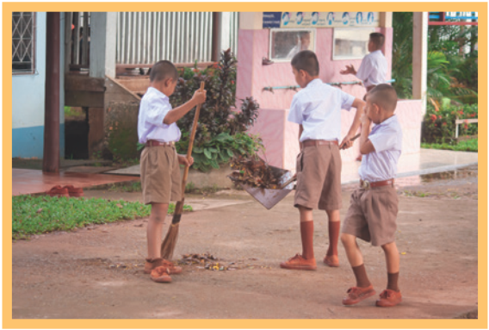
3. _______ plastic bottles

