Slide 1
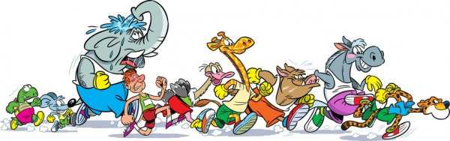
UNIT 9
What’s the fastest animal in the world?
Lesson 3

Slide 2
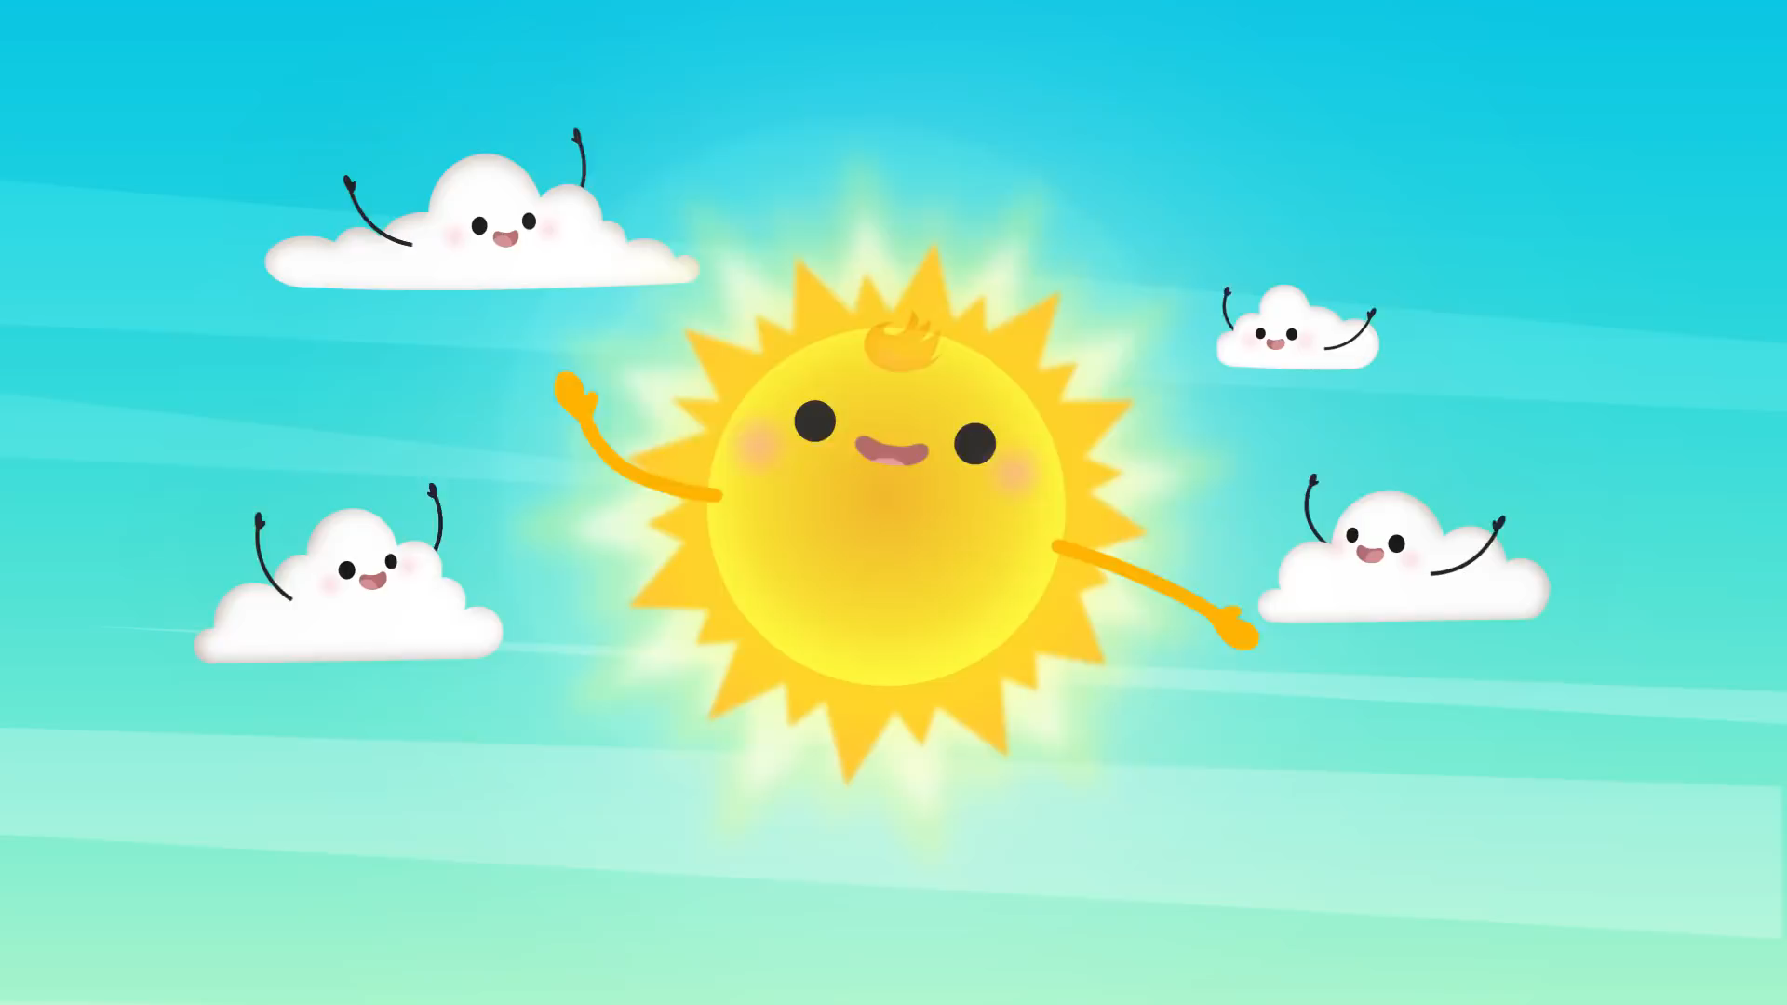

Slide 3

PAIR WORK
ASK AND ANSWER

Slide 4
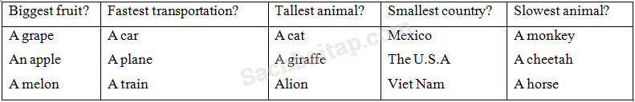
Example:
What's the slowest animal?
=> A monkey!

Slide 5

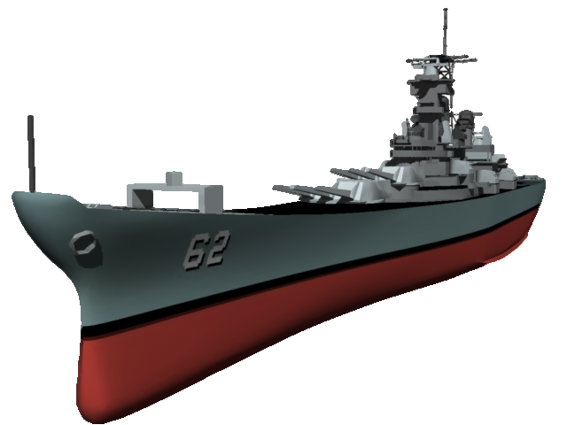



by HERBER

Slide 6










Battleship
What is the highest mountain in the world?
Mount Everest
TIME’S
UP
CHECK

Slide 7
Battleship
What is the longest river in the world?
The Nile river
TIME’S
UP
CHECK

Slide 8
Battleship
What is the biggest river in the world?
The Amazon river
TIME’S
UP
CHECK

Slide 9
Battleship
What is the deepest ocean in the world?
The Pacific Ocean
TIME’S
UP
CHECK

Slide 10
Battleship
What is the biggest country in the world?
Russia
TIME’S
UP
CHECK

Slide 11
Battleship
What is the most populated country in the world?
China
TIME’S
UP
CHECK

Slide 12
Battleship
What is the smallest country in the world?
Vatican City
TIME’S
UP
CHECK

Slide 13
Battleship
What is the fastest animal in the world?
Peregrine falcon
TIME’S
UP
CHECK

Slide 14
Battleship
What is the slowest animal in the world?
The three-toed sloth
TIME’S
UP
CHECK

Slide 15
Battleship
What is the fastest animal on land?
Cheetah
TIME’S
UP
CHECK

Slide 16
Battleship
What is the hardest mineral in the world?
Diamond
TIME’S
UP
CHECK

Slide 17
Battleship
What is the farthest planet from the sun?
Neptune
TIME’S
UP
CHECK

Slide 18
Battleship
What is the closest planet to the sun?
Mercury
TIME’S
UP
CHECK

Slide 19
Battleship
What is the hottest planet?
Venus
TIME’S
UP
CHECK

Slide 20
Battleship
What is the coldest place in the world?
Antarctica
TIME’S
UP
CHECK

Slide 21
Battleship
What is the country with the oldest population?
Japan
TIME’S
UP
CHECK

Slide 22

Listen and point

Slide 23


Slide 24

LISTEN and
SING

Slide 26
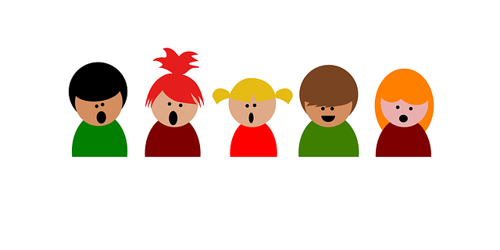
GROUP WORK: SING AND DO

Slide 27
PERFORMANCE
TIME!!!!

Slide 28

Workbook time!!!

Slide 29
