Slide 1


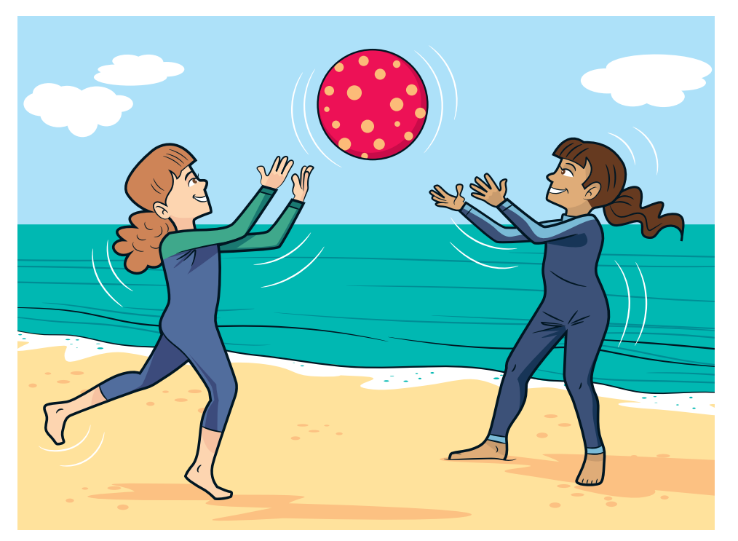

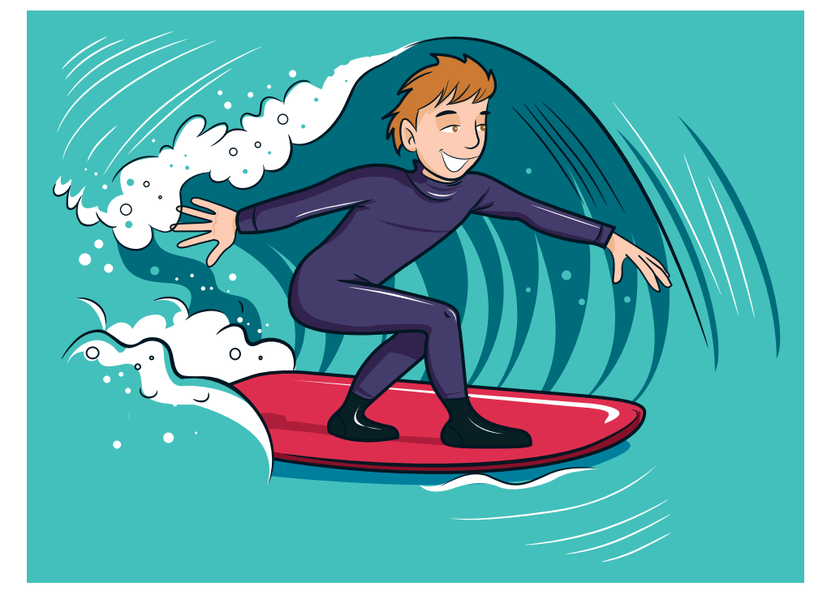
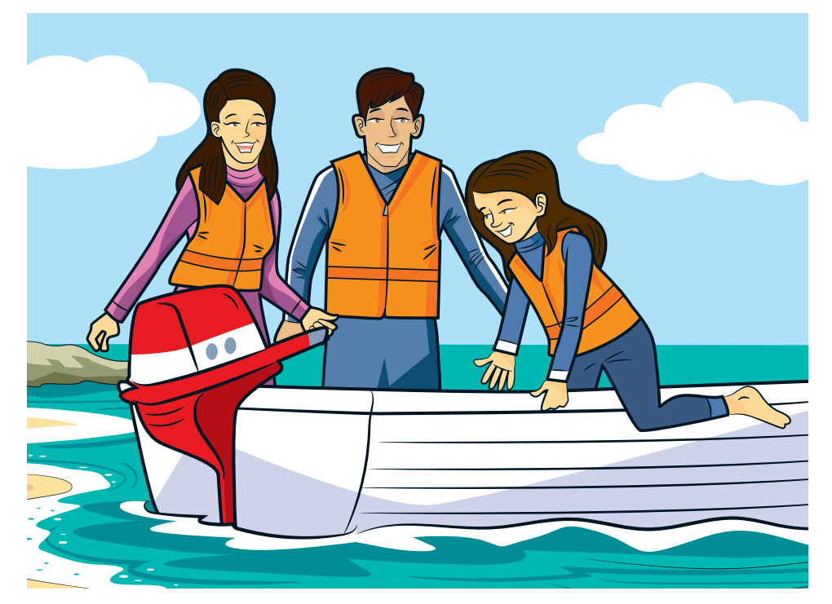
Unit 5
We’re having fun at the beach!
Lesson 2 – Grammar – Period 1

Slide 2
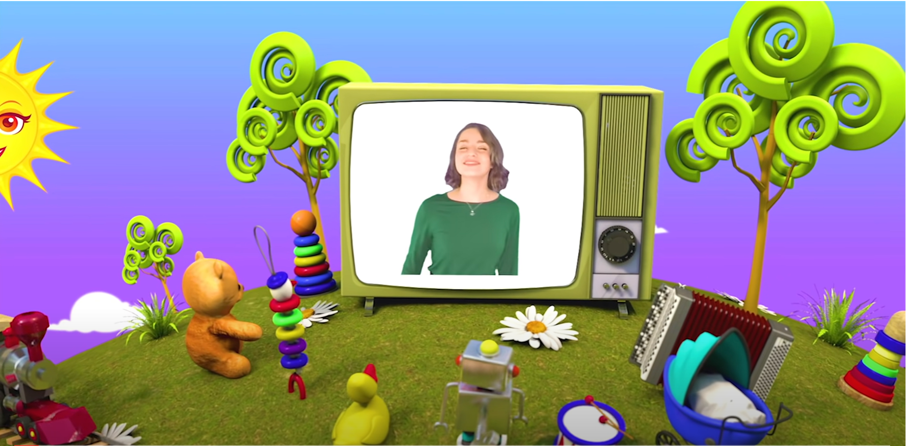
HELLO SONG

Slide 3






Slide 4

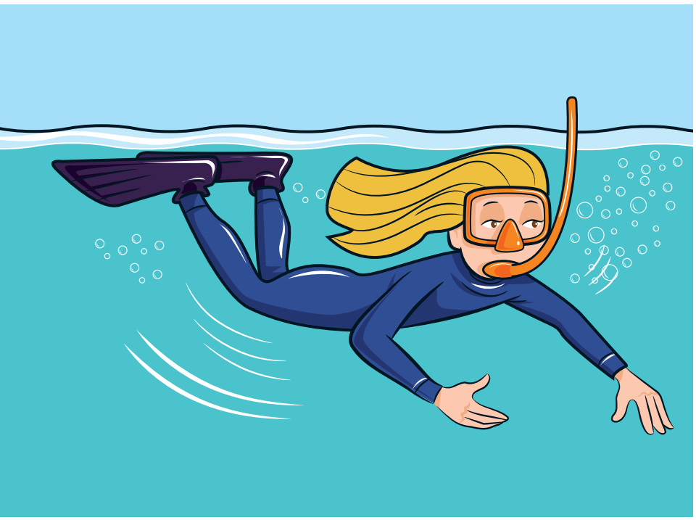
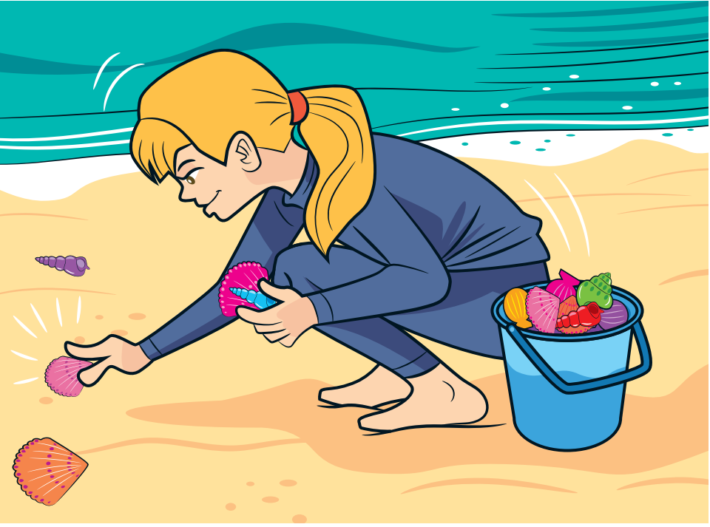
Game: Listen, Point and Say.
Notes:
* Game: Listen, point and say.
Place lesson flashcards around the classroom.
Call out a word. The children point to the correct flashcard.
Alternatively, play the chant from this unit. Children point to the correct flashcard when they hear the word.
Now point to the flashcard. The children say the word.

Slide 5



Slide 6
Answer the questions.
Who does Amy phone?
What does Max / Holly do?
Can Leo stand on his hand?
Notes:
Lead-in:
With books closed, ask children to remember the beach activities Leo does in the story (surfing and swimming). Ask about the story, e.g. Who does Amy phone? What does Max / Holly do?
Hold up your book to encourage ideas.

Slide 7
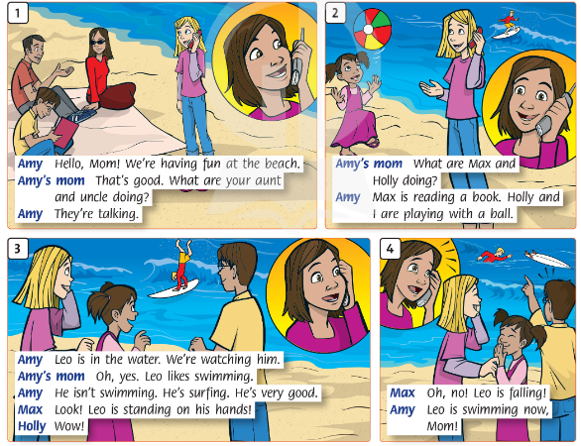

Listen
and
Repeat.

Slide 8
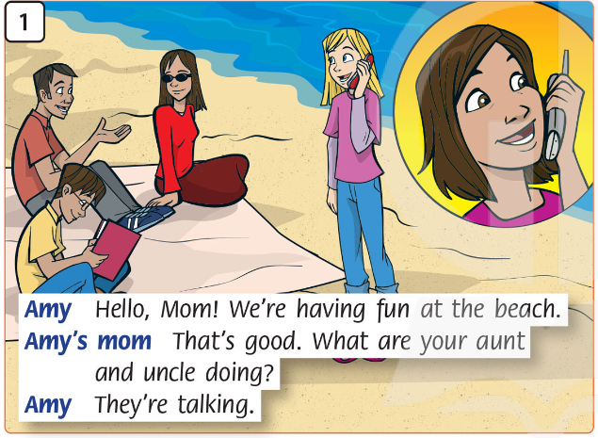
Say
and
Do the actions.
Notes:
Story Action
Picture 1: Max reads a book. Amy and Mom talk on the phone.

Slide 9
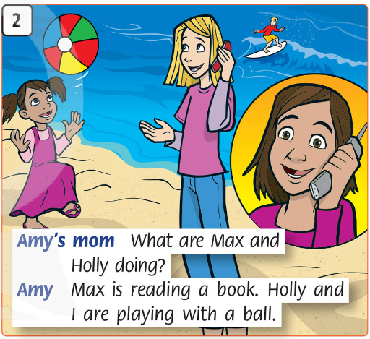
Say
and
Do the actions.
Notes:
Story Action
Picture 2: Amy and Mom talk on the phone. Leo surfs. Holly plays with a ball.

Slide 10
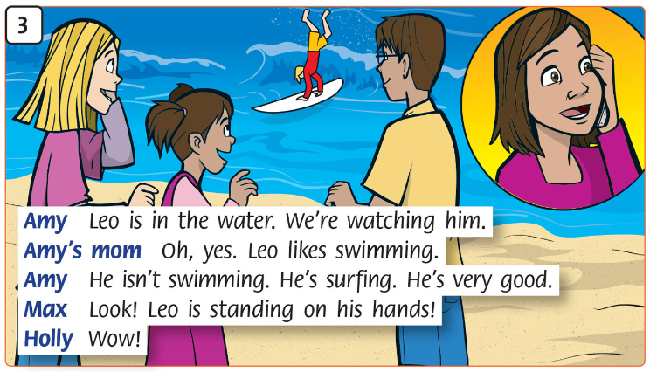
Say
and
Do the actions.
Notes:
Story Action
Picture 3: Leo stands on his hands (children touch their toes). Amy and Mom talk on the phone. Amy, Max, and Holly point at Leo.

Slide 11
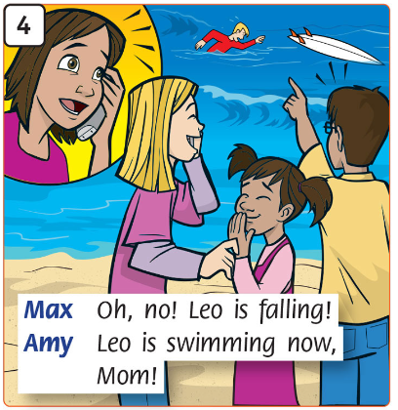
Say
and
Do the actions
Notes:
Story Action
Picture 4: Leo swims. Amy and her mom talk on the phone. Mom is concerned. Holly and Max laugh and point.

Slide 12
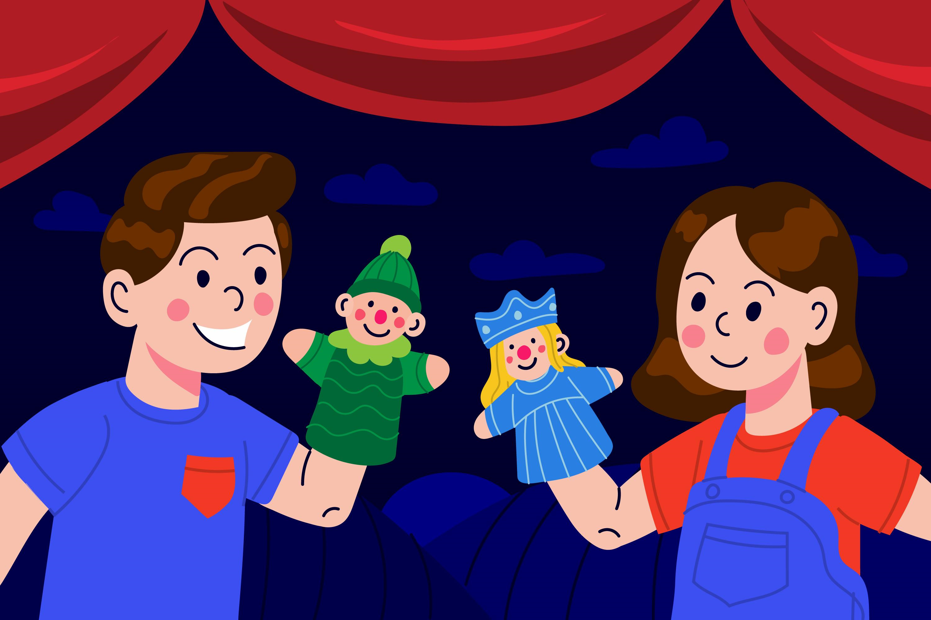
Story Actions
Notes:
Picture 1: Max reads a book. Amy and Mom talk on the phone.
Picture 2: Amy and Mom talk on the phone. Leo surfs. Holly plays with a ball.
Picture 3: Leo stands on his hands (children touch their toes). Amy and Mom talk on the phone. Amy, Max, and Holly point at Leo.
Picture 4: Leo swims. Amy and her mom talk on the phone. Mom is concerned. Holly and Max laugh and point.

Slide 13
Look at the teacher and Say.
You’re surfing.
Notes:
Listen and say. (Track 61)
Mime surfing and elicit You’re surfing.

Slide 14
Look at the teacher and Listen.
I’m playing with a ball.
Notes:
Now mime playing with a ball and say I’m playing with a ball.

Slide 15
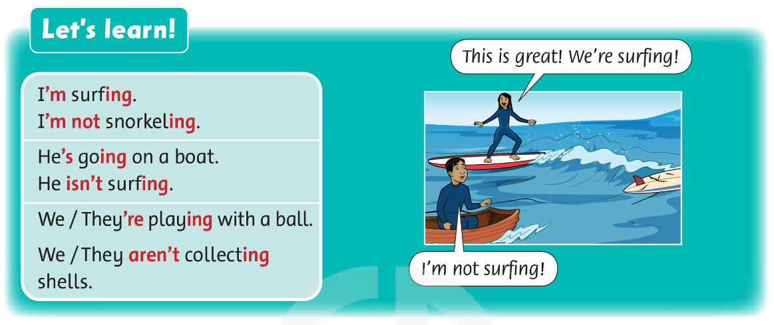
Listen
and
Say.
I’m surfing.
I’m = I am
Notes:
Play Track 61 Write I’m … on the board. Then hold up the flashcards and elicit new sentences.

Slide 16
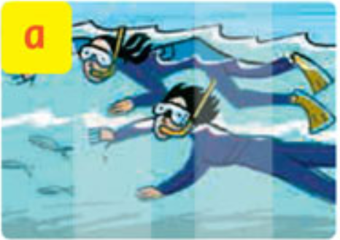
Look and Say.
They’re snorkeling.
Notes:
Ask the children to look at the picture and say the sentence with present progressive.

Slide 17
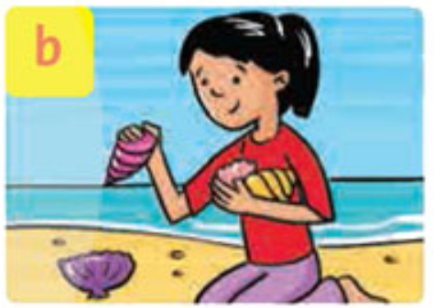
Look and Say.
She’s collecting shells.
Notes:
Ask the children to look at the picture and say the sentence with present progressive.

Slide 18
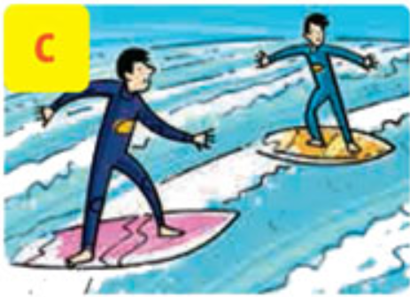
Look and Say.
They’re surfing.
Notes:
Ask the children to look at the picture and say the sentence with present progressive.

Slide 19
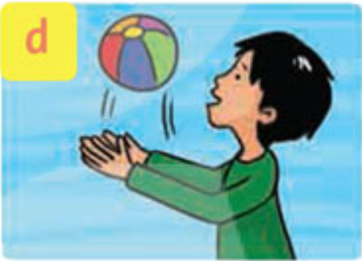
Look and Say.
He’s playing with
a ball.
Notes:
Ask the children to look at the picture and say the sentence with present progressive.

Slide 20
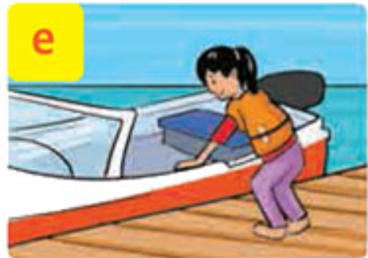
Look and Say.
She’s going on
a boat.
Notes:
Ask the children to look at the picture and say the sentence with present progressive.

Slide 21
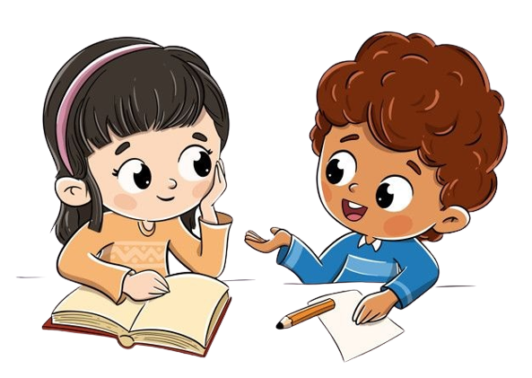
Work in Pairs.
Notes:
Ask two students to work in pairs, look at the Exercise 3 on page 39, make sentences with present progressive in affirmative.

Slide 22

Good job!

Slide 23
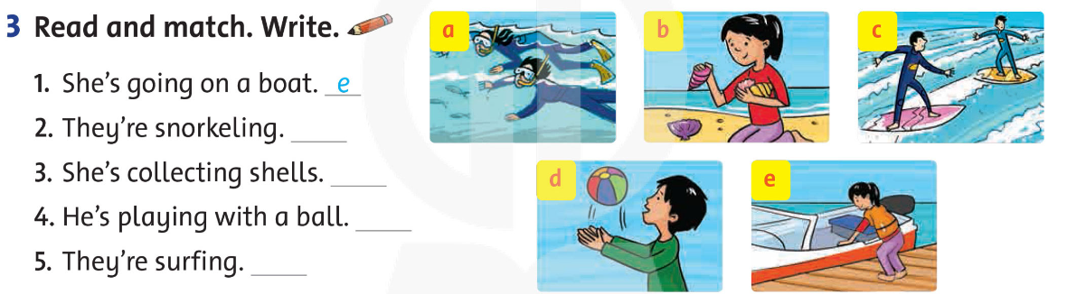
Read and Match. Write.
a
b
d
c
Notes:
* Read and match. Write.
Read out the first sentence and ask Which picture is it? Elicit and point to the example.
Children read the rest of the sentences and write a letter with their pencils.
Answer
1 e 2 a 3 b 4 d 5 c

Slide 24
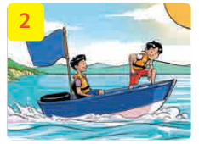
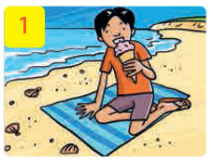
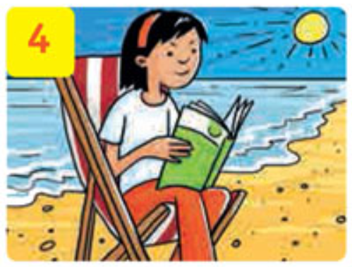
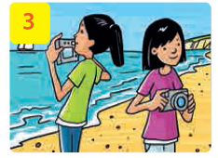
Let’s talk!
Notes:
* Let’s talk.
Show the picture and elicit the sentence I’m eating an ice cream. / He’s eating an ice cream. / ….
In pairs, children take turns saying sentences, using other vocabulary words on the page.

Slide 25
Work in Pairs.
Notes:
Ask two students to work in pairs, look at the Exercise 4 on page 39, make sentences with present progressive in affirmative.

Slide 26
Let’s talk!
He’s eating an ice cream.
Notes:
Invite some volunteers to talk in the front.

Slide 27
Let’s talk!
They’re going on a boat.
Notes:
Invite some volunteers to talk in the front.

Slide 28
Let’s talk
They’re taking photos.
Notes:
Invite some volunteers to talk in the front.

Slide 29
Let’s talk
She’s reading a book.
Notes:
Invite some volunteers to talk in the front.

Slide 30
Good job!

Slide 31

Homework
Do the exercises in Workbook page 39.
Prepare for the next lesson
(Unit 5 Lesson 2 Period 2).

Slide 32


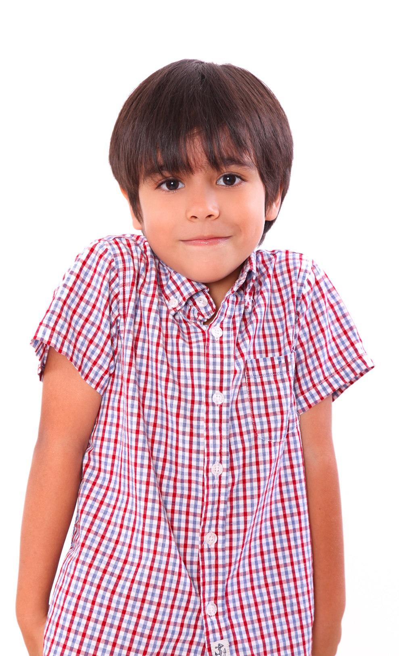
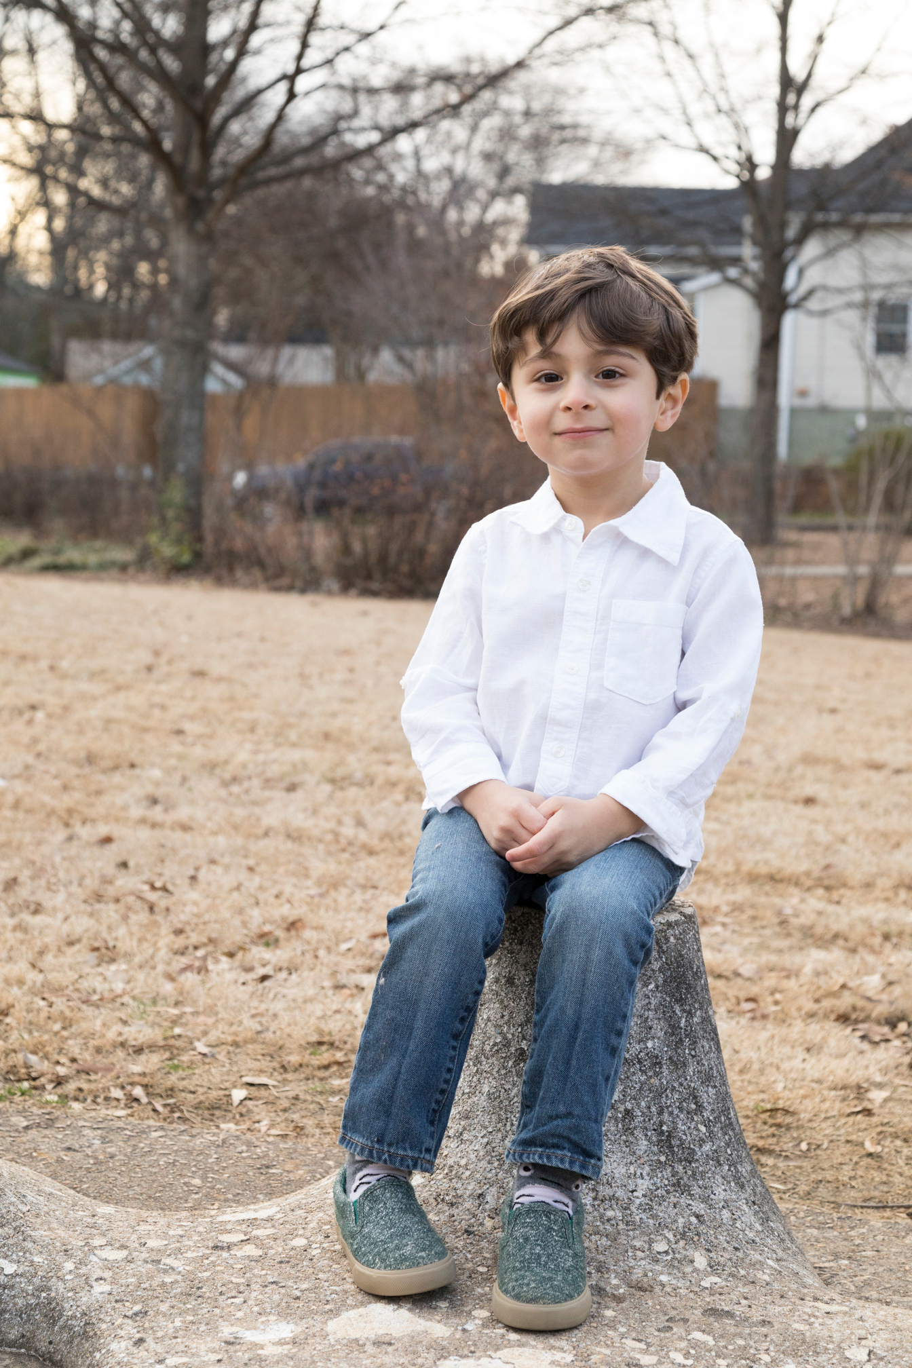
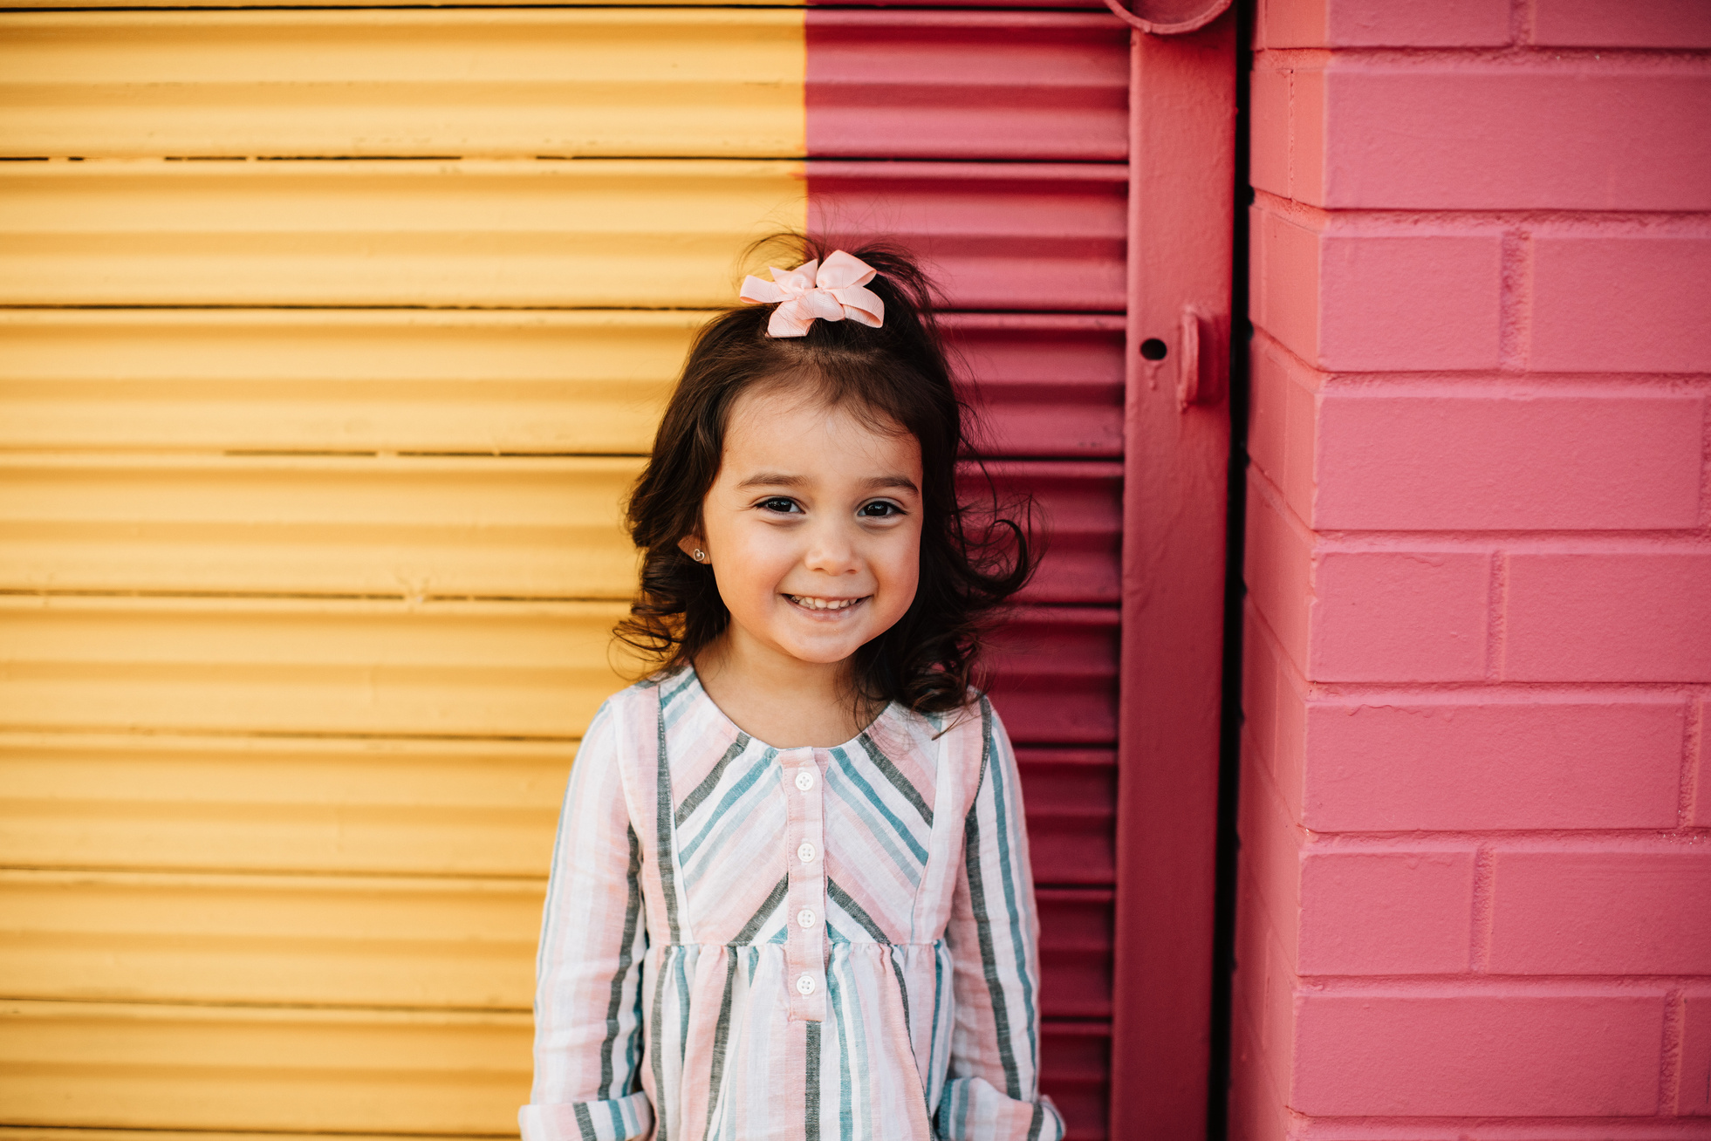
Our Winners!
Peter
Eric
Julie

Slide 33
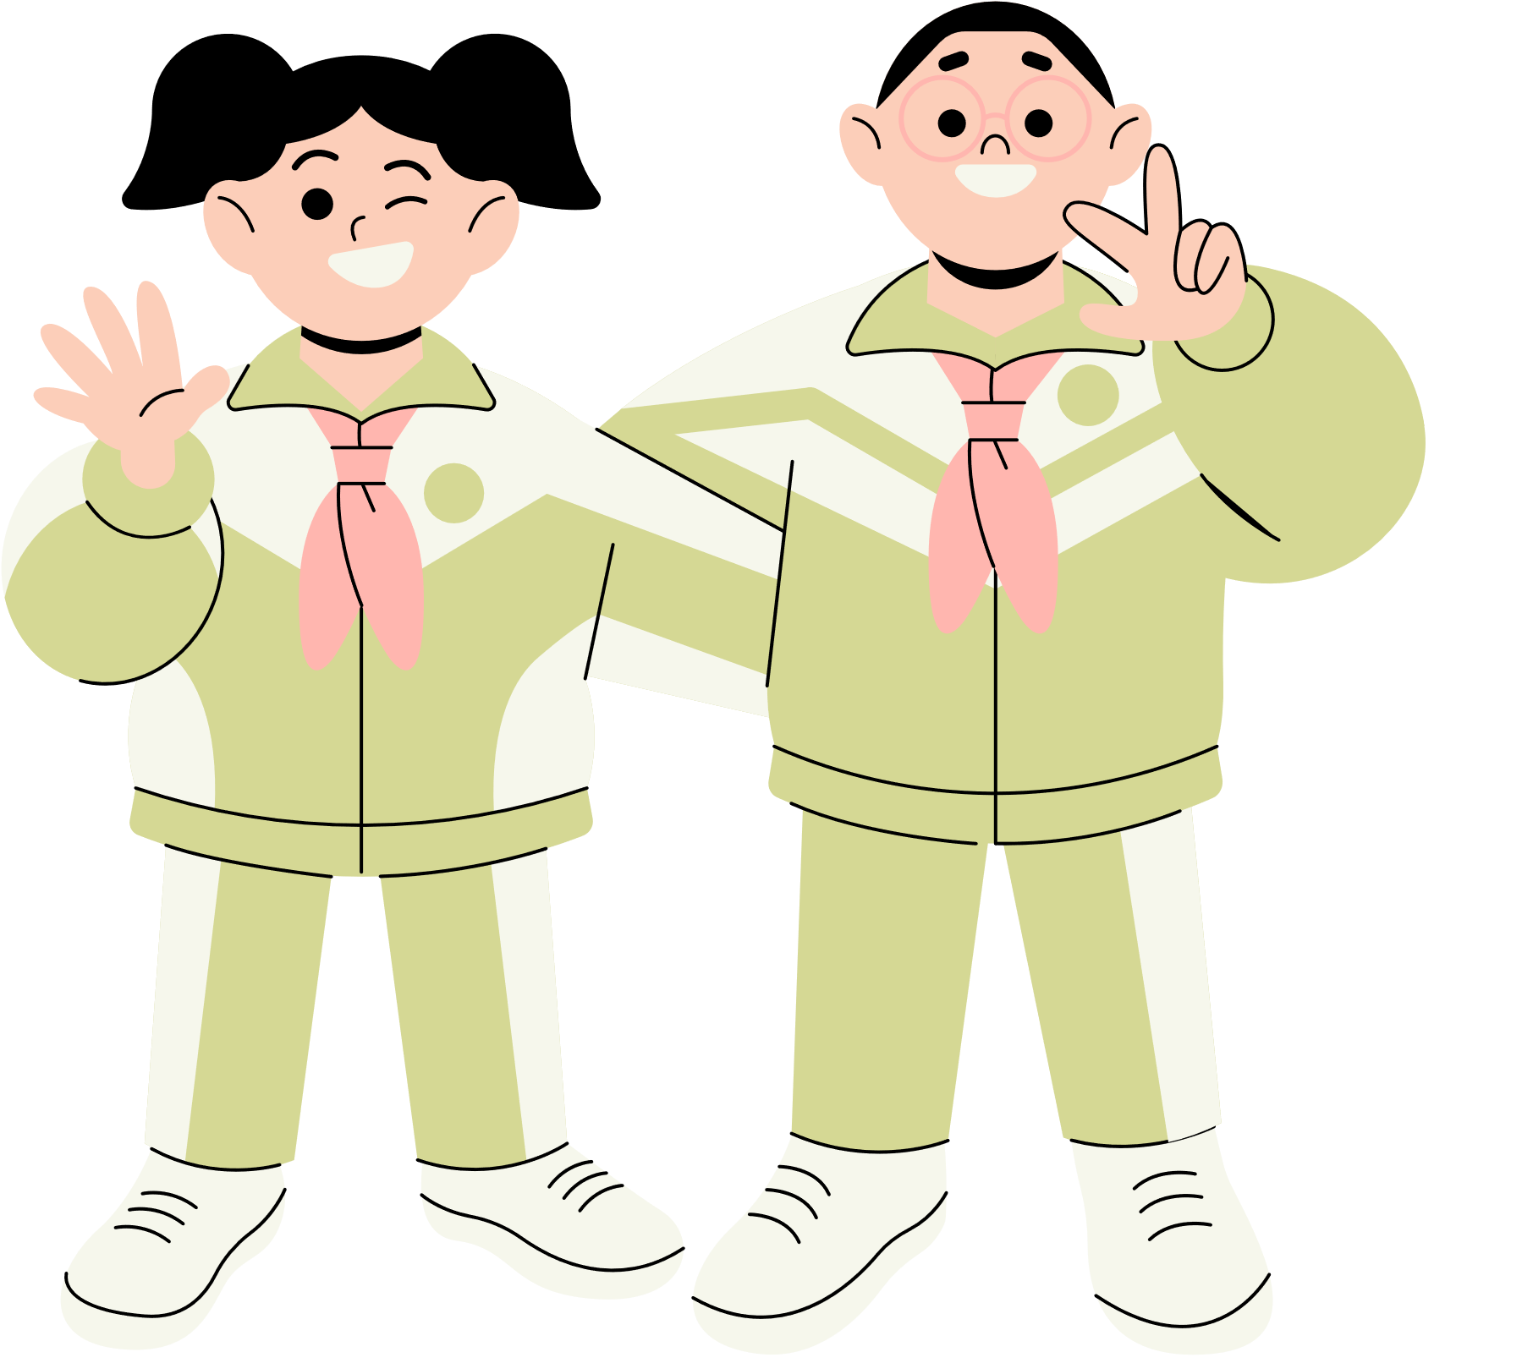




Thank You!
See You Next Time.

