Slide 1

NAME THE PICTURES
GUESS THE KEY WORD

Slide 2
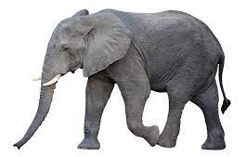

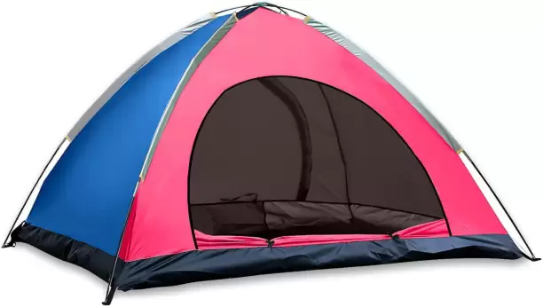
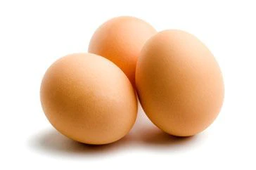



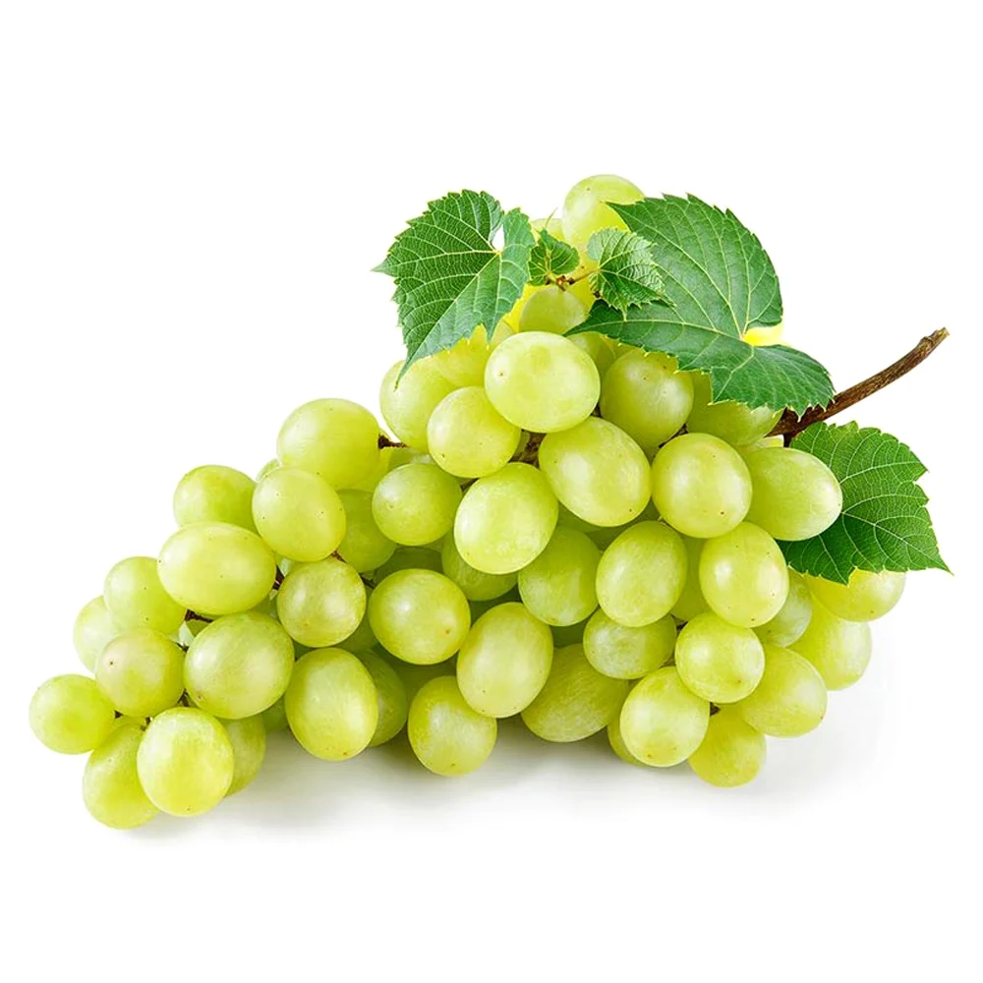
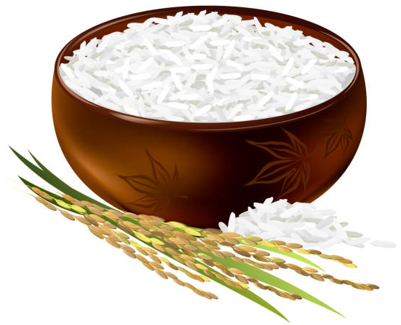
Tent
Eggs
Elephant
Nose
Apple
Grapes
Eagle
Rice
Sunflower

Slide 3


Slide 4

forum (n)
/ˈfɔːrəm/

Slide 5

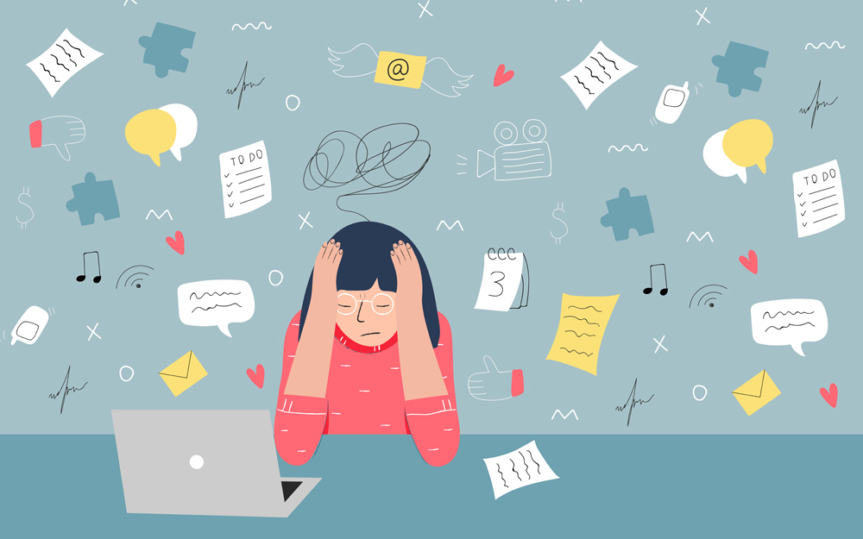
stress (n)
/ˌstres/
stressful (adj)
/ˈstres.fəl/

Slide 6
stress (n)
pressure (n)
/ˌstres/
/ˈpreʃə(r)/

Slide 7
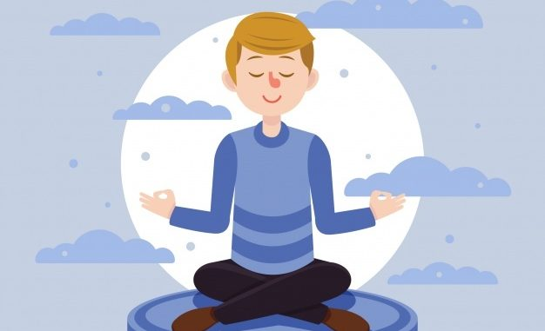
stay calm
keep calm
/steɪ kɑːm/

Slide 8

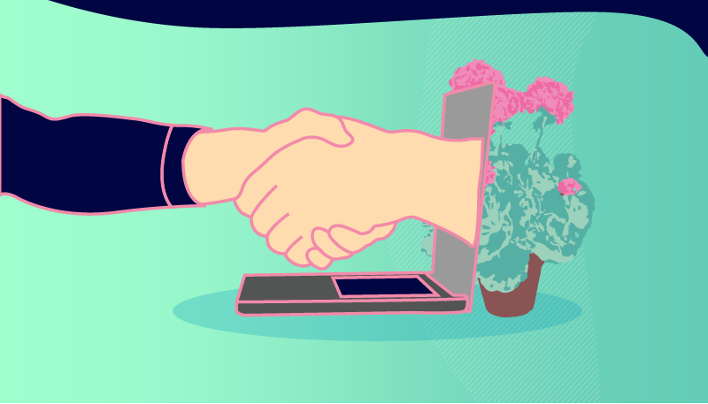
user-friendly (adj)
/ˈjuːzə-ˈfrendli/

Slide 9

midterm (adj)
/ˌmɪdˈtɜːm/
midterm test

Slide 10

New words | Pronunciation | Meaning
1. forum (n) | /ˈfɔːrəm/ | diễn đàn
2. stress (n), stressful (adj) | /stres/ | sự căng thẳng
3. stay calm | /steɪ kɑːm/ | giữ bình tĩnh
4. pressure (n) | /ˈpreʃə(r)/ | áp lực
5. user-friendly (adj) | /ˌjuːzə ˈfrendli/ | thân thiện với người dùng
6. midterm test (adj) | /ˌmɪdˈtɜːm/ | bài kiểm tra giữa kì

Slide 11

PRACTICE
1
Listen and read.
Teacher: It’s great to see you again, class. What’s going on?
Minh: We’ve decided to use Facebook for our class forum, and we joined some school club activities. We’re also preparing for the midterm tests. It’s really stressful.
Teacher: I’m sorry to hear that. I know exams may give you a lot of stress. But stay calm and work hard. What other pressure do you have?
Minh: Well, we also have pressure from our parents and friends.
Teacher: Do you? Let’s discuss these problems in your new Facebook group. By the way, why did you choose Facebook?
Ann: Because it’s user-friendly.
Teacher: Good! How about club activities? Do you find them enjoyable?
Ann: Yes. This year there are some new clubs like arts and crafts, and music. The club leaders will provide us with a variety of activities to suit different interests. And there will also be competitions as usual.
Teacher: Awesome! I hope you all can join the clubs you like.

Slide 12

Teacher: It’s great to see you again, class.
What’s going on?
Minh: We’ve decided to use Facebook for our class forum, and we joined some school club activities.
We’re also preparing for the midterm tests.
It’s really stressful.
Teacher: I’m sorry to hear that. I know exams may give you a lot of stress. But stay calm and work hard. What other pressure do you have?
1
2
3
4

Slide 13
Minh: Well, we also have pressure from our parents and friends.
Teacher: Do you? Let’s discuss these problems in your new Facebook group. By the way, why did you choose Facebook?
Ann: Because it’s user-friendly.
1
2
3
4

Slide 14
Teacher: Good! How about club activities? Do you find them enjoyable?
Ann: Yes. This year there are some new clubs like arts and crafts, and music. The club leaders will provide us with a variety of activities to suit different interests. And there will also be competitions as usual.
Teacher: Awesome! I hope you all can join the clubs you like.
1
2
3
4

Slide 15


2
Read the conversation again and write T (true) or F (False).
Sentences | T | F
1. The students finished their midterm tests
2. Minh mentions the different types of pressure they are facing.
3. The teacher tells them to stay calm and work hard.
4. The class will discuss their problems offline.
5. The school has different clubs for its students.
They are preparing for the midterm test.
The class will discuss their problems in their new Facebook group.

Slide 16
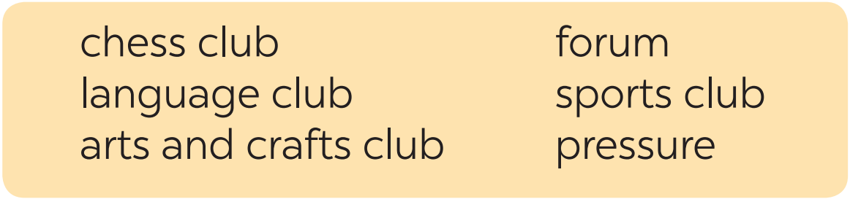


3
Write a word or phrases from the box under the correct pictures.
language club
pressure
1. _______________
2. _______________

Slide 17
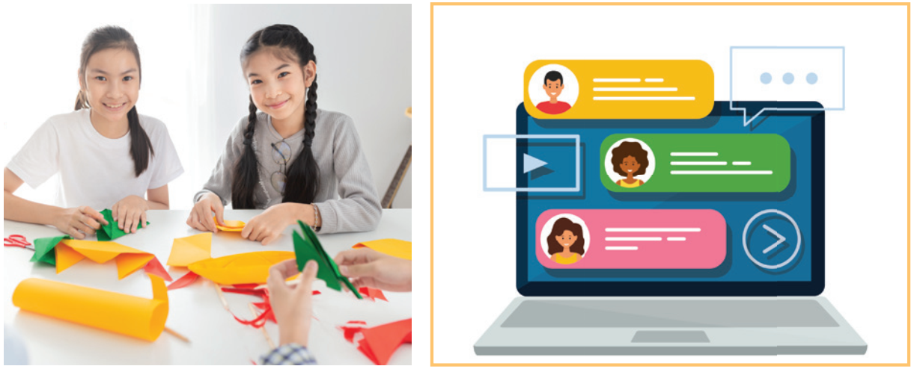
arts and crafts club
forum
3. _______________
4. _______________

Slide 18
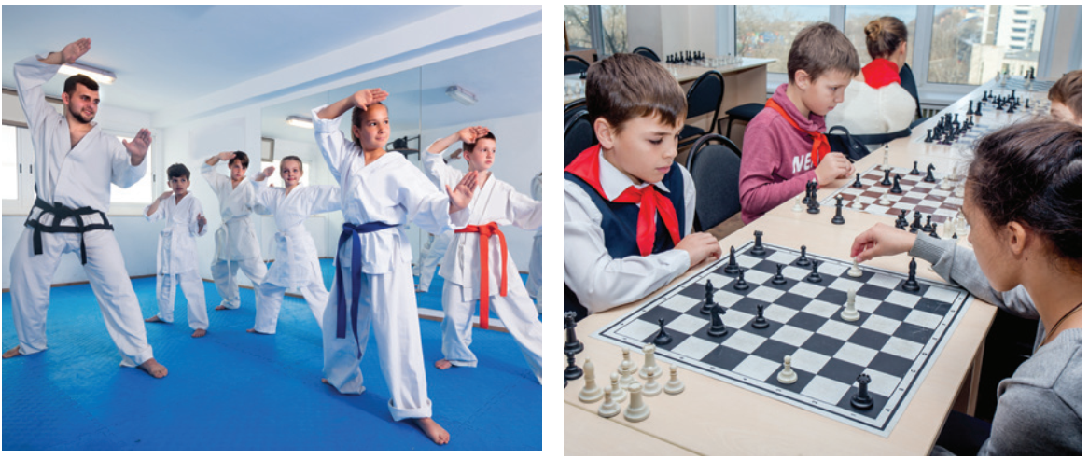
sports club
chess club
3. _______________
4. _______________

Slide 19
PRACTICE
4
Complete each of the sentences with a word or phrase in 3. There is one extra word or phrase.
arts and crafts club
1. Minh is a member of our ________________. The greeting cards he makes are really creative.
2. Students can discuss their problems in their class ______.
3. We share the essays and stories that we write in English in our _____________.
4. She is not feeling very well this weekend because of all the _______
from her school work.
5. The coach of our _____________ tells us to drink plenty of water during our practice sessions.
forum
language club
pressure
sports club

Slide 20

The football club is the most popular ….. at my school.
language club
forum
pressure
sports club
arts and crafts club

Slide 21
The online ….. is a great place
to discuss different topics.
language club
forum
pressure
sports club
arts and crafts club

Slide 22
I'm feeling a lot of ….. at work.
language club
forum
pressure
sports club
arts and crafts club

Slide 23
The online ….. allowed people to connect and discuss social issues.
language club
forum
pressure
sports club
arts and crafts club

Slide 24
I'm joining the English ….. to improve my speaking skills.
language club
forum
pressure
sports club
arts and crafts club

Slide 25
The ….. holds weekly painting sessions.
language club
forum
pressure
sports club
arts and crafts club

Slide 26

