Slide 1
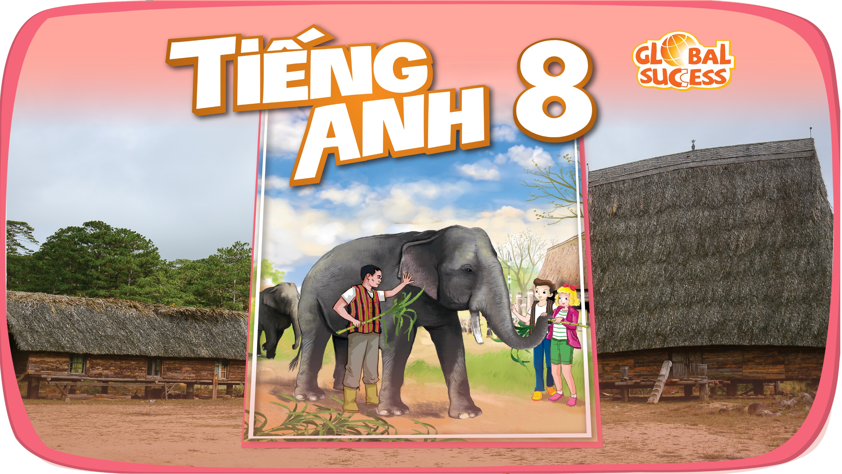

Slide 2
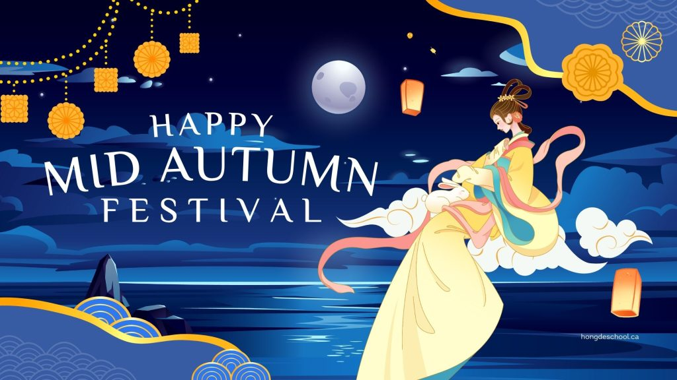
What is this festival?

Slide 4
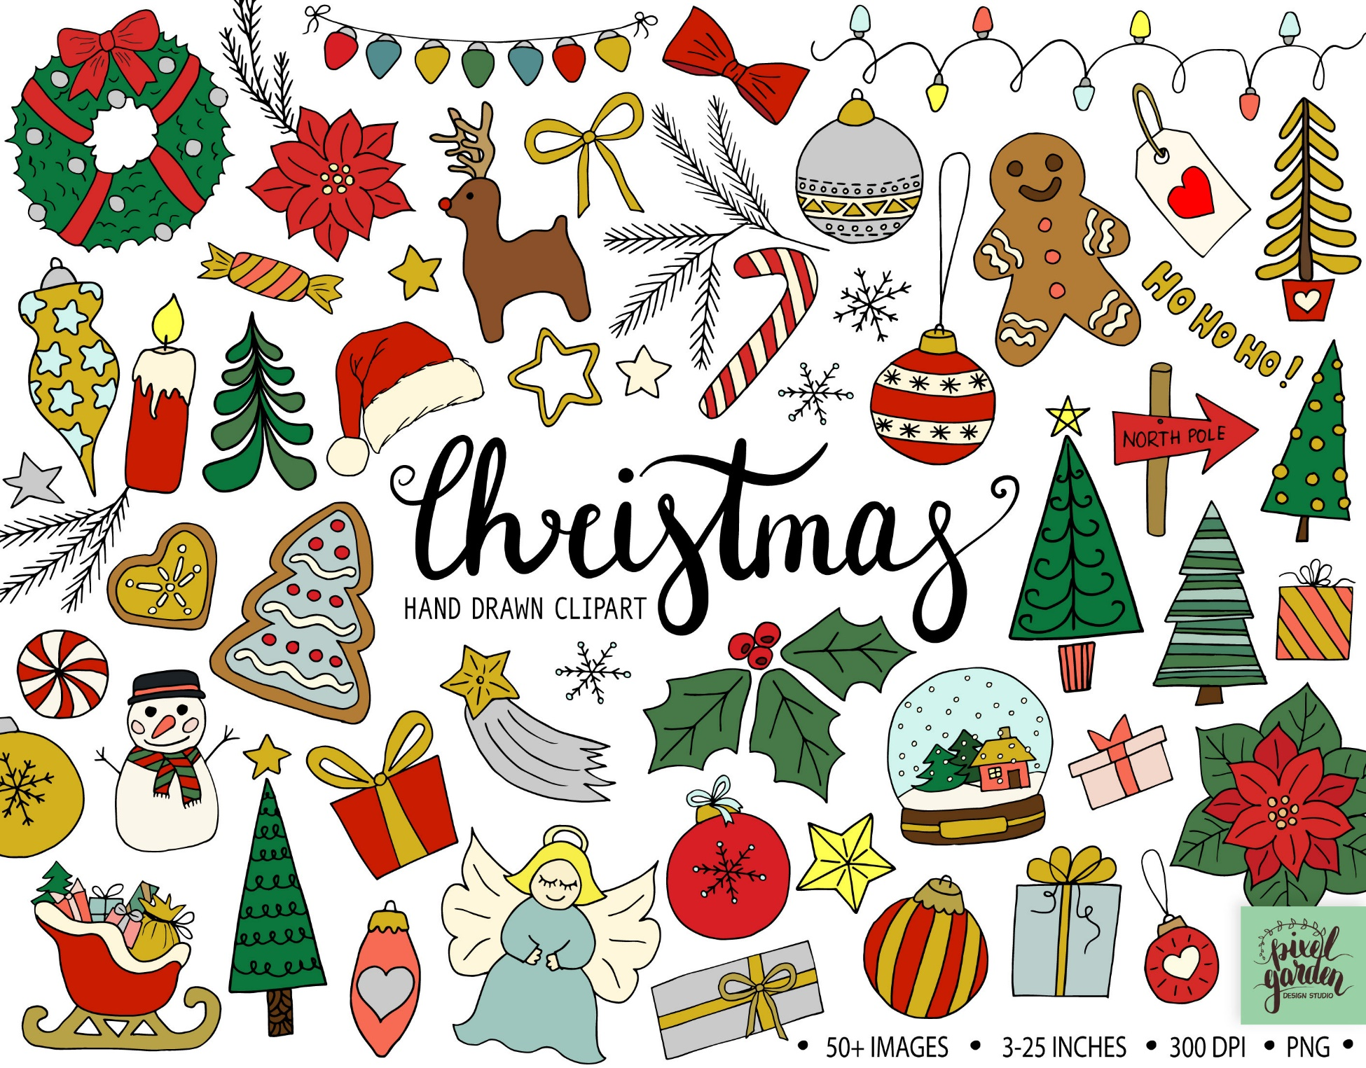
What is this festival?

Slide 6
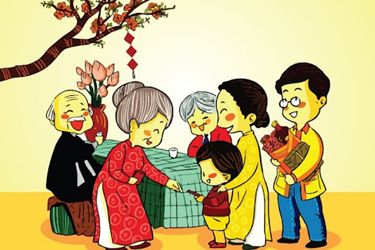
What is this festival?
Notes:
Game link: https://www.baamboozle.com/game/283002
Teacher can devide the class into 4 or 8 groups and let students choose numbers to answer the questions.

Slide 7
Notes:
Game link: https://www.baamboozle.com/game/283002
Teacher can devide the class into 4 or 8 groups and let students choose numbers to answer the questions.

Slide 8

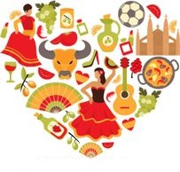
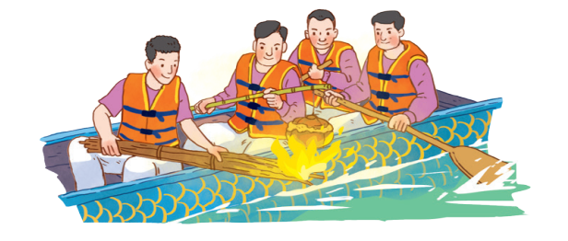
Unit
5
OUR CUSTOMS AND TRADITIONS
Unit
ETHNIC GROUPS OF VIET NAM
LESSON 5: SKILLS 1
LESSON 3: A CLOSER LOOK 2
Unit
HOBBIES
READING
SPEAKING

Slide 9
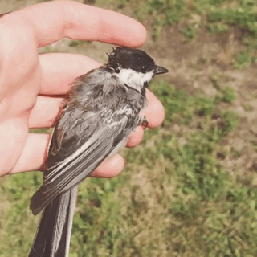
release (v)
/rɪˈliːs/

Slide 10
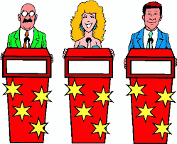
contestant (n)
/kənˈtestənt/

Slide 11
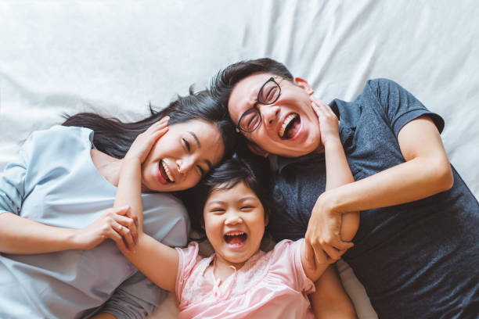
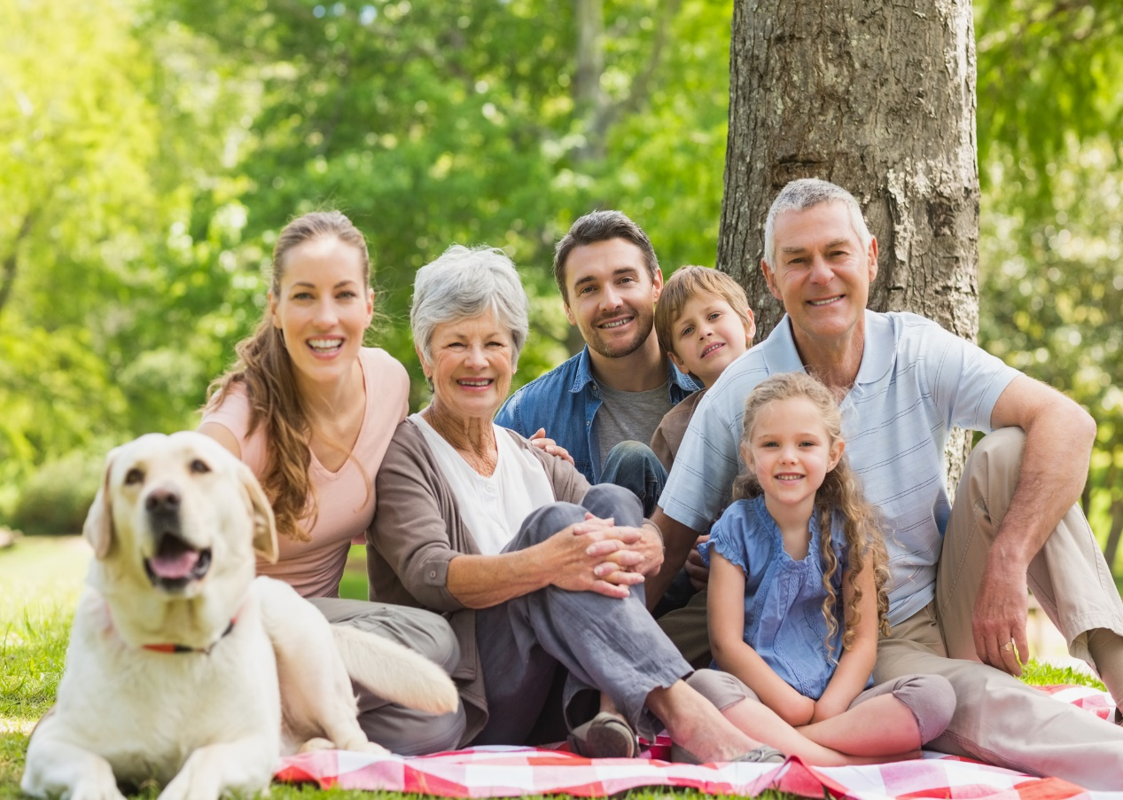
family bonding
/ˈfæməli ˈbɒndɪŋ/

Slide 12
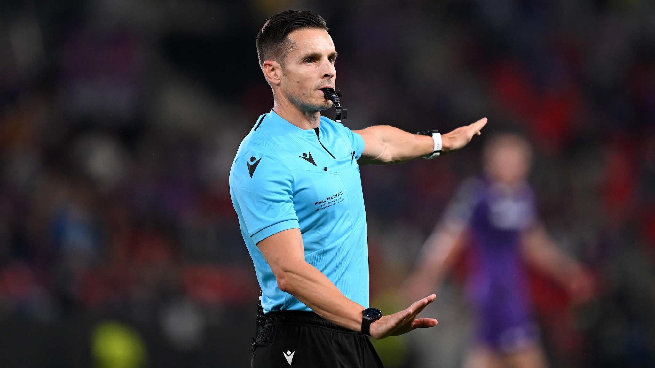
referee
/ˌref.əˈriː/

Slide 13


New words | Pronunciation | Meaning
- release (v) | /rɪˈliːs/ | thả
- contestant (n) | /kənˈtestənt/ | thí sinh
- family bonding (n) - Referee (n) | /ˈfæməli ˈbɒndɪŋ/ | sự gắn kết tình cảm gia đình

Slide 15


A village festival day
I live in a small village in northern Viet Nam. Every year, people in my village look forward to the third day of Tet.
It is one of our most important festival days.

Slide 16

In the morning, we gather along the riverside to watch some competitions. First, there is a special boat race. Some team members cook rice on the boat while others row the boat as fast as they can. The fastest team with well-cooked rice wins the race.

Slide 17
Then, the referee releases a duck into the middle of the river. Contestants jump into the river to catch it. The atmosphere becomes loud with the sound of drums and cheers of festival goers.

Slide 18
At noon, there is a village party at the communal house for the elders. Each family also holds a home party. We cook traditional dishes like sticky rice and steamed chicken. Sometimes, we include food that children love, such as bun cha or even pizzas!

Slide 19
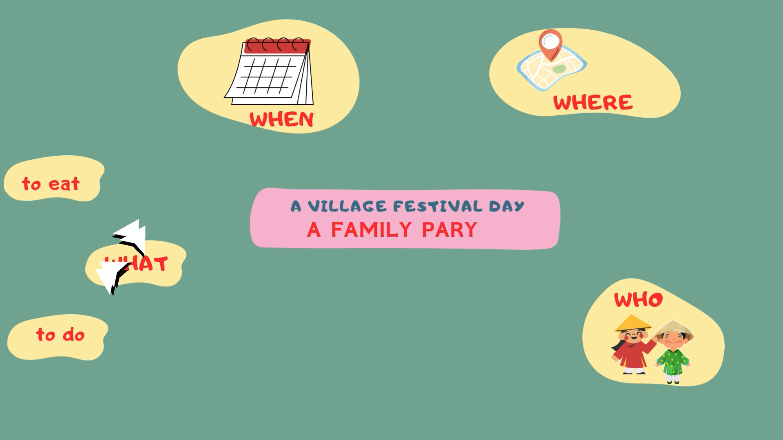

Slide 20
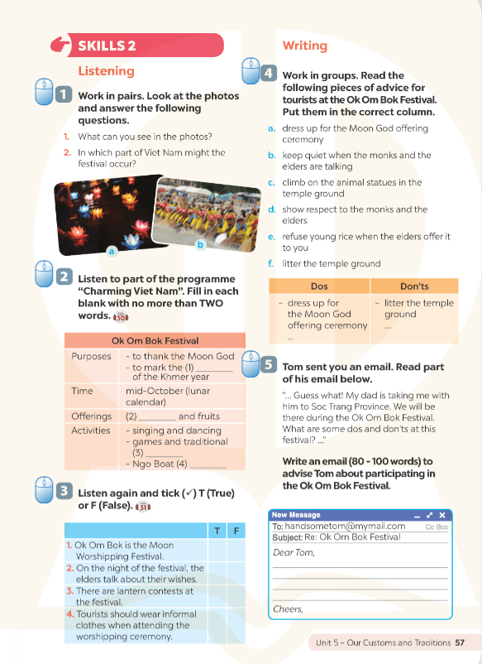
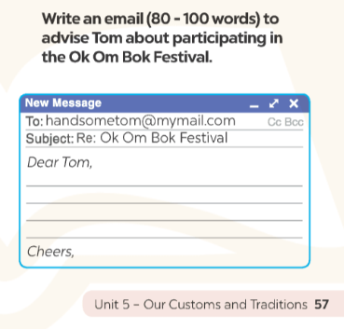

Slide 21
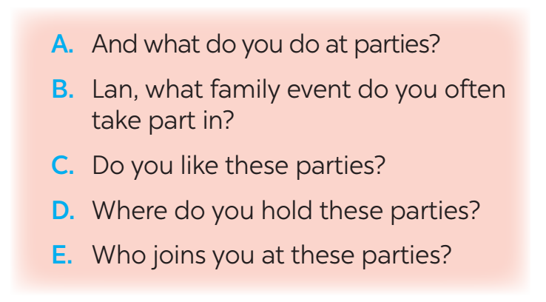
SPEAKING
4
Work in pairs. Put the questions (A - E) in the correct blanks (1 - 5) to make a complete dialogue. Then role-play it.
Nick: (1) ______
Lan: Well, I join birthday parties of all my family members.
Nick: (2) ______
Lan: In a Vietnamese restaurant. But sometimes we break with tradition by going to a Western one.
Nick: (3) ______
Lan: Everyone in my family.
Nick: (4) ______
Lan: Well, the birthday person opens the gifts. and everyone has some good food.
Nick: (5) ______
Lan: Yes, I always look forward to them. They are a great time for family bonding.

Slide 22
SPEAKING
5
Make notes about a normal family event that you take part in. Use the questions below as cues.
1. What is the event?
2. Where and when does it happen?
3. Who joins with you?
4. What do you often do at that event?
5. Do you like it or not? Why or why not?
Full Moon Festival
Now work in pairs.
Make a dialogue asking and answering about the event. You can use your notes.
On the 15th day of the 8th Lunar Month in Asia
My family, my friends,…
Eat moon cake, hang lantern....
Yes, I do. Because I can celebrate it with my family.

Slide 23
CONSOLIDATION
1
Wrap-up
+ Reading:
Read for specific information about a village festival day.
+ Speaking:
Talk about a family event.

Slide 24

CONSOLIDATION
2
Homework
Do exercises in the workbook.

Slide 25

Website: hoclieu.vn
Fanpage: facebook.com/www.tienganhglobalsuccess.vn/

