Slide 1


Slide 3



Unit
3
HEALTHY LIVING FOR TEENS
LESSON 2: A CLOSER LOOK 1

Slide 4

VOCABULARY
achieve (v)
/əˈtʃiːv/
Notes:
Achieve (v) to succeed in reaching a particular goal, status or standard, especially by making an effort for a long time

Slide 5
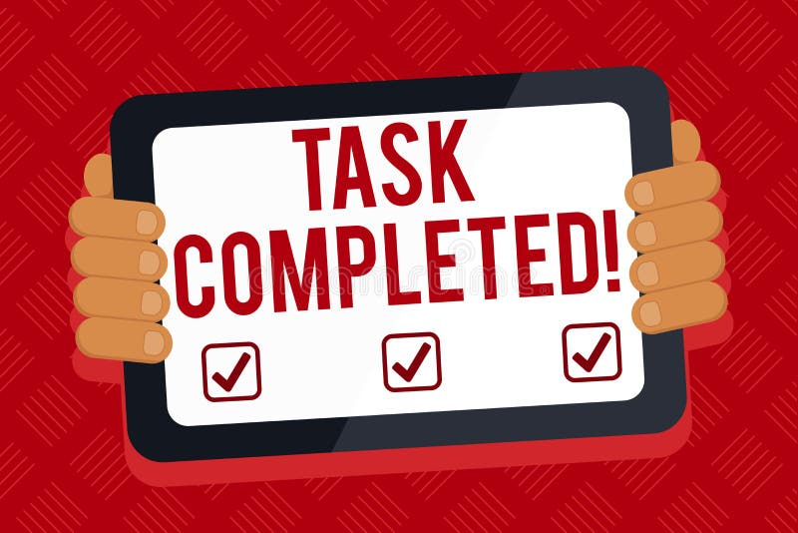
VOCABULARY
accomplish (v)
/əˈkɑːmplɪʃ/
Notes:
Accomplish (v): to succeed in doing or completing something

Slide 6

VOCABULARY
due date (n)
/ˈduː deɪt/
Notes:
Due date (n): the date by or on which something is expected, especially the payment of a bill or the birth of a baby

Slide 7

VOCABULARY
distraction (n)
/dɪˈstræk.ʃən/
Notes:
Distraction (n): a thing that takes your attention away from what you are doing or thinking about

Slide 8

VOCABULARY
optimistic
/ˌɒp.tɪˈmɪs.tɪk/
Notes:
Distraction (n): a thing that takes your attention away from what you are doing or thinking about

Slide 9

New words | Pronunciation | Meaning
1. achieve (v) | /əˈtʃiːv/ | đạt được
2. accomplish (v) | /əˈkɑːmplɪʃ/ | hoàn thành
3. due date (n) | /ˈduː deɪt/ | hạn chót
4. distraction (n) 5. optimistic | /dɪˈstrækʃn/ /ˌɒp.tɪˈmɪs.tɪk/ | điều gây xao lãng lạc quan

Slide 10
1
Circle the correct word or phrase to complete each sentence.
1. It’s always difficult for students to give / make priority to work, school, and family.
2. David works out at his home gym to maintain his mental / physical health.
3. Well-balanced / Badly balanced living is hard to achieve if you have many things to do.
4. Managing / Making time means organising and planning how to divide your time between different activities.
5. I tried to accomplish / get my goal of cycling five kilometres a day.

Slide 11
2
Match the words and phrases with their definitions.
a. the planned day and time that something is required to be completed
b. believing that good things will happen
c. too anxious and tired to be able to relax
d. things that stop you from paying attention to what you are doing
e. not to do somethinguntil a later time
* Keys
1. delay
1. e
2. a
3. b
4. c
5. d
2. due date
3. optimistic
4. stressed out
5. distractions

Slide 12
3
Complete the sentences with the words and phrases from 2.
1. I want to know the _________ for my history assignment.
2. I’m trying to go to bed earlier because I’m feeling _____________ at the moment.
3. He intended to ______ telling her the news, waiting for the right moment.
4. I’m ______________ about the result of the exam I took last week.
5. I prefer to study in the school library because there are too many ____________ at home.
due date
stressed out
delay
optimistic
distractions

Slide 13
Despite the challenges, he maintained an/a ….. outlook.
mental health
priority
optimistic
counsellor

Slide 14
Education is a/an ….. in our family.
mental health
priority
optimistic
counsellor

Slide 15
I need to submit my report before the …...
due date
delay
distractions
well-balance

Slide 16
She tried to relax, but couldn't shake off the feeling of being …..
due date
accomplish
stressed out
well-balance

Slide 17
How do you ….. to do so much work?
make
accomplish
manage
delay

Slide 18
The diet is ….., lacking in vitamins.
priority
healthy
maintaining
badly balanced

Slide 19
My team ….. the meeting
until next week
accomplished
delayed
maintained
balanced

Slide 20
The noise from the construction site was a major …..
due day
physical health
distraction
well- balanced

Slide 21
It is difficult to ….. anything without hard work.
accomplish
come down with
delay
get around

Slide 22
I made an appointment with a mental health ….. to discuss my anxiety.
electrician
firefighter
artisan
counsellor

Slide 23

PRONUNCIATION

Slide 24

4
Listen and repeat the words. Pay attention to the sounds /h/ and /r/.
/h/ | /r/
healthy happiness habit ahead perhaps | regularly really ready worrying several

Slide 25
PRONUNCIATION
5
Listen and practise the sentences. Pay attention to the bold words with /h/ and /r/.
1. Keep healthy by eating well and exercising regularly.
2. He usually does his homework and then reads a good book.
3. I’m ready to change my eating habits.
4. I finished several days ahead of the due date.
5. She’s always worrying about her physical health.

Slide 26
FURTHER PRACTICE
RULES:
Work in 2 teams.
T reads out word by word, one student will run to the board and slap on the correct word with the correct sound.
The team with more correct answers will be the winner.

Slide 27
FURTHER PRACTICE
hygiene
handicraft
pottery
preserve
role
happy
pricey
hand
fragrance
tourist
home
arround
free
Notes:
* Teacher should prepare these words to stick on the board.

Slide 28

CONSOLIDATION
List some phrases learned in the lesson.
List some other learned words / phrases related to students’ life and schoolwork.
Pronounce 2 sounds learned in the lessons and give examples.

Slide 29

Homework
Do exercises in the workbook.
Prepair lesson 3: A closer look 2

Slide 30
Thank you!
Have a nice day!

