Slide 1

Grade 2
Unit 1:
Is this your mom?

Slide 2
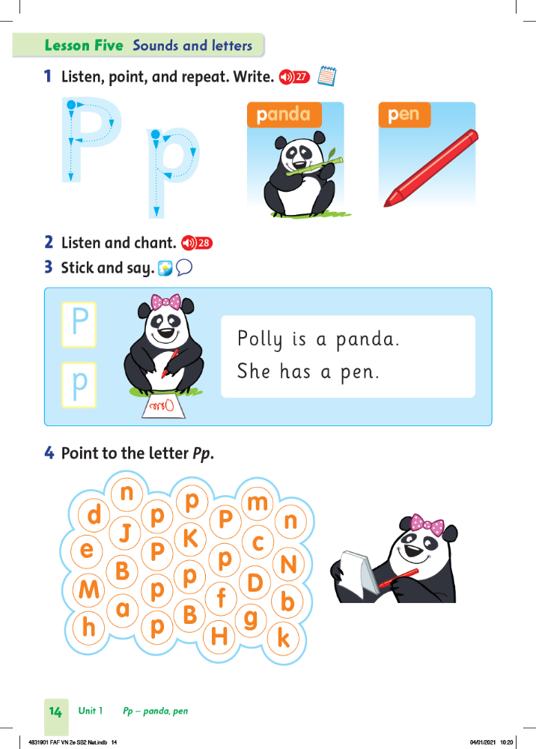
p
P
Underline the words with Pp:

Slide 3

1. Polly.
2. Pen.
3. Panda.

Slide 4

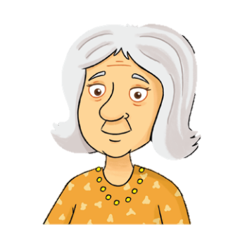
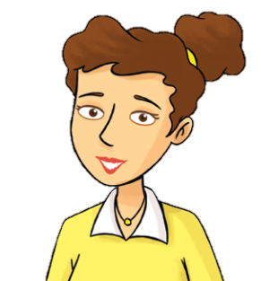

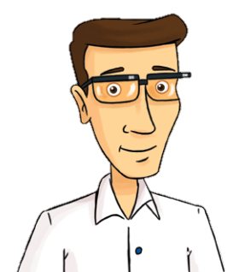
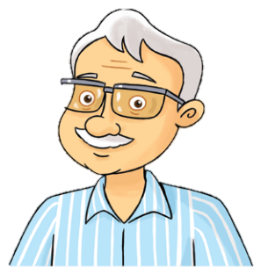
Look and say => This is my………
1. 2. 3.
4. 5 6.

Slide 5
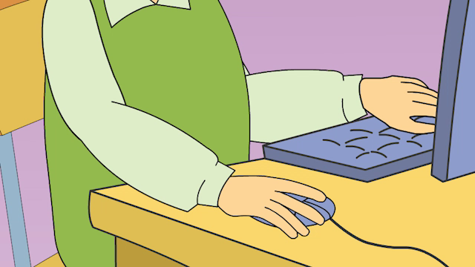
1. Watch a film

Slide 6
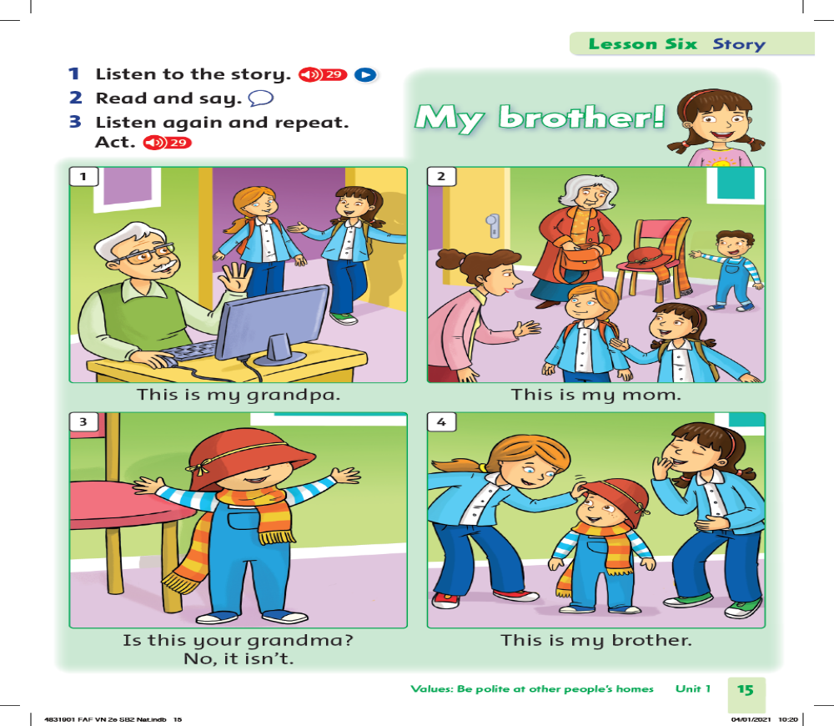

2. Read and say:

Slide 7
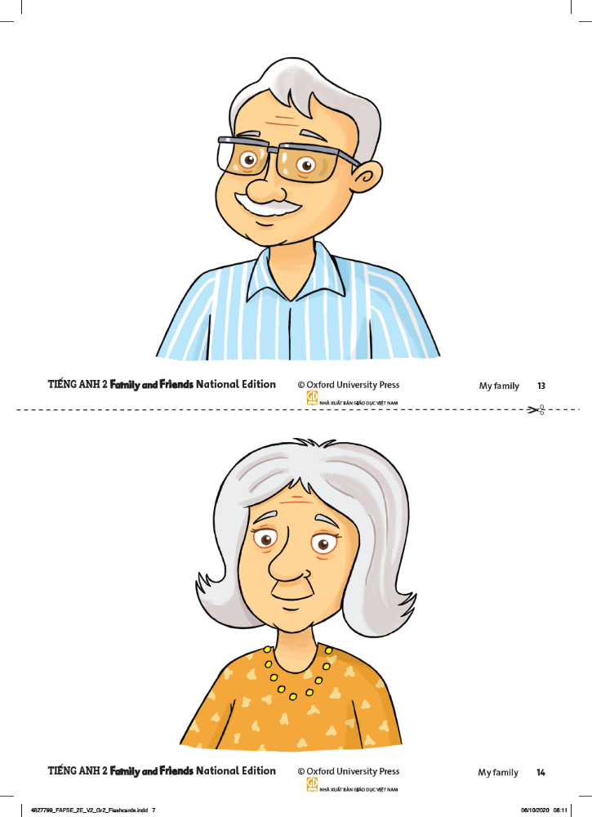
Is this your…………….?
grandma

Slide 8
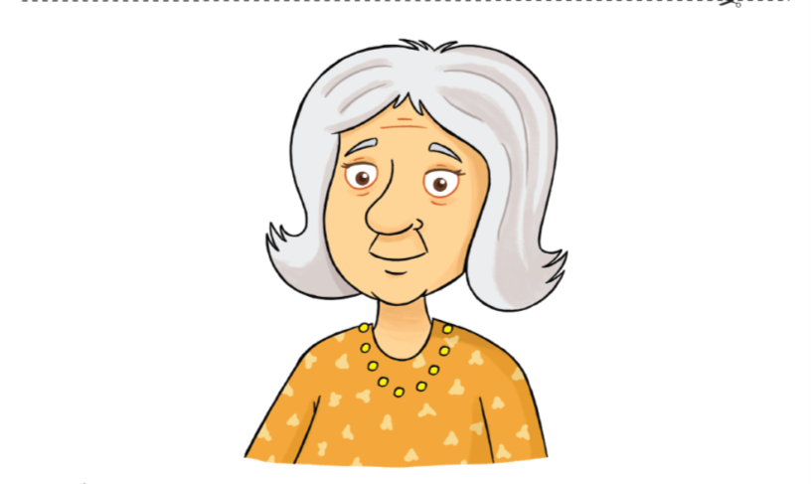
Is this your…………….?
grandma

Slide 9
3. Listen again and repeat:

Slide 10
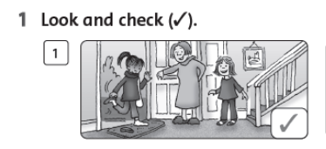
Is this girl polite?( Lịch sự)
✓

Slide 11
1. Is this your……..?=> Yes,…./ No,…..

Slide 12

Thank you for your watching!

