Slide 1


MATH
CHANH NGHIA PRIMARY SCHOOL
TEACHER’S NAME: LY NGOC MINH

Slide 2



Slide 3

Shapes

Slide 4


THE MAGIC BAG

Slide 5

Shapes

Slide 6

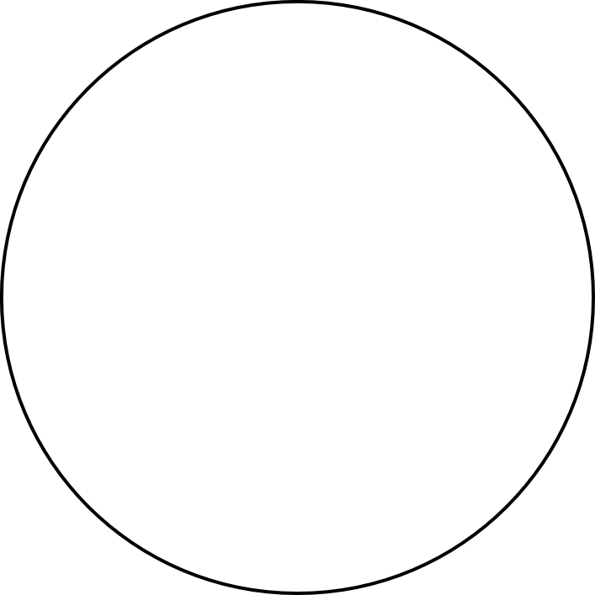


Slide 7
CIRCLE

Slide 8


TRIANGLE

Slide 9


SQUARE

Slide 10


RECTANGLE

Slide 11


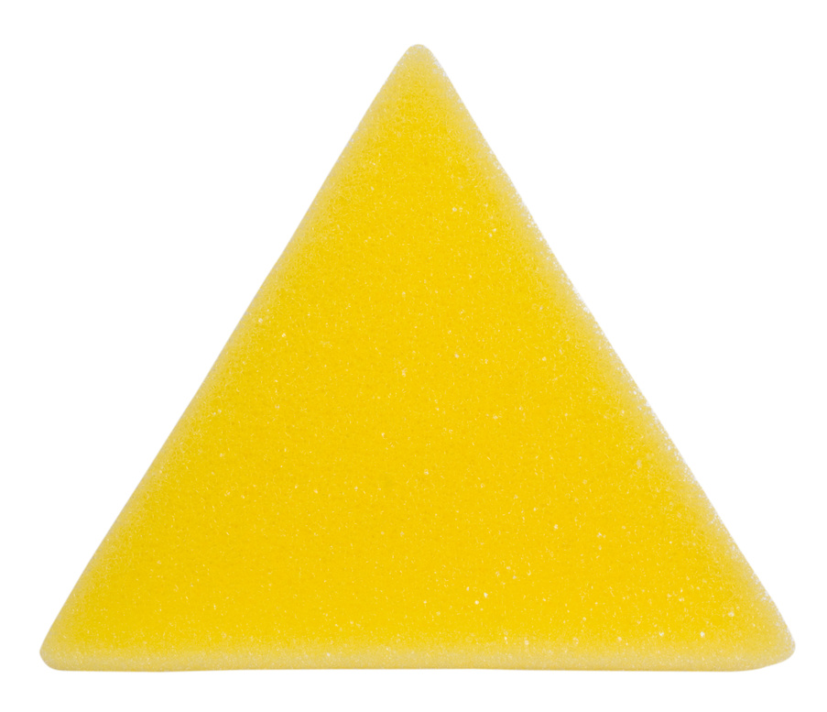


Slide 12
RECTANGLE

Slide 13
RECTANGLE
SQUARE

Slide 14
RECTANGLE
SQUARE
TRIANGLE

Slide 15
RECTANGLE
SQUARE
TRIANGLE
CIRCLE

Slide 16


Slide 17



Slide 18

REVIEW
GROUP

Slide 19
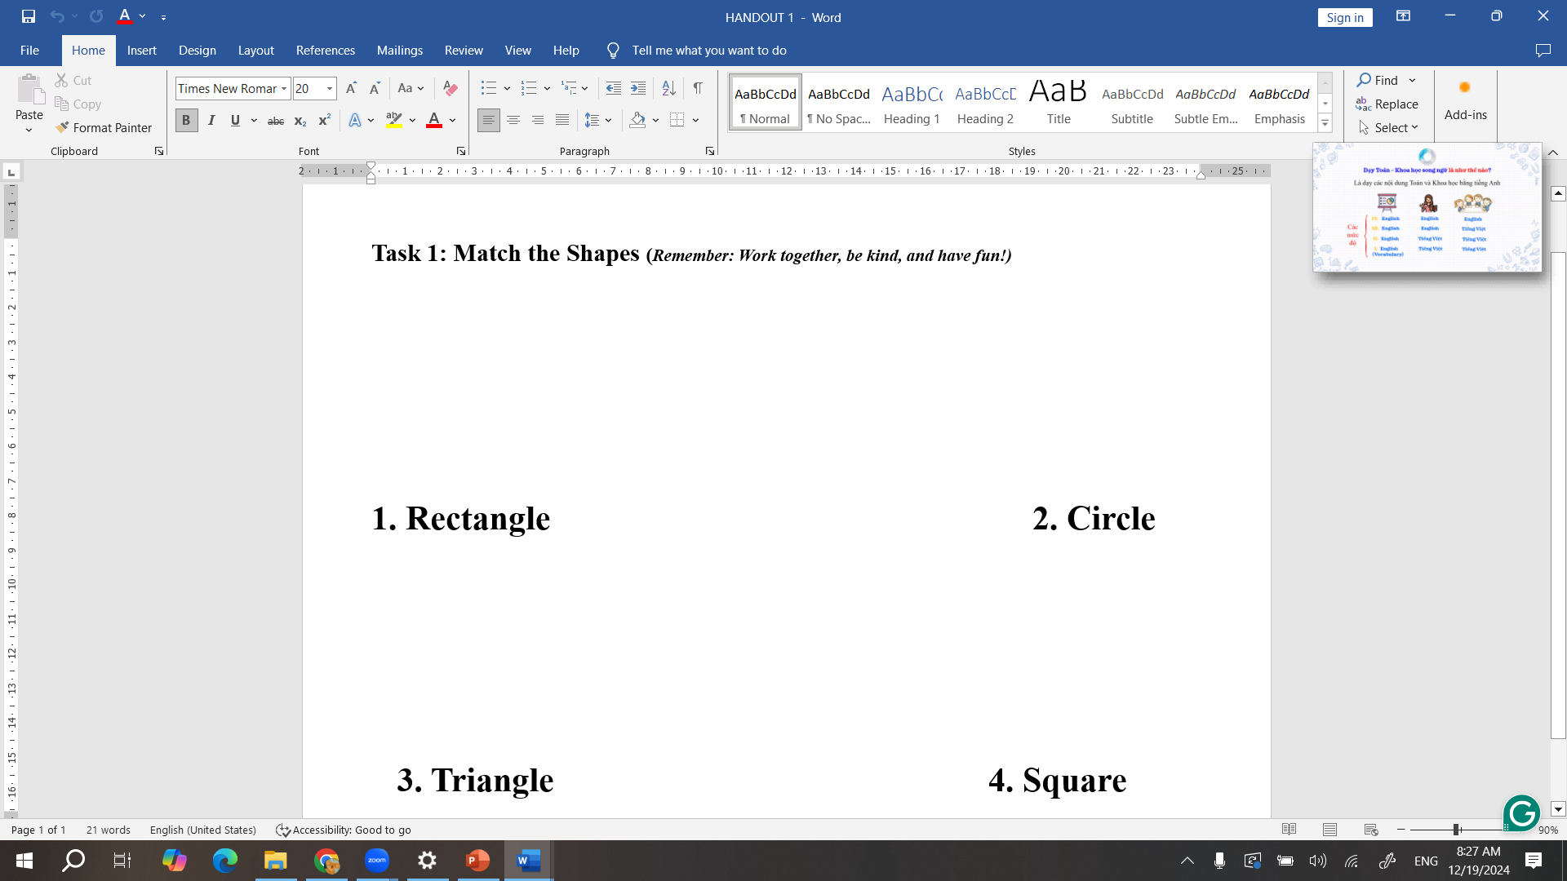

Slide 20


Slide 21


Slide 22


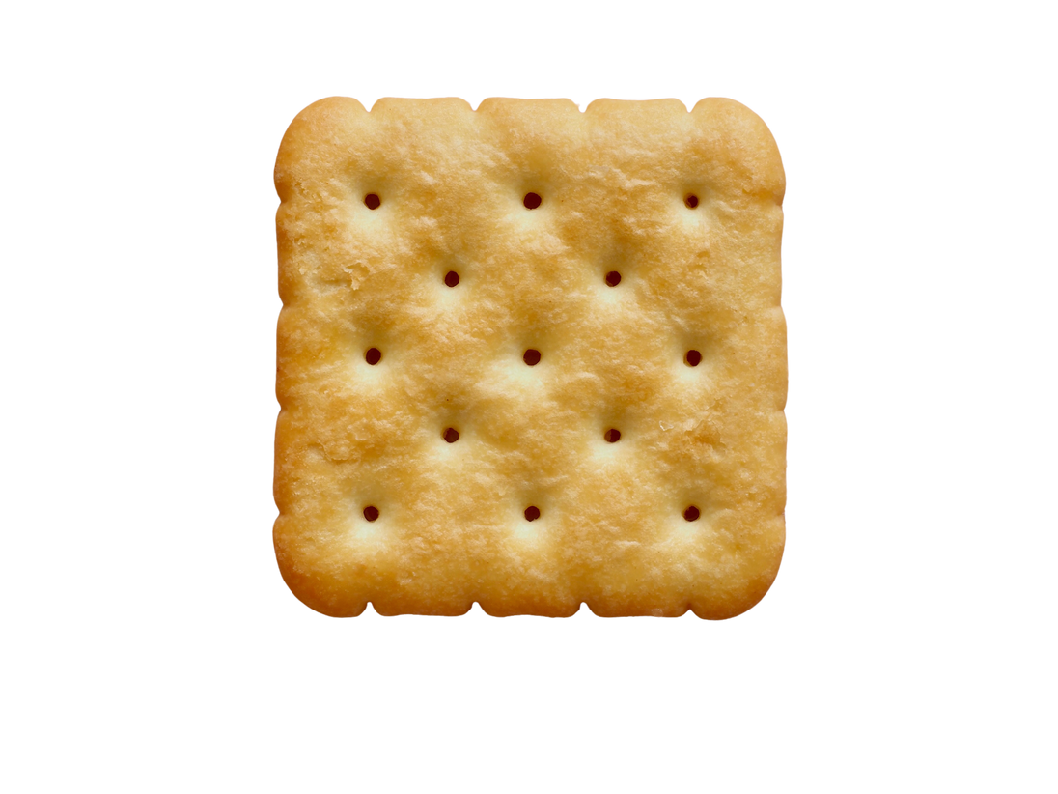

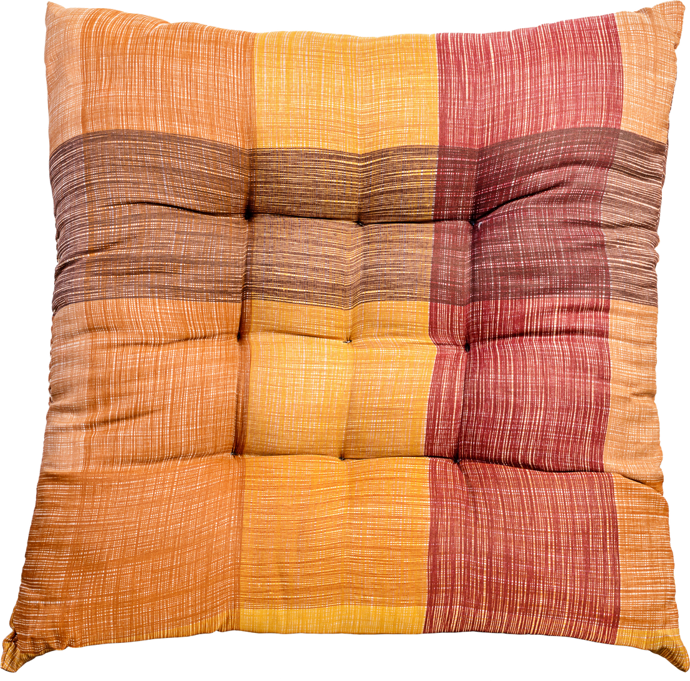
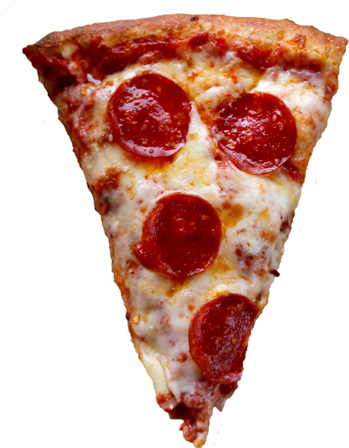
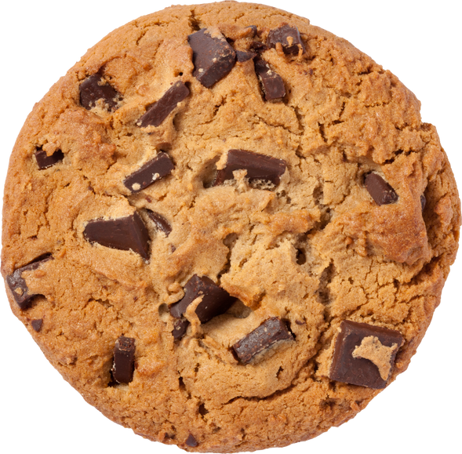

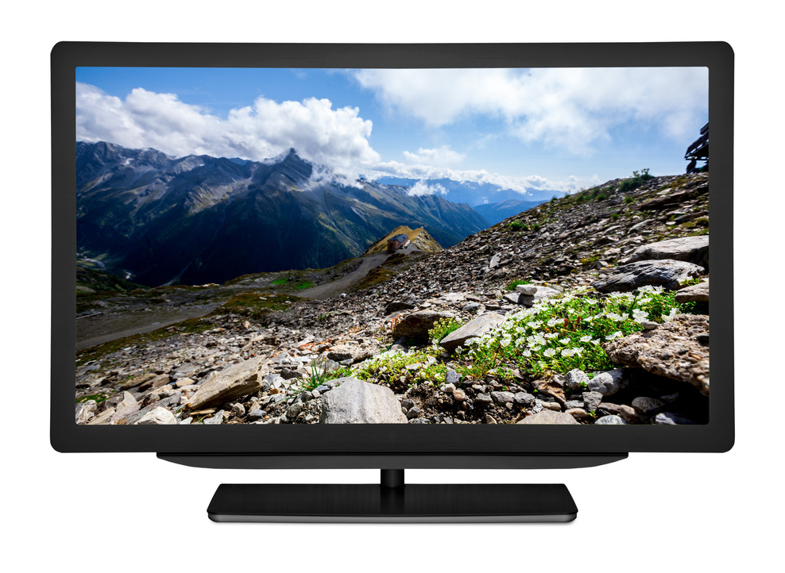
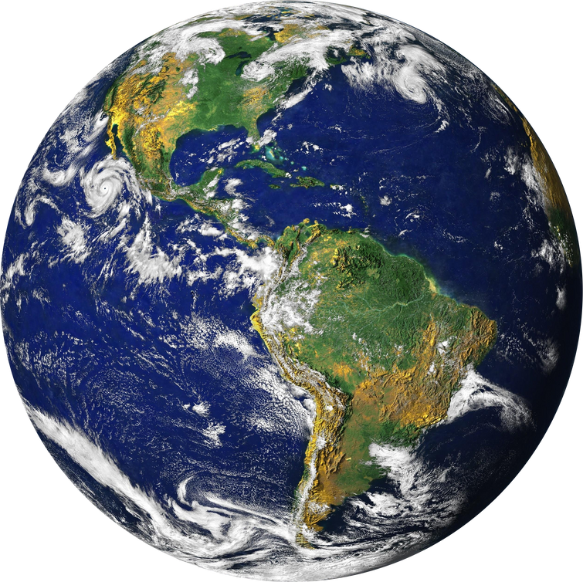

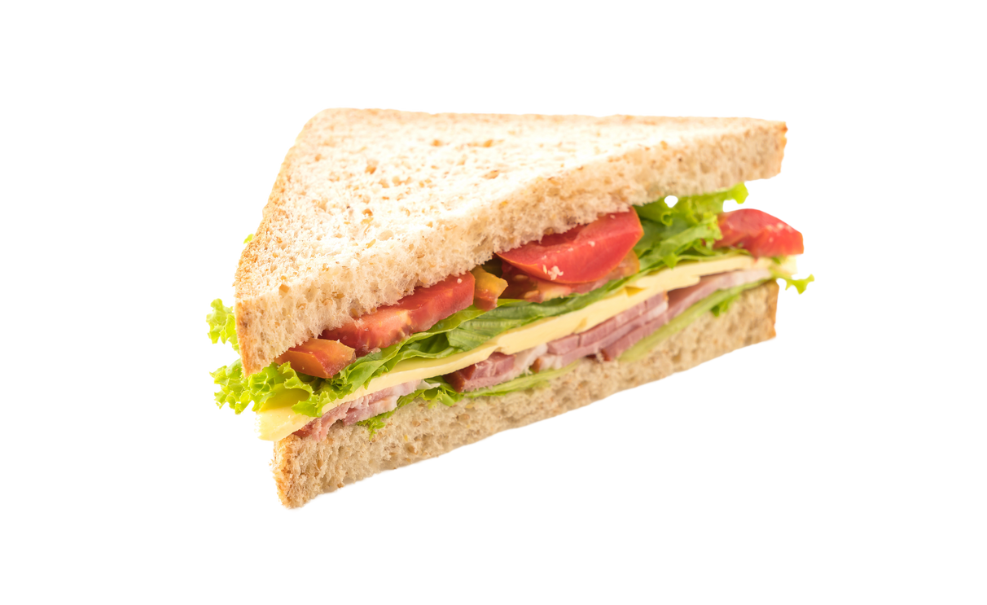

Slide 23
3 TRIANGLES

Slide 25
2 SQUARES

Slide 27
4 RECTaNGLES

Slide 29
3 CIRCLES

Slide 30



Slide 33


Slide 34
REVIEW
THANK YOU!

