Slide 1

Unit 6
The Ancient Mayans

Slide 2
Lesson 2
Page 43

Slide 3
Content
1
Warm Up
2
Practice
3
Review game

Slide 4
1
Warm Up

Slide 5


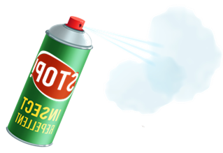



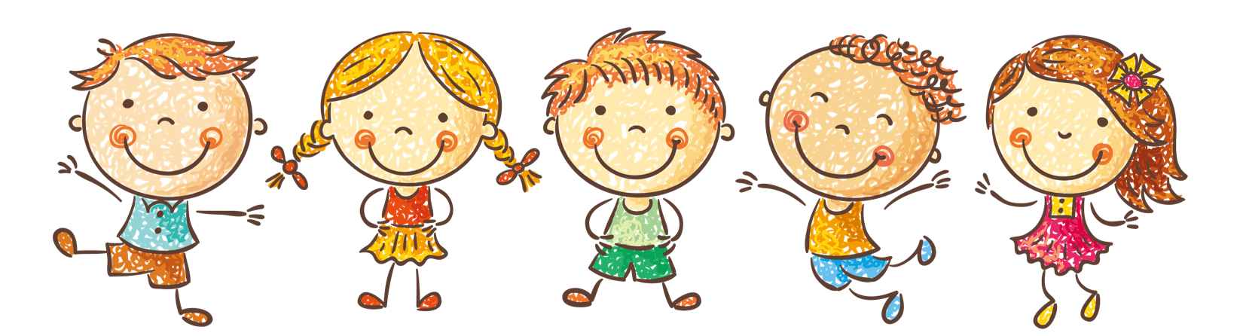
Thanh Yen Tran 0967 255 149 /081 811 4340 zalo / FB https://www.facebook.com/thanhyentrananhngutaymy
END
Thanh Yen Tran 0967 255 149 /081 811 4340 zalo / FB https://www.facebook.com/thanhyentrananhngutaymy
Thanh Yen Tran 0967 255 149 /081 811 4340 zalo / FB https://www.facebook.com/thanhyentrananhngutaymy
Thanh Yen Tran 0967 255 149 /081 811 4340 zalo / FB https://www.facebook.com/thanhyentrananhngutaymy
Notes:
Thanh Yến Trần 0967 255 149 / 081 811 4340 zalo/ FB https://www.facebook.com/thanhyentrananhngutaymy

Slide 6
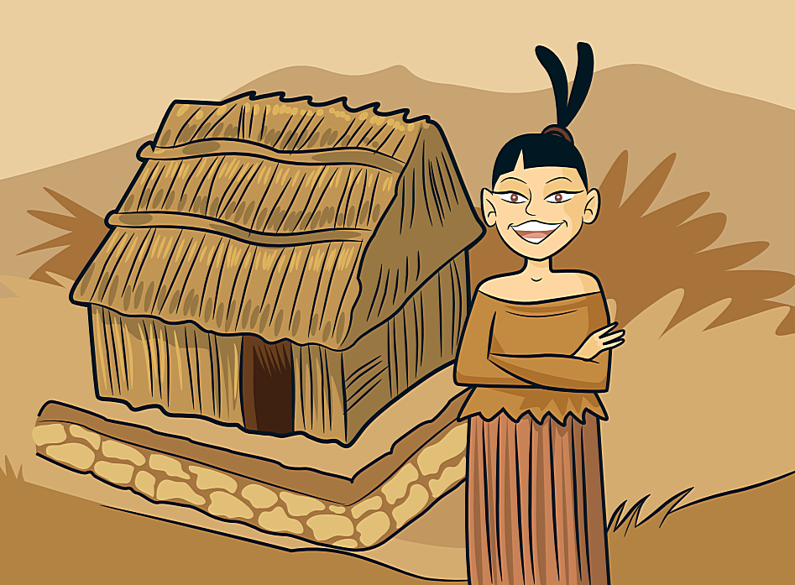
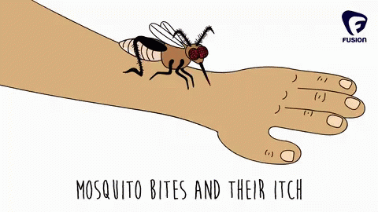



Thanh Yen Tran 0967 255 149 /081 811 4340 zalo / FB https://www.facebook.com/thanhyentrananhngutaymy
Look and choose
Thanh Yen Tran 0967 255 149 /081 811 4340 zalo / FB https://www.facebook.com/thanhyentrananhngutaymy
a. hate
c. love
Thanh Yen Tran 0967 255 149 /081 811 4340 zalo / FB https://www.facebook.com/thanhyentrananhngutaymy
b. live
d. start
Thanh Yen Tran 0967 255 149 /081 811 4340 zalo / FB https://www.facebook.com/thanhyentrananhngutaymy

Slide 7

Listen and choose
a. finish
c. start
b. want
d. use

Slide 8
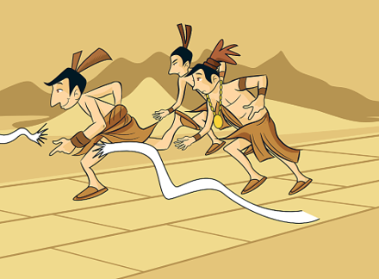
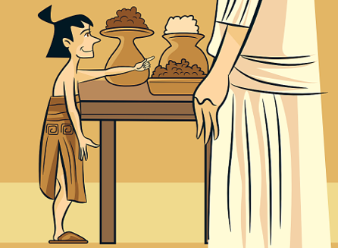
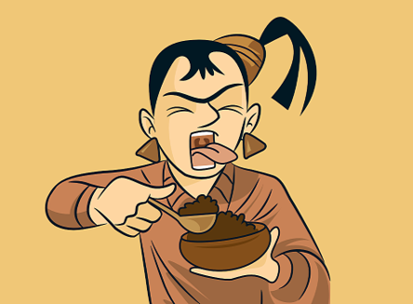
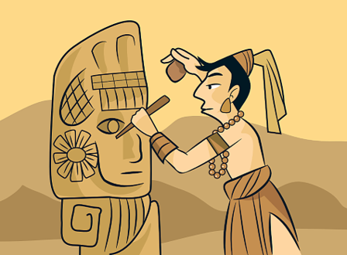
Look and choose
finish
a.
c.
b.
d.

Slide 9
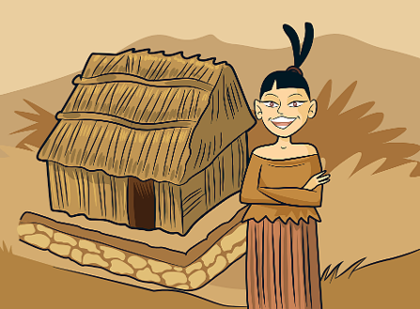
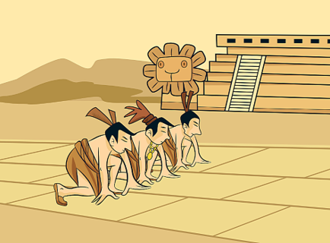
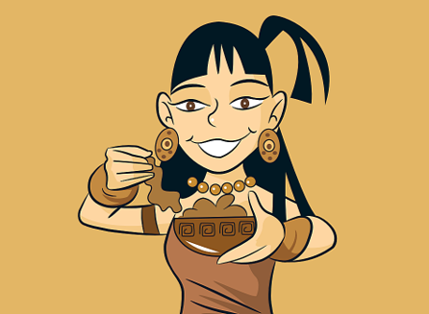
Listen and choose
a.
c.
b.
d.
Notes:
Thanh Yến Trần 0967 255 149 / 081 811 4340 zalo/ FB https://www.facebook.com/thanhyentrananhngutaymy

Slide 10
Reorder
t-h-a-e
a. teha
b. thae
c. hate
d. heta
Notes:
Thanh Yến Trần 0967 255 149 / 081 811 4340 zalo/ FB https://www.facebook.com/thanhyentrananhngutaymy

Slide 11
Fill the missing letter
__ant
1. s
2. w
3. f
4. l

Slide 12
Listen and choose
a. love
b. want
c. start
d. cook

Slide 13
Look and choose
a. start
C. use
b. want
d. live
Notes:
Thanh Yến Trần 0967 255 149 / 081 811 4340 zalo/ FB https://www.facebook.com/thanhyentrananhngutaymy

Slide 14
2
Practice

Slide 15
1.
Listen to the story and repeat.

Slide 16
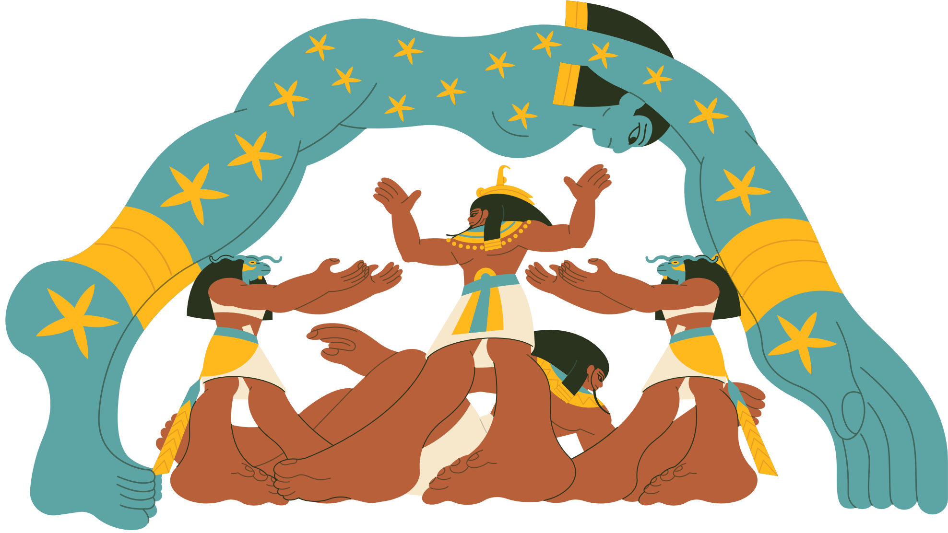
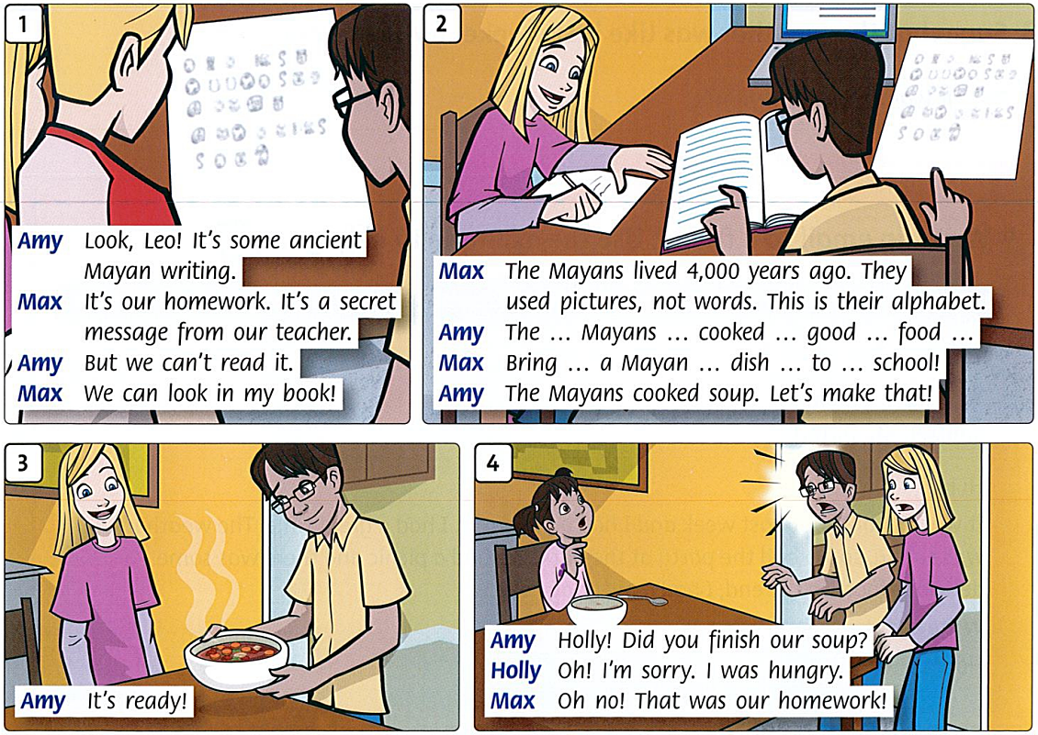
df
1. Listen to the story and repeat.

Slide 17
2.
Listen and say.

Slide 18
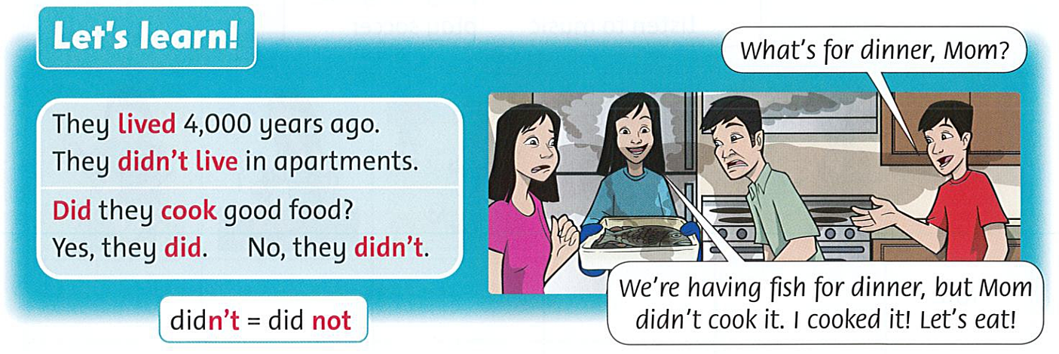
2. Listen and say.

Slide 19
3
Review game

Slide 20

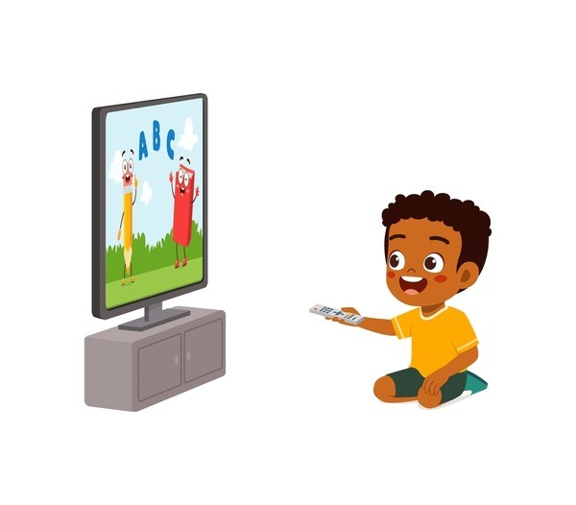



I ………….. TV last night.
b. didn’t watch
c.
watched
a.
watch
Next
Click on the “hot air balloon” to check the answer.
Ask the whole class to say aloud 3 words.

Slide 21
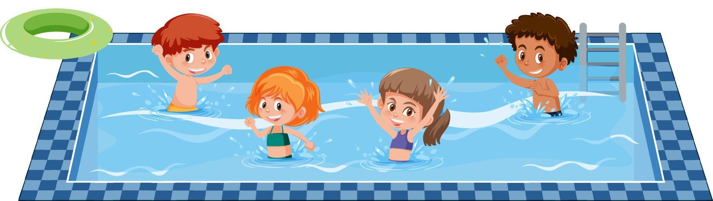
Did they go to
the swimming pool?
B.
No, they didn’t.
A.
Yes, they do.
C.
Yes, they did.
Next
Click on the “hot air balloon” to check the answer.
Ask the whole class to say aloud 3 words.

Slide 22
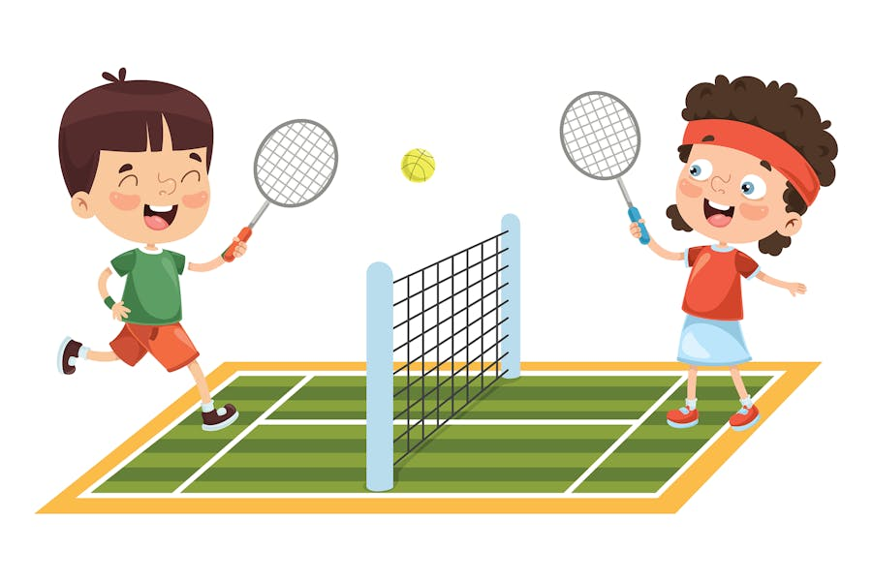

They ……………… yesterday.
B.
didn’t play tennis
A.
played tennis
C.
play tennis
Next

Slide 23
My grandfather ______ (phone) me
last morning .
A.
phone
C.
phones
B.
phoned
Next

Slide 24
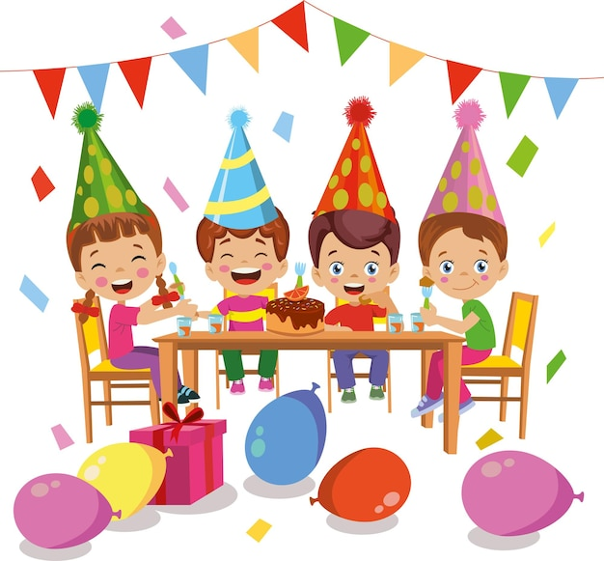
Did they have a great party?
B.
Yes, they do.
A.
No, they didn’t.
C.
Yes, they did.
Next
Notes:
Thanh Yen Tran 0967 255 149 /081 811 4340 zalo / FB https://www.facebook.com/thanhyentrananhngutaymy

Slide 25
We …………… (visit) two days ago.
C.
visits our grandma
A.
didn’t visit our grandma
B.
are visiting our grandma
Next

Slide 26
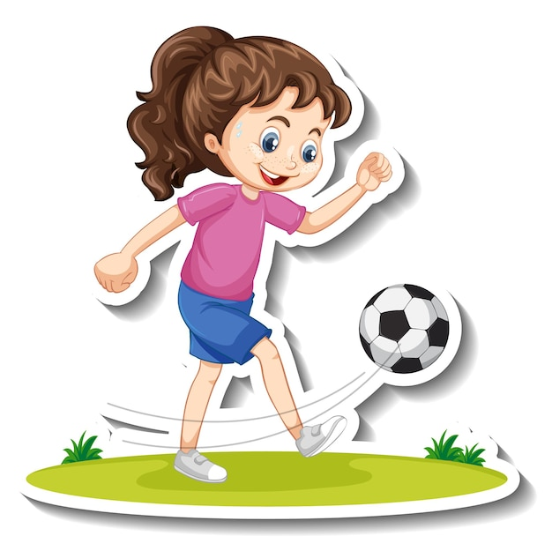
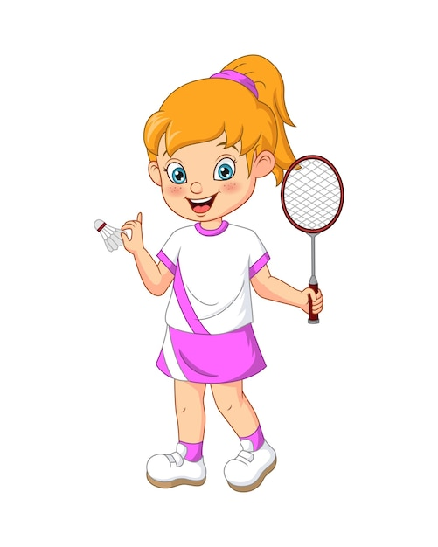
She _____soccer last Sunday.
She____ badminton.
A.
doesn’t play - plays
C.
played - didn’t play
B.
didn’t play
- played
Next

Slide 27
He …………(not play) football last Sunday.
B.
didn’t play
A.
doesn’t play
C.
don’t play
Next

Slide 28
____they ___(cook) dinner last weekend?
→ No, they ___.
B.
Did - cook - didn’t
A.
Do - cooked - don’t
C.
Did - cooked - did
Next

Slide 29
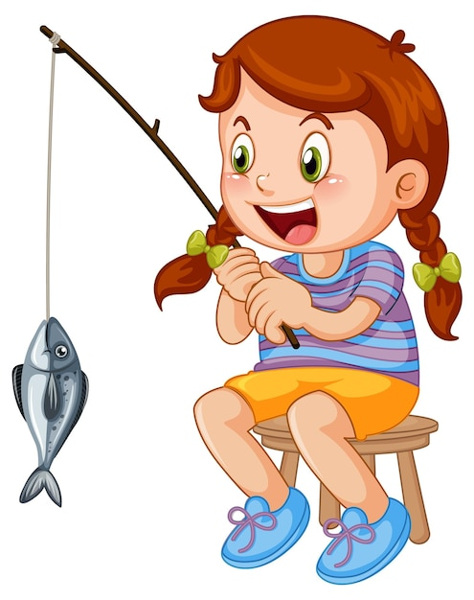
She …………………… last weekend.
B.
didn’t fished
C.
didn’t fish
A.
fished
Next
Notes:
Thanh Yen Tran 0967 255 149 /081 811 4340 zalo / FB https://www.facebook.com/thanhyentrananhngutaymy

Slide 30
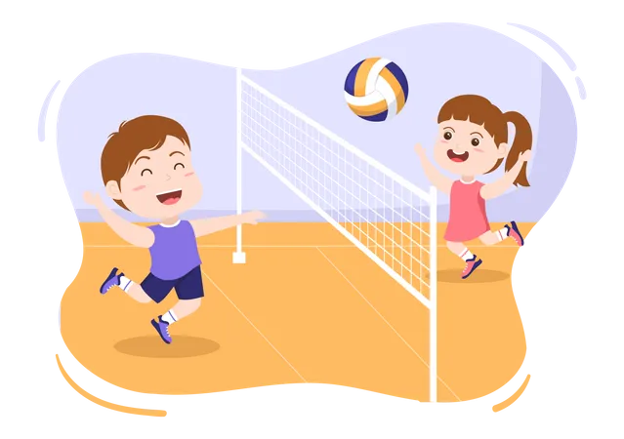
I ……… volleyball last Friday.
A.
play
B.
didn’t play
C.
played
Next

Slide 31
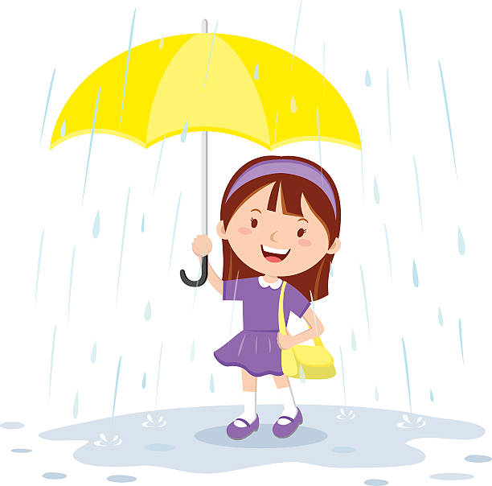
Look and choose
She ……………… her umbrella
last Monday.
A.
used
C.
doesn’t use
B.
didn’t use
Next

Slide 32
Amy ……………(visit) her family last month.
C.
visited
A.
is visiting
B.
visits
Next

Slide 33
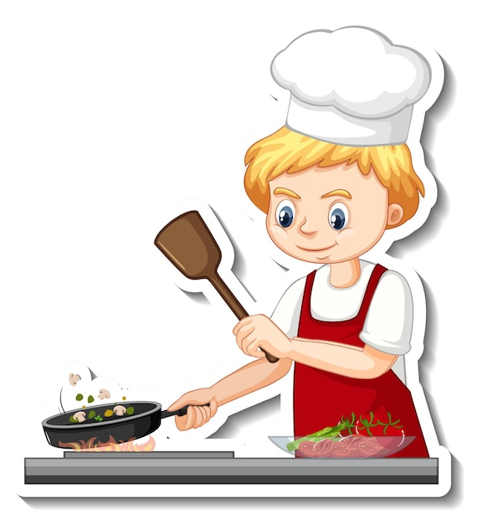
He _______dinner for his family
last night.
A.
cooked
B.
didn’t cook
C.
cooks
Next

Slide 34
I ________ to the roof when I was child.
A.
climbed
B.
phoned
C.
cooked
Next

Slide 35
My sister ______(dance) at a party
two days ago.
B.
dance
A.
danced
C.
dances
Next

Slide 36
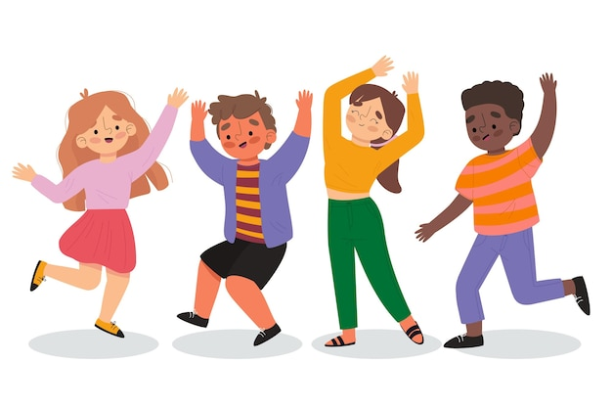
Did they ___ at the party?
→ No, they ____.
A.
dance - didn’t
C.
dance - don’t
B.
danced - didn’t
Next

Slide 37
Complete the sentence
______(they/listen) to music last night?
B.
Did they watch
C.
They did watch
A.
They watched
Next

Slide 38




Great job!
End

Slide 39
3.
Look, read, and circle.

Slide 40

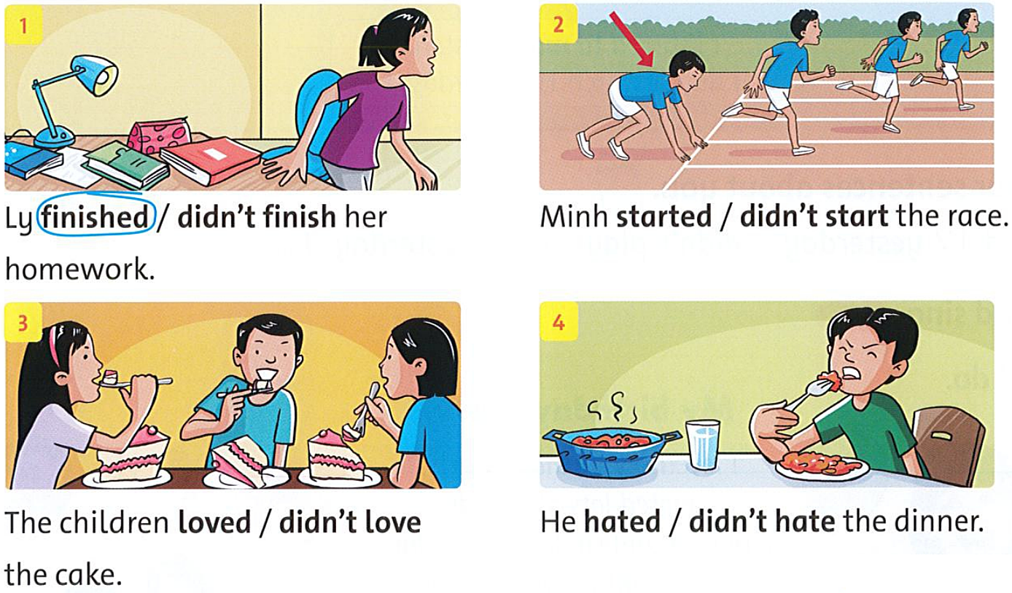
3. Look, read, and circle.

Slide 41
4.
Read the story again and answer the questions.

Slide 42
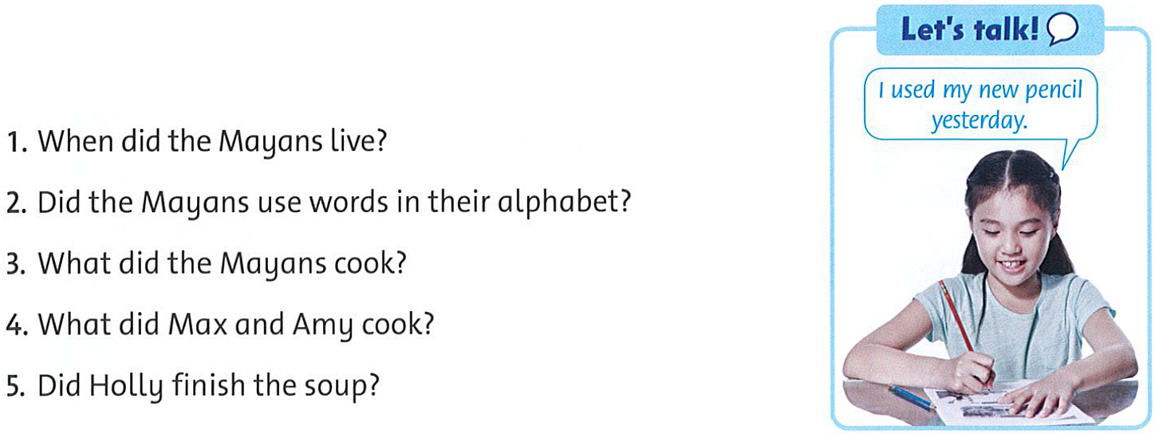
4. Read the story again and answer the questions.
1. They lived 2,000 years ago.

Slide 43
4. Read the story again and answer the questions.
2. No, they didn’t. They used pictures.

Slide 44
4. Read the story again and answer the questions.
3. They cooked soup / good food.

Slide 45
4. Read the story again and answer the questions.
4. They cooked soup.

Slide 46
4. Read the story again and answer the questions.
5. Yes, she did.

Slide 47

Goodbye

