Slide 1

UNIT 6
I HAVE A NEW FRIEND
GRADE 3
LESSON 1

Slide 2

LET’S SING

Slide 3
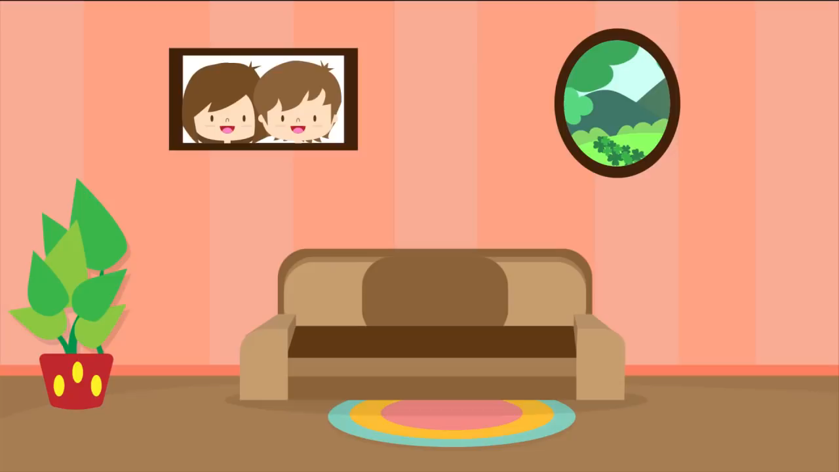


Slide 4







Give Me Five
Notes:
Class Rules

Slide 5

Puzzle Time
Notes:
Students work in groups to do a puzzle.

Slide 6
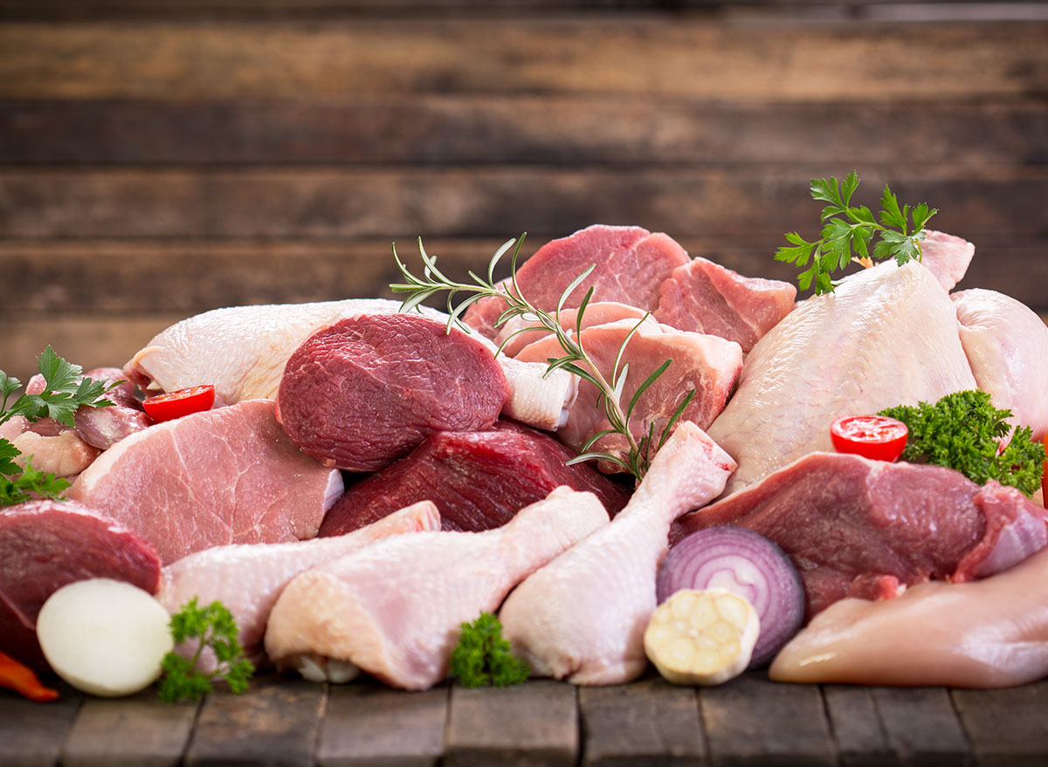
Notes:
Chấp nhận câu trả lời bằng tiếng Việt của HS
MEAT

Slide 7
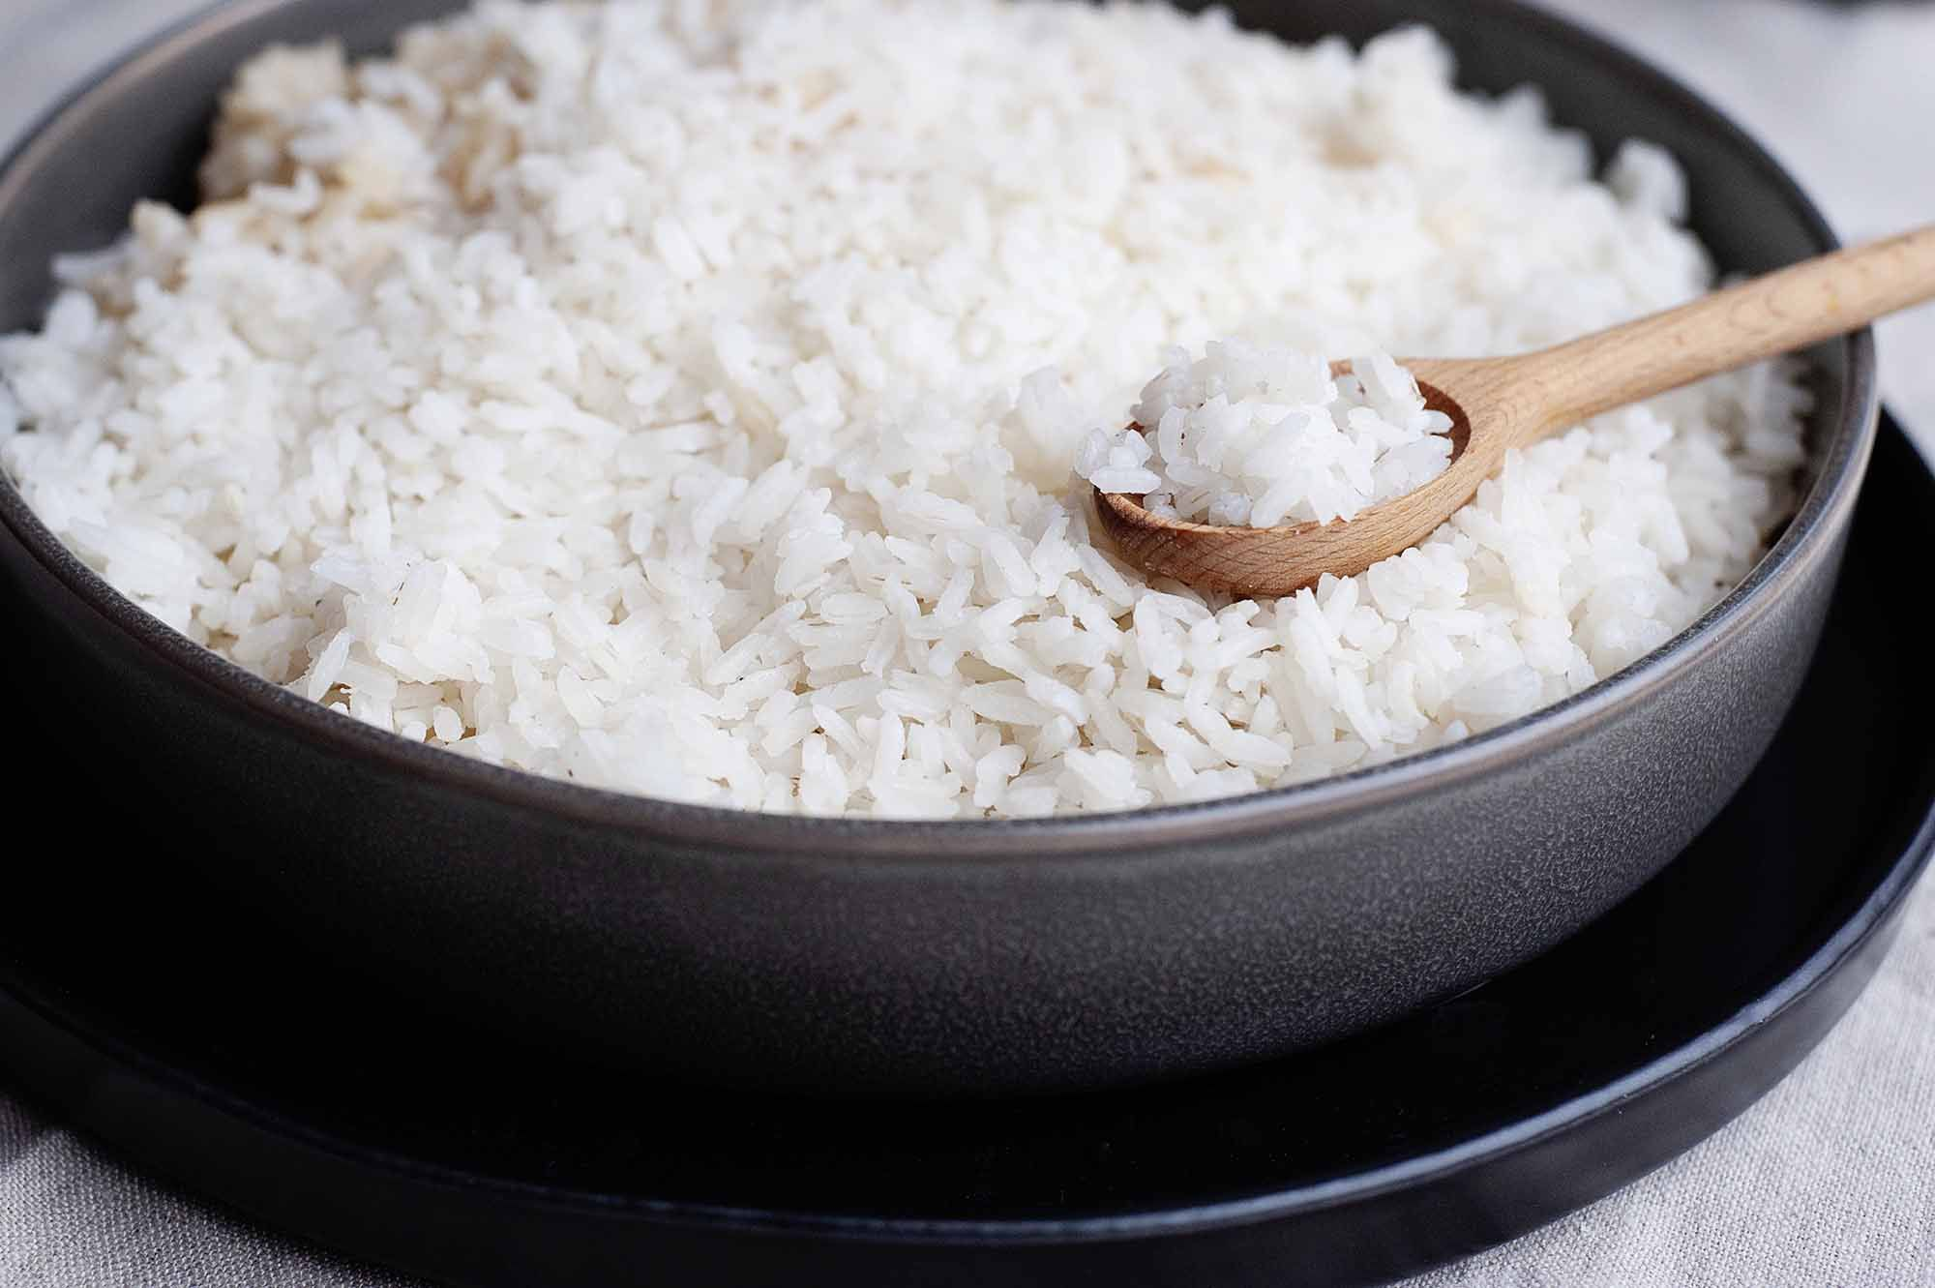
Notes:
RICE

Slide 8
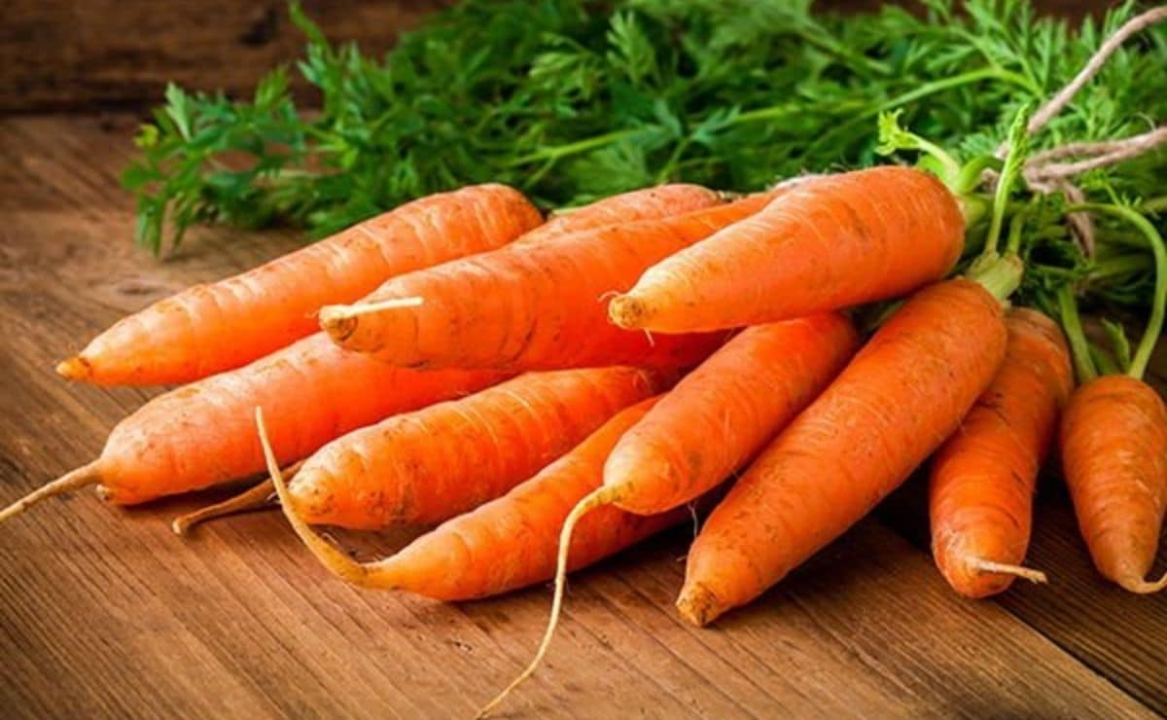
Notes:
CARROTS

Slide 9

Notes:
YOGURT

Slide 10
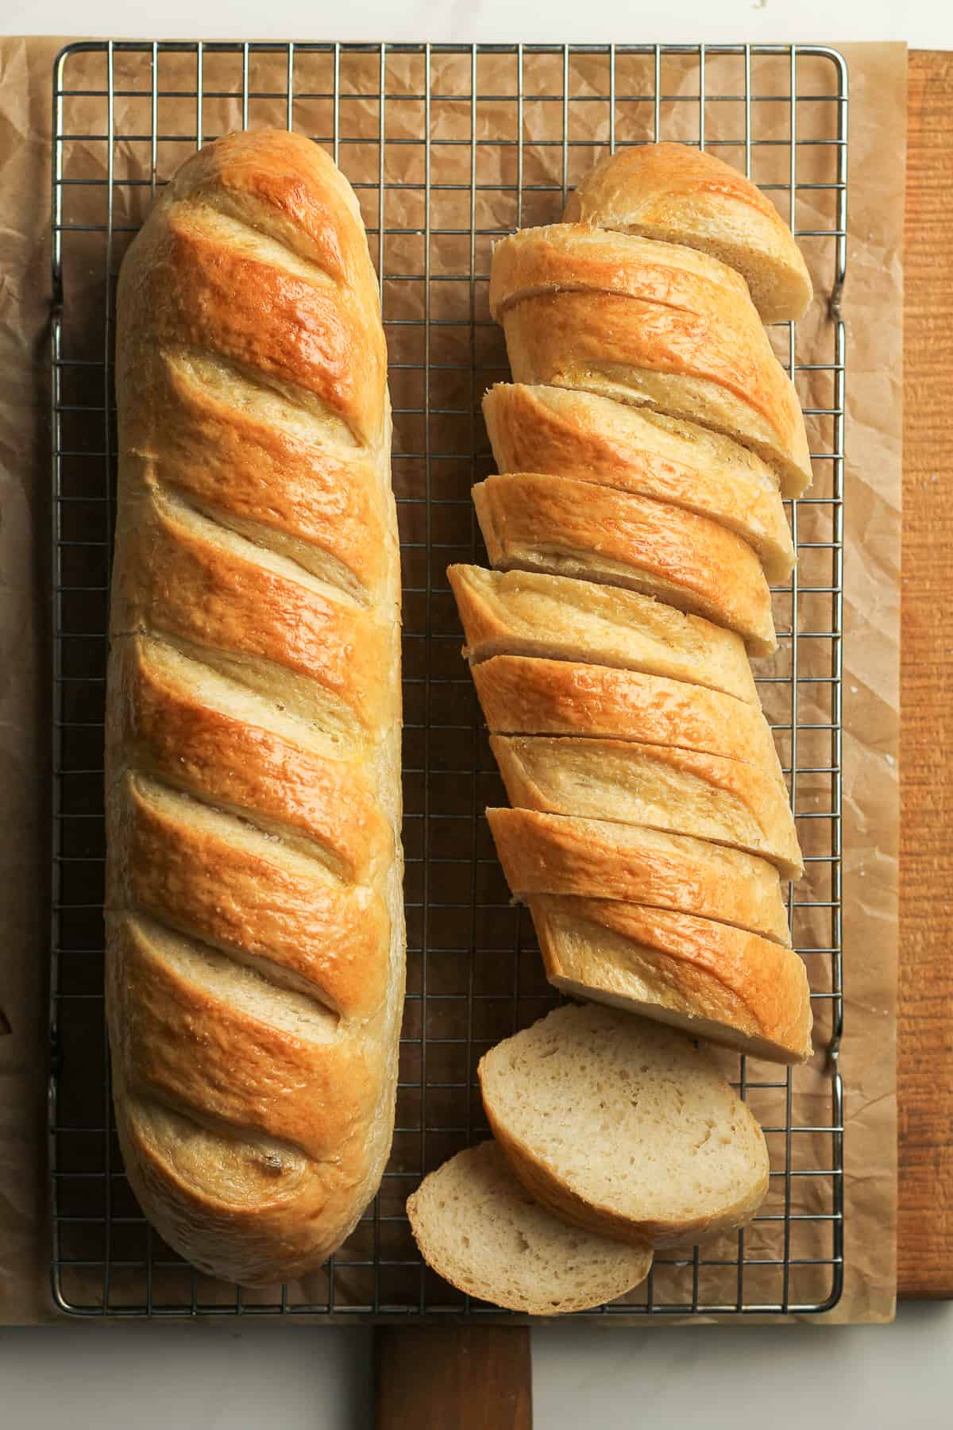
Notes:
BREAD

Slide 11
UNIT 6
I HAVE A NEW FRIEND
GRADE 3
LESSON 1

Slide 12

LISTEN AND POINT

Slide 13


Slide 14

LISTEN AND REPEAT

Slide 16



Game time

Slide 17

long

Slide 18


curly

Slide 19


black

Slide 20


short

Slide 21
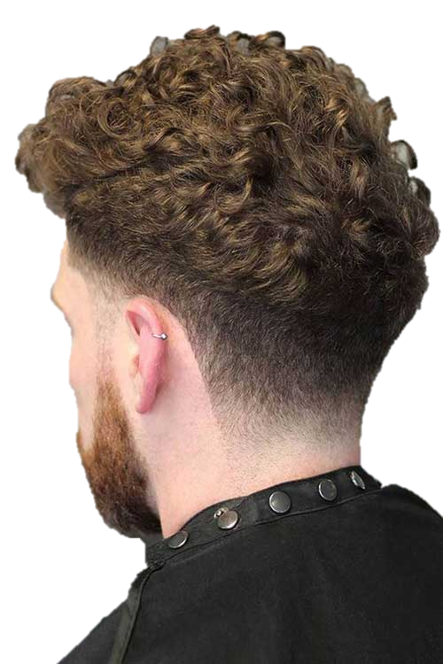

straight

Slide 22
LISTEN AND POINT

Slide 23
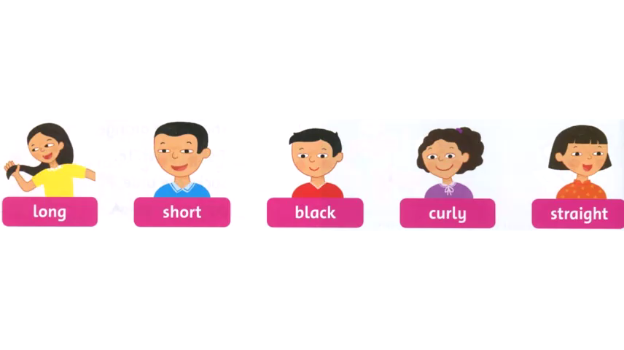

Slide 24

LET’S
CHANT

Slide 26

TASK
Work in group of 5
Chant and do

Slide 27

Workbook time
This Photo by Unknown Author is licensed under CC BY-NC-ND

Slide 28


It’s time to say GOODBYE

