Slide 1

Unit 9
WHAT TIME IS IT ?
Lesson 4: Phonics

Slide 2

Warm Up

Slide 3

CONTENTS OF THIS TEMPLATE
Here’s what you’ll find in this Slidesgo template:
A slide structure based on a multi-purpose educational presentation, which you can easily adapt to your needs. For more info on how to edit the template, please visit Slidesgo School or read our FAQs.
An assortment of pictures that are suitable for use in the presentation can be found in the alternative resources slide.
A thanks slide, which you must keep so that proper credits for our design are given.
A resources slide, where you’ll find links to all the elements used in the template.
Instructions for use.
Final slides with:
The fonts and colors used in the template.
A selection of illustrations. You can also customize and animate them as you wish with the online editor. Visit Stories by Freepik to find more.
More infographic resources, whose size and color can be edited.
Sets of customizable icons of the following themes: general, business, avatar, creative process, education, help & support, medical, nature, performing arts, SEO & marketing, and teamwork.
You can delete this slide when you’re done editing the presentation.

Slide 4
1.
Listen, point and repeat.

Slide 5



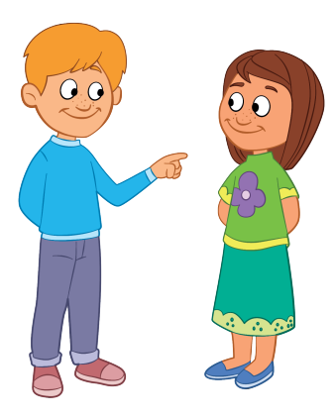
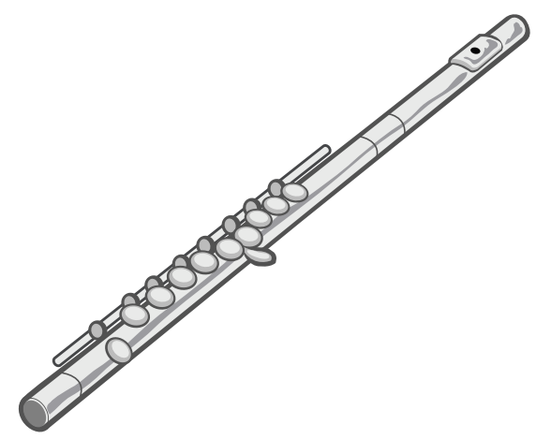

Slide 6

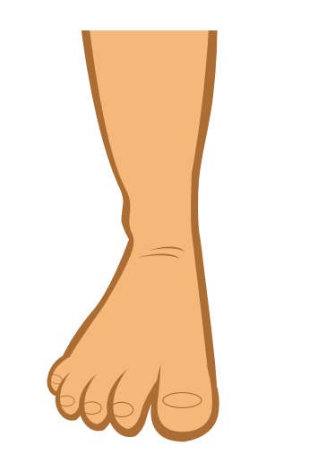
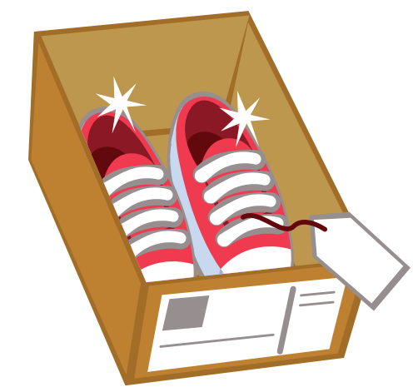


Slide 7
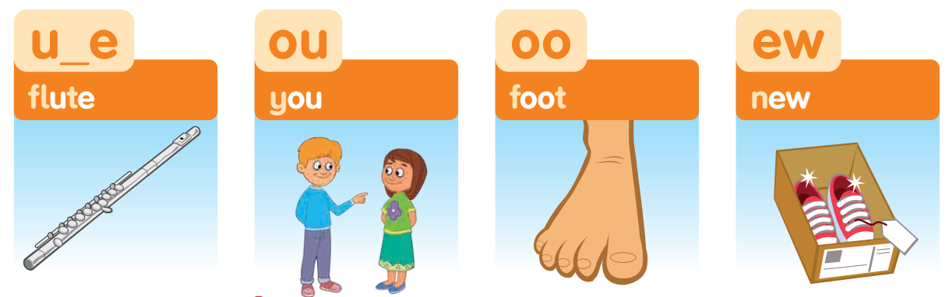

Slide 8
Review

Slide 9




BOMSTAR
PLAY

Slide 10









10
10
10
20
20
10

Slide 11



Unscramble
U-F-E-L-T
Back
a. fluet
b. fletu
c. flute

Slide 12



Find the picture with "oo" sound
Back
b.
c.
a.

Slide 13
Listen and choose
the sound "ew"
Back
Back
a.
b.
c.

Slide 14
Choose the suitable word.
Back
a. food
b. foot
c. cook

Slide 15
Chose the word begin with
sound U_E.
Back
Back
b. foot
c. new
a. flute

Slide 16
Listen and choose
Back
Back
b. cook
c. blouse
a. you

Slide 17
Uncramble
O-C-O-K
Back
Back
a. bock
b. kcoo
c. cook

Slide 18
Choose the word with sound "ew"
Back
Back
a. wet
b. new
c. flute

Slide 19
2.
Listen and chant.

Slide 20
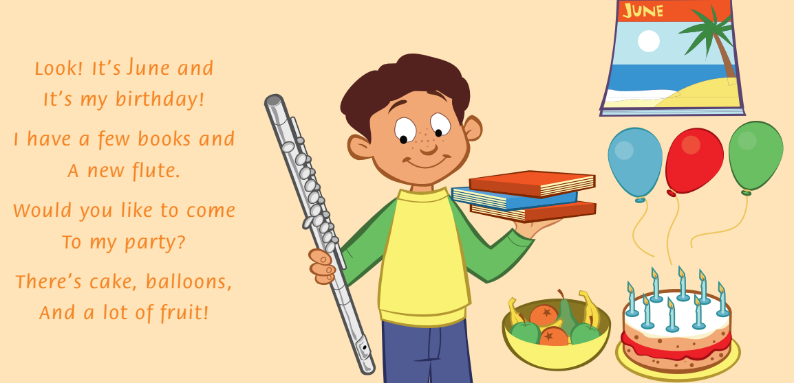

Slide 21
3.
Read the chant again.
Say the words with u_e, ew, ou, and oo. Write.

Slide 22
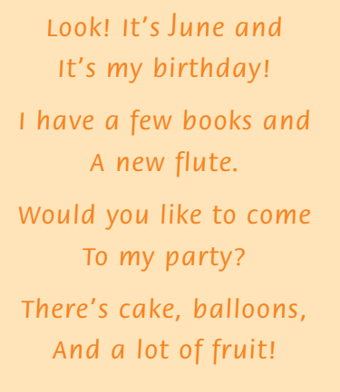



Slide 23
4.
Look ,match and say.

Slide 24
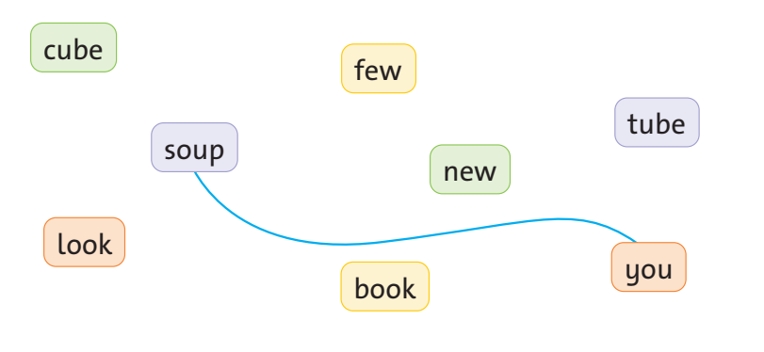

Slide 25


