Slide 1
Unit 5
GRADE 1
This is my nose!

Slide 2
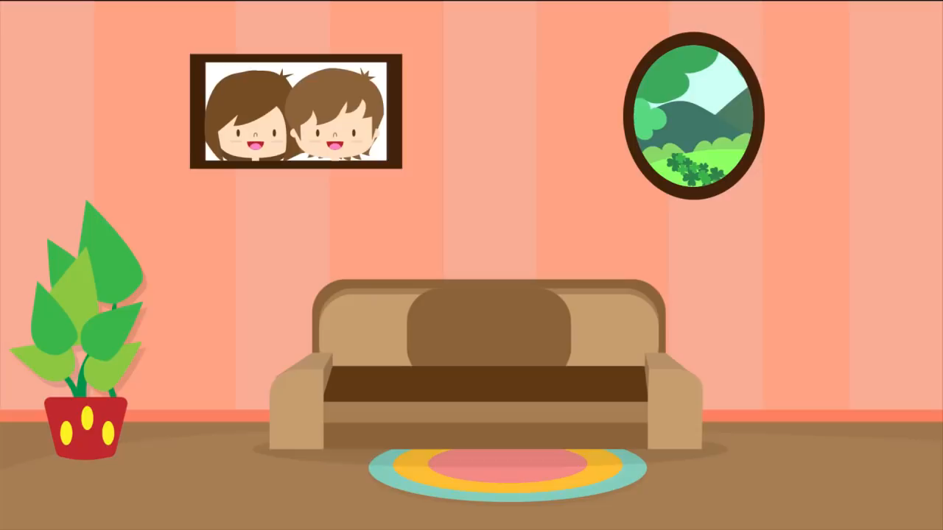


Slide 3
Watch the conversation

Slide 4

Watch the conversation

Slide 5
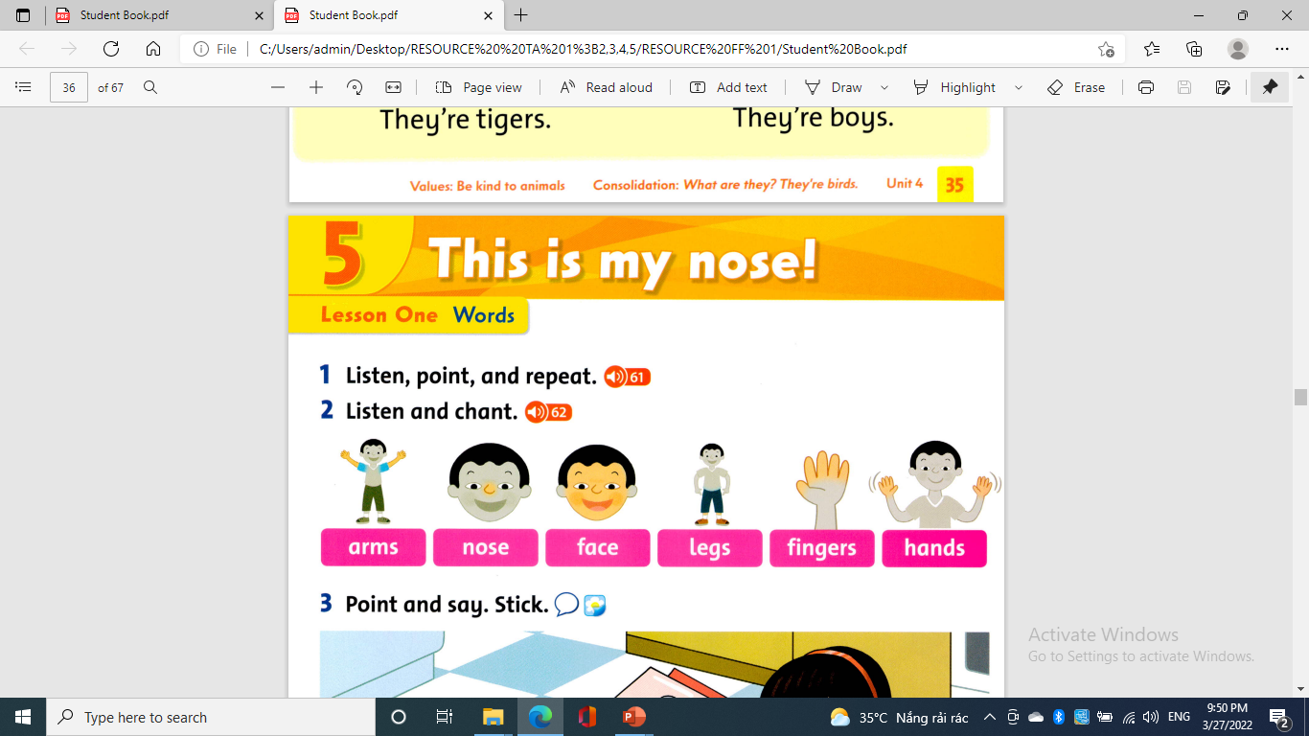

Listen, point and repeat:

Slide 6
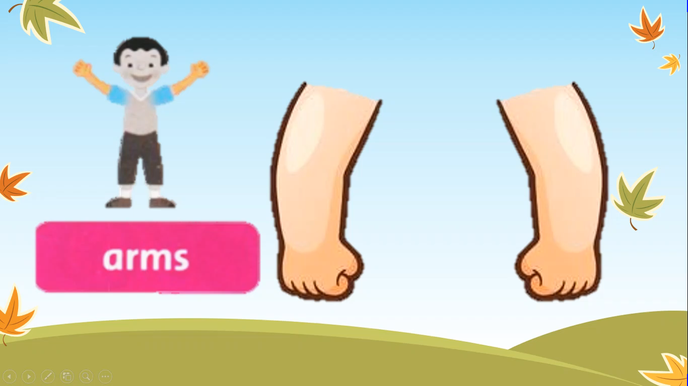
Listen, point and repeat

Slide 7
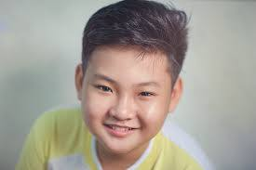
This is my face.

Slide 8
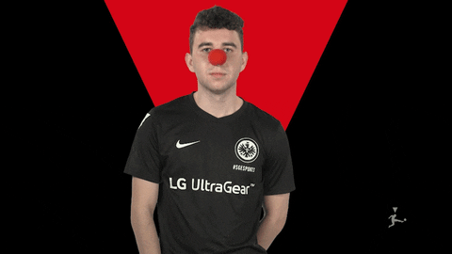
This is my nose.

Slide 9

This is my arm.

Slide 10
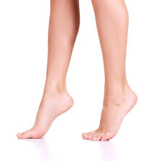
These are my legs.

Slide 11

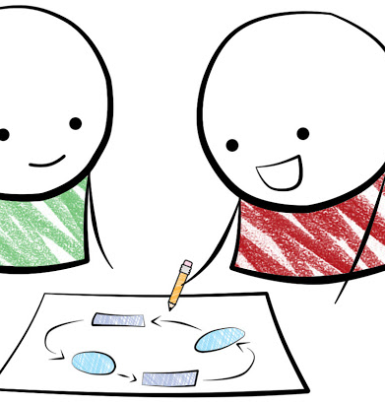
Pair work
Work in pair
Practice reading
Play the roles

Slide 12
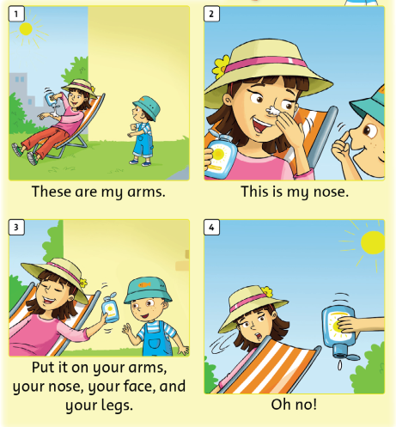

Slide 13
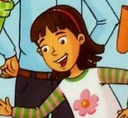
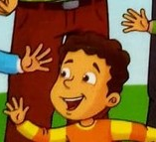
ROLE - PLAY
ROSY
BILLY

Slide 14
WORKBOOK TIME

Slide 15


It’s time to say GOODBYE

