Slide 1

Unit 10
DO THEY LIKE FISHING?
Lesson 5: Skills time

Slide 2
WARM UP !

Slide 3

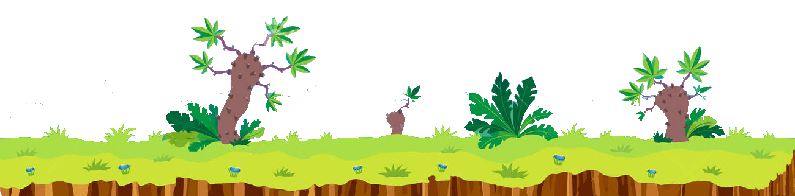

Helping me to find out the way to my home, please!

Slide 4
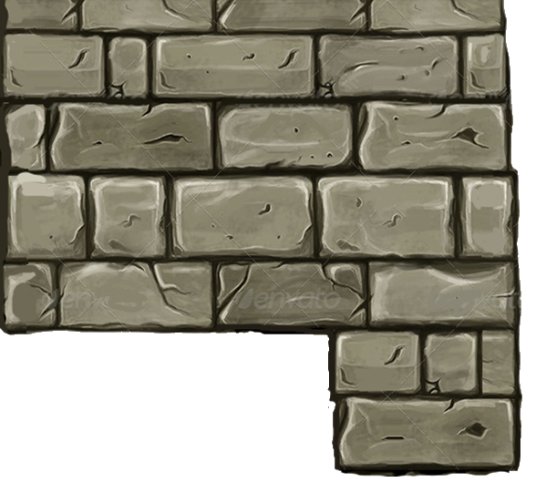


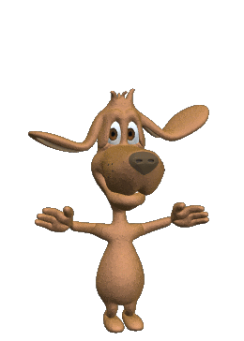
NEXT
A. No, she don't.
B. No, I don’t.
C. Yes, she does.
D. Yes, I don’t.
Does she like fishing?
……….
Thank you!

Slide 5
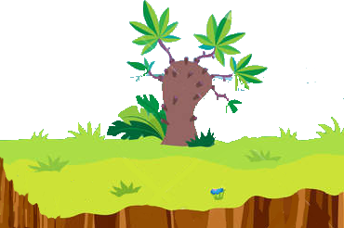
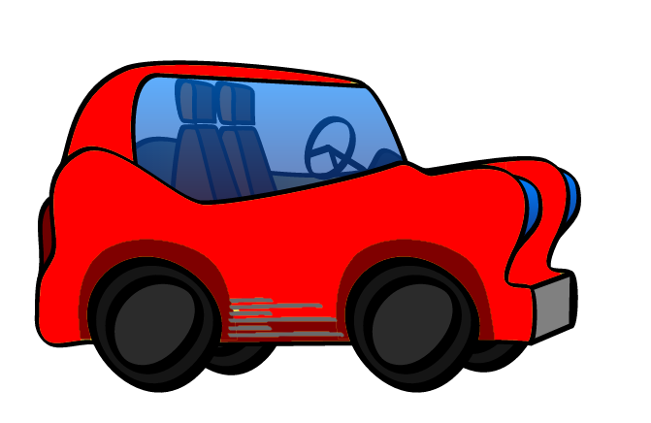





NEXT
A. Yes, they does.
B. Yes, they do.
C. Yes, I do.
D. No, they don't.
Thank you!
Do they like playing chess?

Slide 6
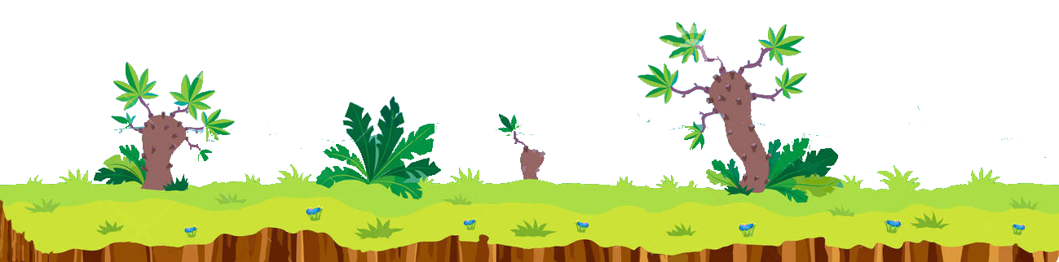
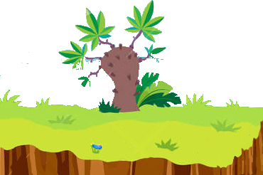
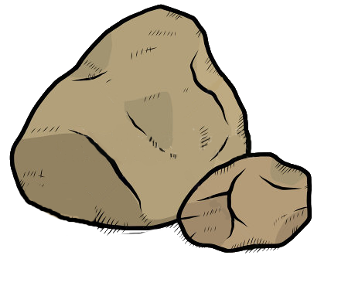






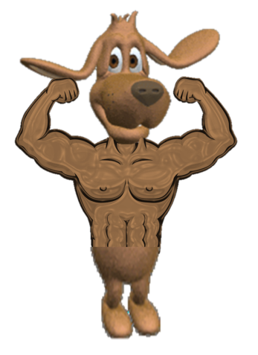
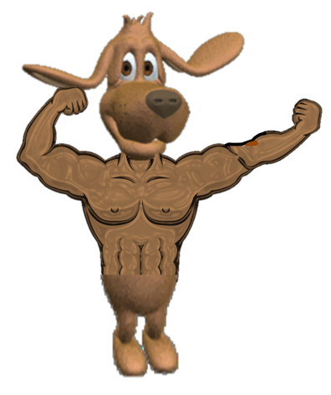









NEXT
A. Does
B.
Do
C.
Are
D. Is
…..you like reading comics?
Thank you

Slide 7
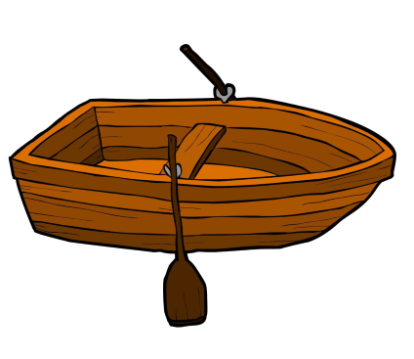


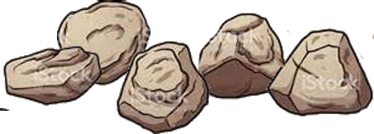
A. playing basketball
C. fishing
NEXT
B. playing badminton
D. taking photos
Thank you!
They like..........

Slide 8


NEXT
A. fish
C. play chess
B. read comics
D. play badminton
Thank you!

Slide 9
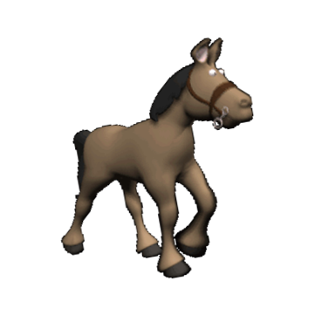
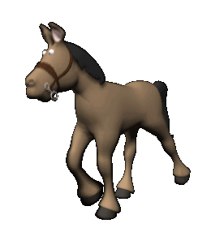
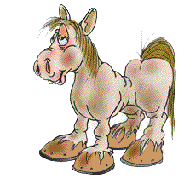
NEXT
A. guitar
D.
photos
B.
comics
C.
chess
Thank you!
Take........

Slide 10
Thank you so much

Slide 11
01
Look at the profiles?
Where are the children from?

Slide 12
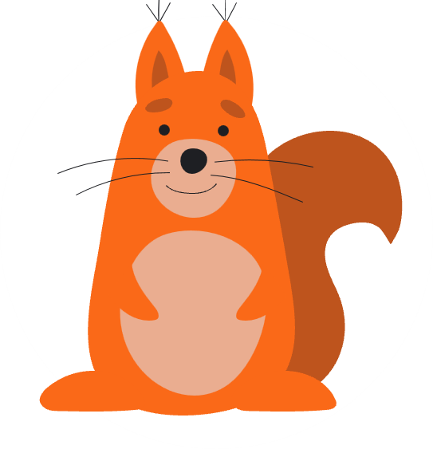
- Hoang is from Vietnam.
- Eun-sol is from South Korea.
- Mon is from Thailand.

Slide 13
02
Listen and read.

Slide 14
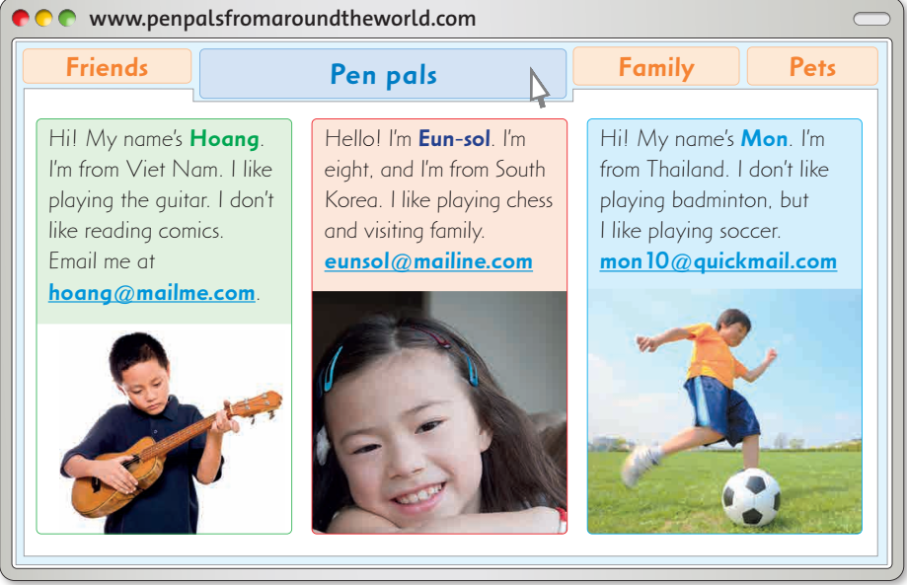

Slide 15
Review Reading

Slide 16

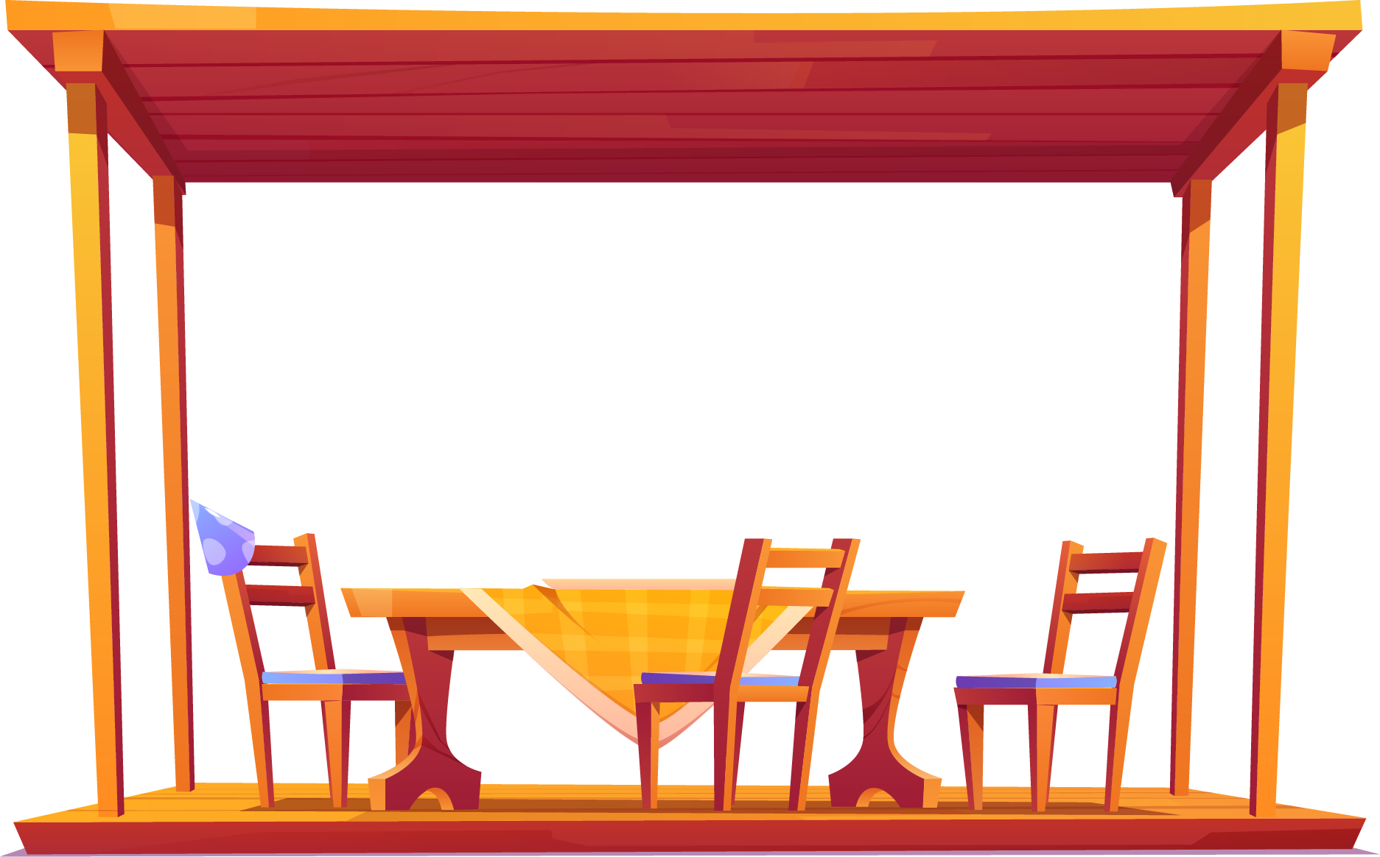




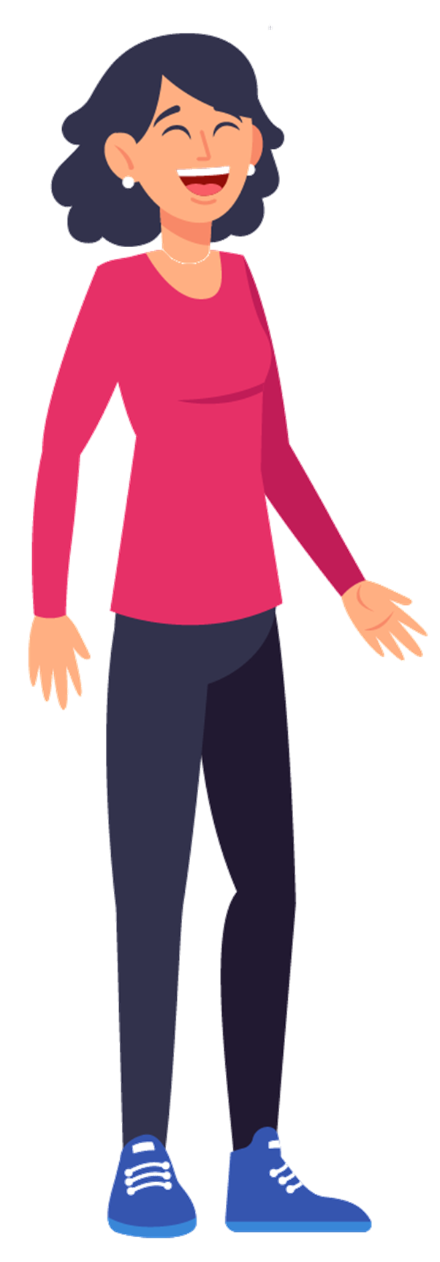
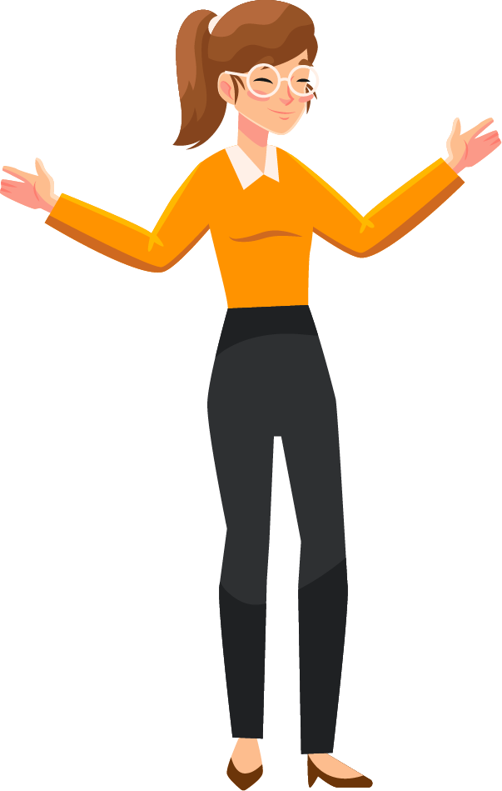
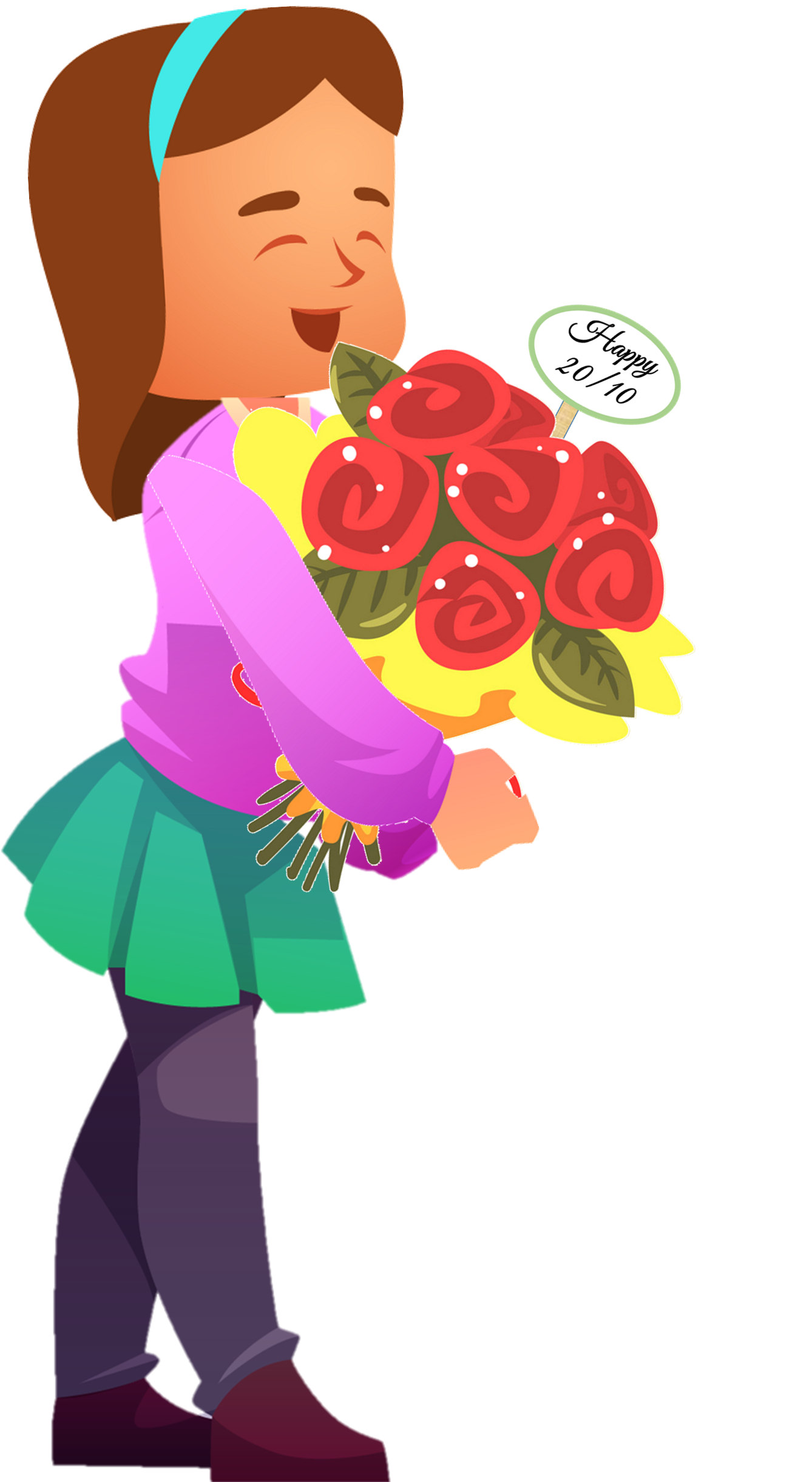
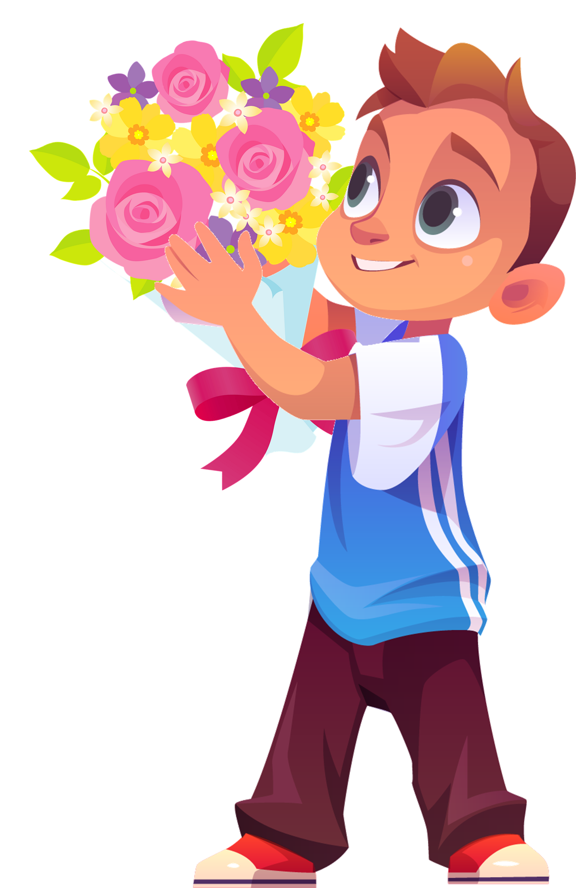





WONDERFUL PARTY

Slide 17

Sắp đến ngày 20/10, hôm nay mẹ sẽ dẫn cô giáo đến nhà chơi. Các bạn hãy chuẩn bị 1 bữa tiệc 20/10 bất ngờ cho mẹ và cô giáo nhé ^^

Slide 18








Chúc mẹ và cô ngày 20/10
vui vẻ
END

Slide 19




Q1: What does Hoang like?
A. He likes playing the guitar.
B. He likes cooking.
C. He likes reading comics.
d. He likes playing the piano.

Slide 20
Q2 : Where is Eun-sol from?
A. She's from Malaysia
B. She's from South Korea
C. She's from Thailand
D. She's from North Korea

Slide 21
Q3: Who likes visting family and playing chess?
A.Hoang
B. John
C.Eun-sol
D. Mon

Slide 22
Q5: How old is Eun-sol?
A. She's 10
B. She's 9
C. She's 8
D. She's 11

Slide 23
Q4: Which sentences is NOT true about Mon?
A. He doesn't like visiting family.
B. He likes playing badminton
C. He's from Thailand
D. He likes playing soccer

Slide 24
03
Read again and write YES or NO.

Slide 25

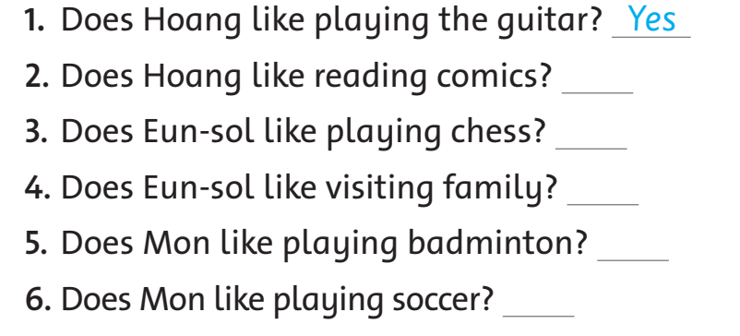
No
Yes
Yes
No
Yes

Slide 26
04
What activities do you and your friends like doing in your free time?

Slide 27
My name is Anh. I'm from.............. I like playing ...................
This is my best friend. Her name is Thanh. She .............swimming, but she ...........like fishing.
We ..........playing chess together in .........time.
likes badminton free like doesn't Vietnam
Vietnam
badminton
likes
doesn't
like
free

Slide 28

My name is........
I'm from.............. I like playing ...................
This is my best friend. .......name is.........
She likes ............., but she doesn't like........
We like........................

Slide 29
GOODBYE!
Thanks for your attention!

