Slide 1





UNIT 12
SOMETHING NEW TO WATCH!
Notes:
Thanh Yen Tran 0967 255 149 /081 811 4340 zalo / FB https://www.facebook.com/thanhyentrananhngutaymy

Slide 2


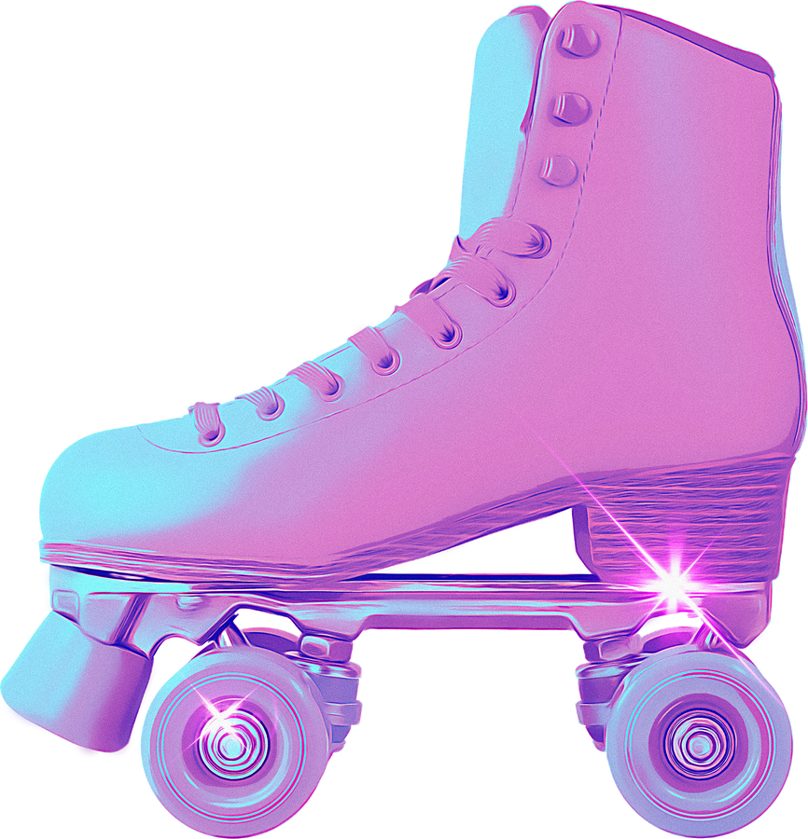

Lesson 3 page 90

Slide 3


















LOADINGGGGG............

Slide 4

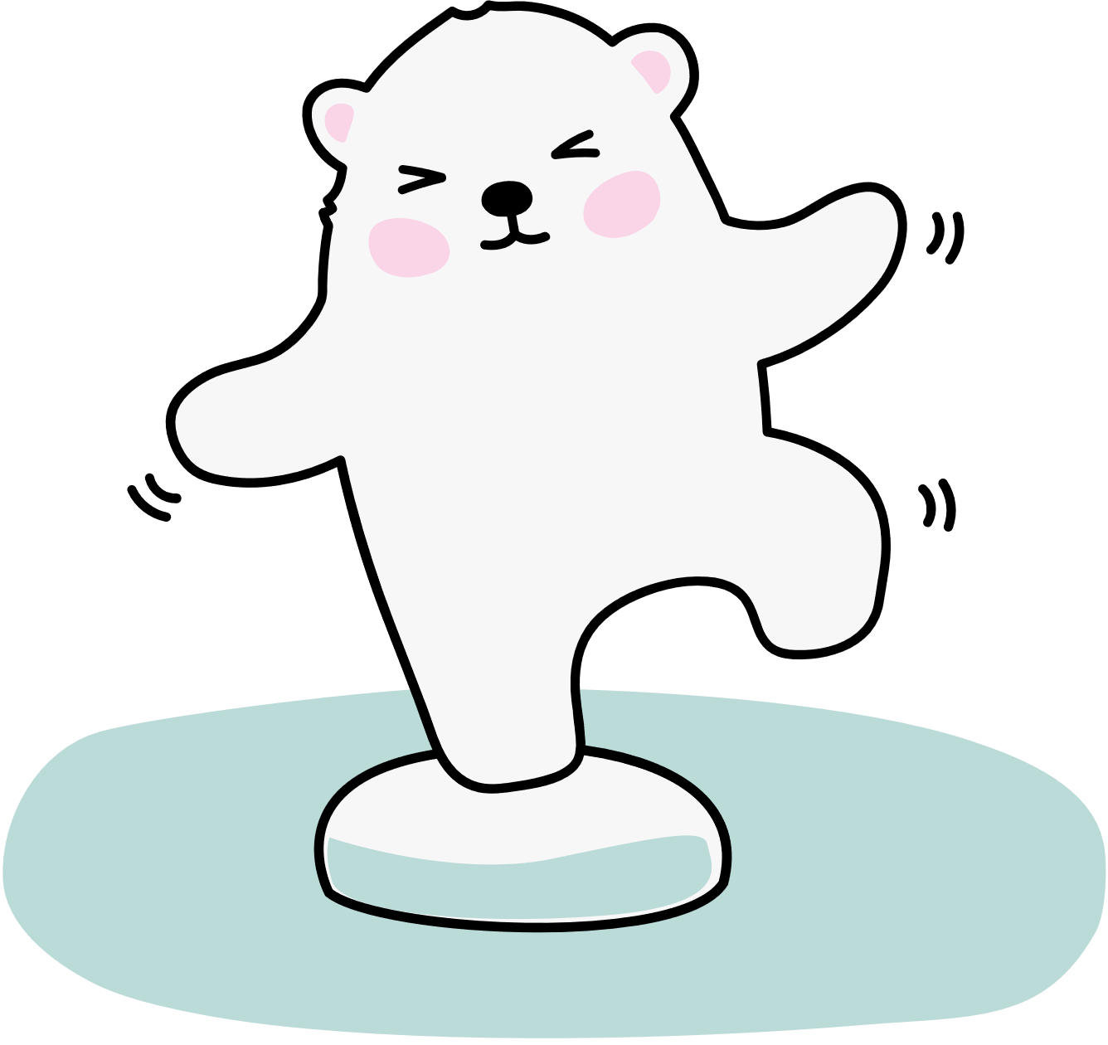



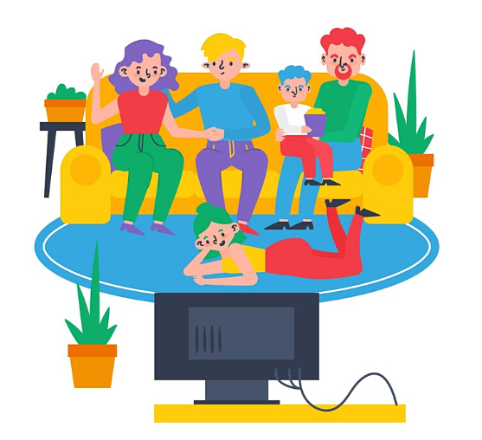





They ………… ­watch TV tonight.
1
2
3
aren’t going to
are going to
is going to

Slide 5
Reorder
is/ use/ to/ Lucy/ her/ going/ smartphone/.
1
2
3
Lucy is to going use her smartphone.
Lucy is going to use her smartphone.
Lucy is going use to her smartphone.

Slide 6



___ your Mom and Dad going to _____ (visit) Hoi An next Sunday?
1
2
3
Are - visting
Is - visit
Are - visit

Slide 7
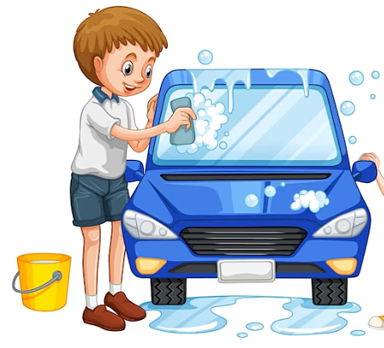







Is Tom going to clean his room?
1
2
No, he isn’t.
Yes, he is.

Slide 8

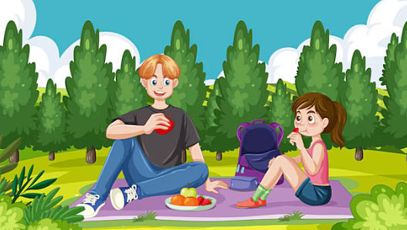





Nam and Hoa _________ have a picnic next Sunday.
1
aren’t going to
2
3
isn’t going to
are going to

Slide 9
___you_______(play) chess
in this afternoon?
3
2
Are - going to play
1
Is - going to play
Are - going to playing

Slide 10
Reorder
am/ I/ to/ go/ going /outside/ .
1
2
3
I am going to outside go.
I am going to go outside.
I am go to going outside.

Slide 11




1
2
3
No, they aren’t.
Yes, they are.
Yes, they do.
Are they going to read books tomorrow?

Slide 12
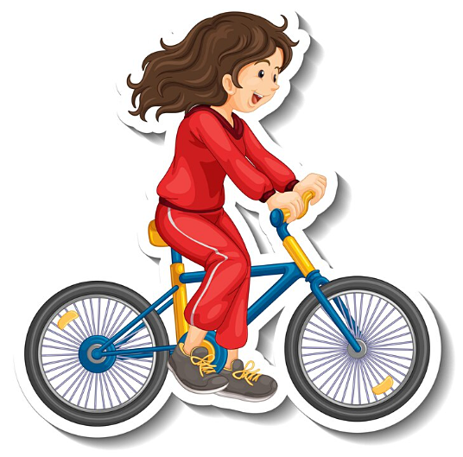
She _______ a bike
tomorrow.
1
2
3
is riding
is going to ride
is going ride

Slide 13
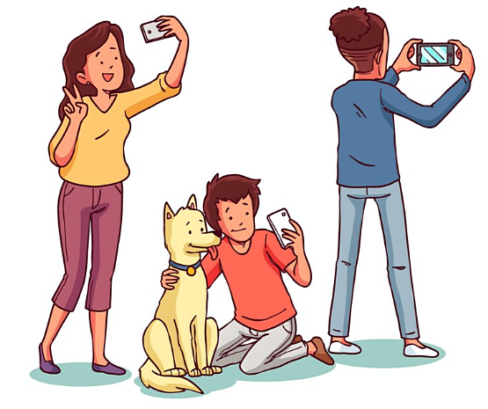

They __________take photos.
1
2
is going to
3
are going to
am going to

Slide 14
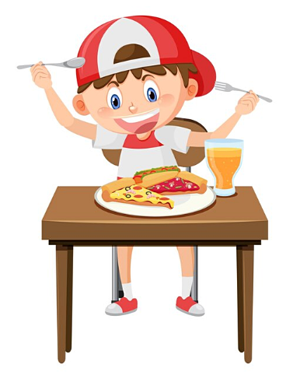
He __________eat
a pizza today.
1
2
3
is going to
isn’t going to
am not going to

Slide 15

Is she going to make a cake?
1
2
No, she isn’t.
Yes, she is.

Slide 16
Reorder
he/ Is/ to/ DVD/ watch/ going a/ ?
1
2
3
Is going he to watch a DVD?
Is he going to watch a DVD?
He is going to watch a DVD?

Slide 17
Complete the sentence
______(she/do) her homework next weekend?
1
2
3
She is going to do
Is she going to do
She is going to do

Slide 18
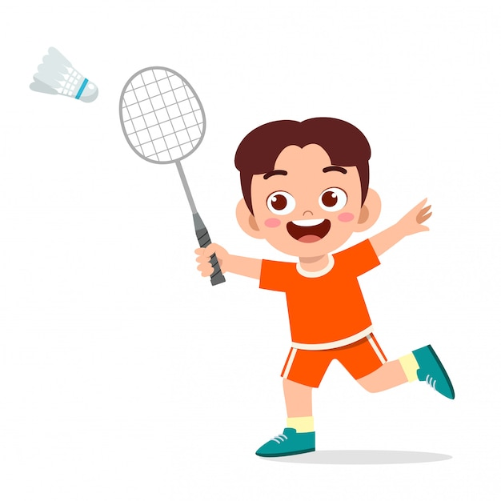
1
2
3
Yes, he is.
No, he isn’t.
No, he doesn’t.
Is he going to
play soccer?

Slide 19




Slide 20



1. Read. Check (a) the true sentences for you.

Slide 21

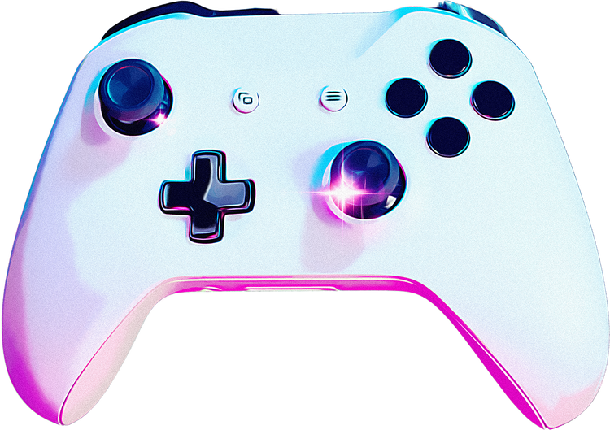
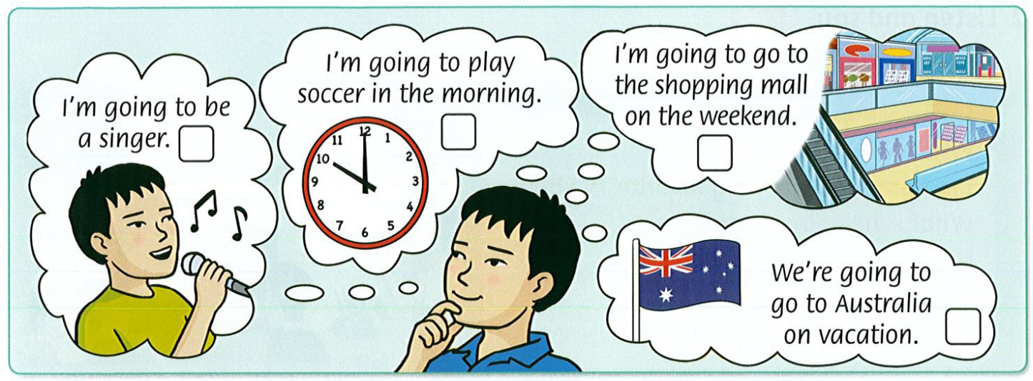


Slide 22

2. Talk to a friend.

Slide 23
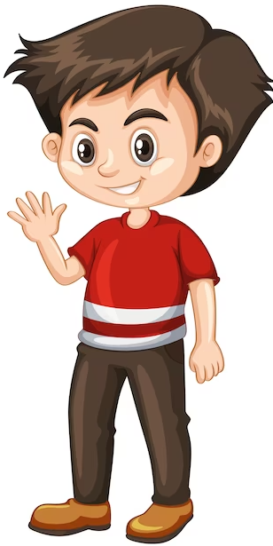
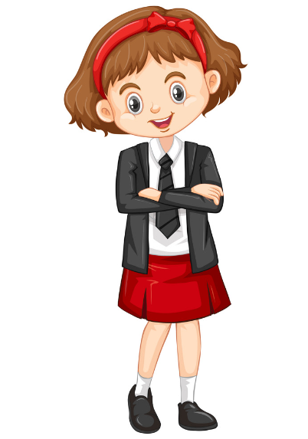
What are you going to do this summer?
I’m going to swim in the sea. I’m not going to study a lot.

Slide 24





Slide 25


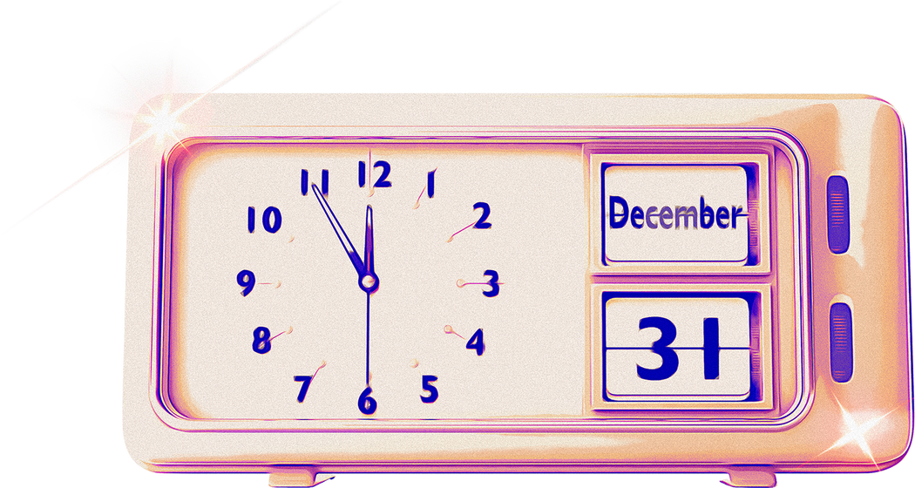
Song

Slide 26
4. Listen and sing.

Slide 27



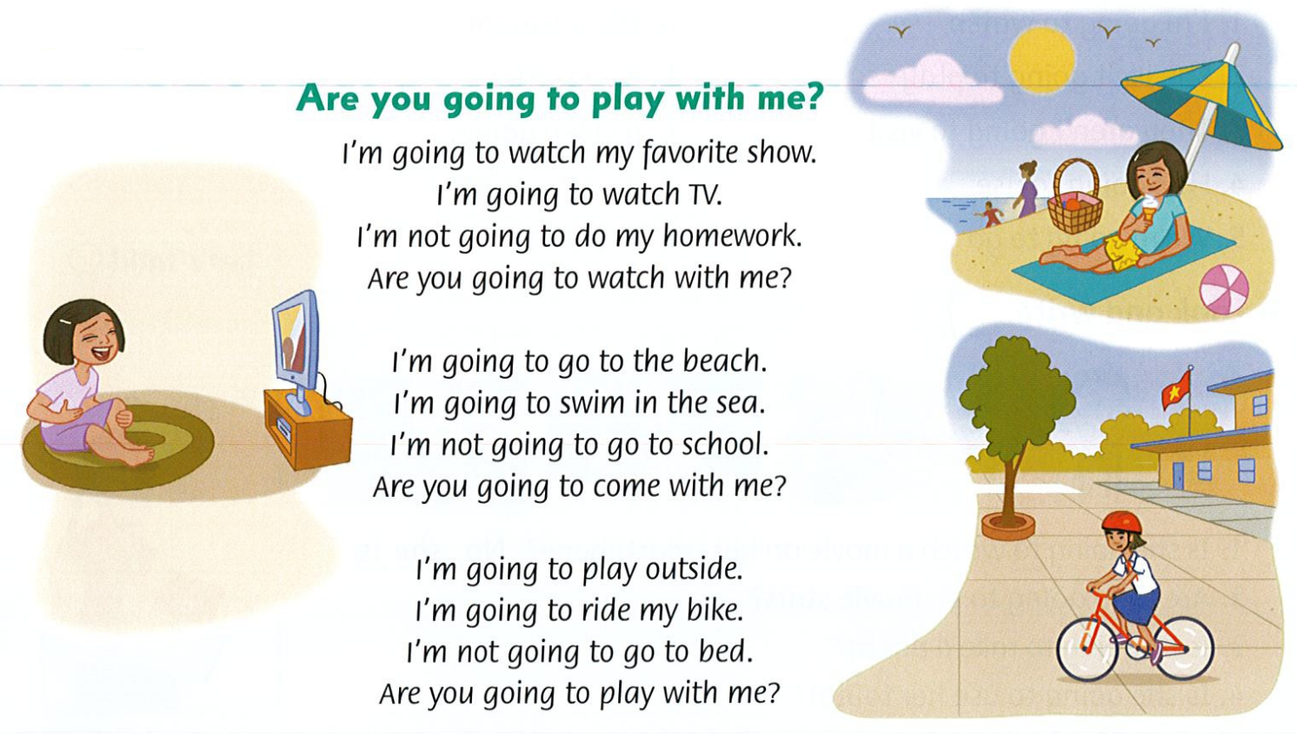

Slide 28
5. Sing and do.

Slide 29
Are you going to play with me?
I'm going to watch my favorite show.
I'm going to watch TV.
I'm not going to do my homework.
Are you going to watch with me?
I'm going to go to the beach.
I'm going to swim in the sea.
I'm not going to go to school.
Are you going to come with me?
I'm going to play outside.
I'm going to ride my bike.
I'm not going to go to bed.
Are you going to play with me?

Slide 30
Thank you

